Slide 1
Innovation and Impact Through Service Learning
Jennifer nutefall
Santa Clara University
Notes:
What I’ll be covering today is a brief overview of service learning and then providing 4 examples of partnerships that will provide an overview of the possibilities of collaboration

Slide 2
What is service learning?
In these programs, field-based “experiential learning” with community partners is an instructional strategy—and often a required part of the course. The idea is to give students direct experience with issues they are studying in the curriculum and with ongoing efforts to analyze and solve problems in the community. A key element in these programs is the opportunity students have to both apply what they are learning in real-world settings and reflect in a classroom setting on their service experiences. These programs model the idea that giving something back to the community is an important college outcome, and that working with community partners is good preparation for citizenship, work, and life. (AAC&U, 2008)
Notes:
Highlight the 3 key components:
Mutually beneficial partnership/reciprocity
Civic education
Reflection

Slide 3
Examples of partnerships
Notes:
What does a service learning course-librarian partnership look like in action? I’m going to highlight three examples from colleagues around the country

Slide 4
Examples of partnerships
Santa Clara University
Sociology 30: Self, Community, and Society

Slide 5
Partnership - SCU
Librarian: Nicole Branch
Three workshops focused on finding and using data
Session 1- Searching is Strategic: Self (school & community)
Session 2- Authority is Constructed & Contextual: Placement site (school & community)
Session 3- Information Has Value: Conditions & assets
Notes:
Non-majors and meets the university’s experiential learning for social justice requirement (ELSJ)
Description: Explores a specific topic related to the self, community, and society. Use of sociological theories, research, community-based learning, and civic engagement activities to help students analyze and explore the role of the individual in influencing community and society as well as how the individual is shaped by these entities
In this particular course, the students were volunteering in a school in a part of South San Jose, which is mainly a lower income, primarily Hispanic community. Prior to their service, Nicole met with the class three times focused on finding and using data.
The goal was for students to be able to use data to better understand themselves, the community organizations, and community. It also provided students with the opportunity to explore needs and assets of schools and the community.

Slide 6
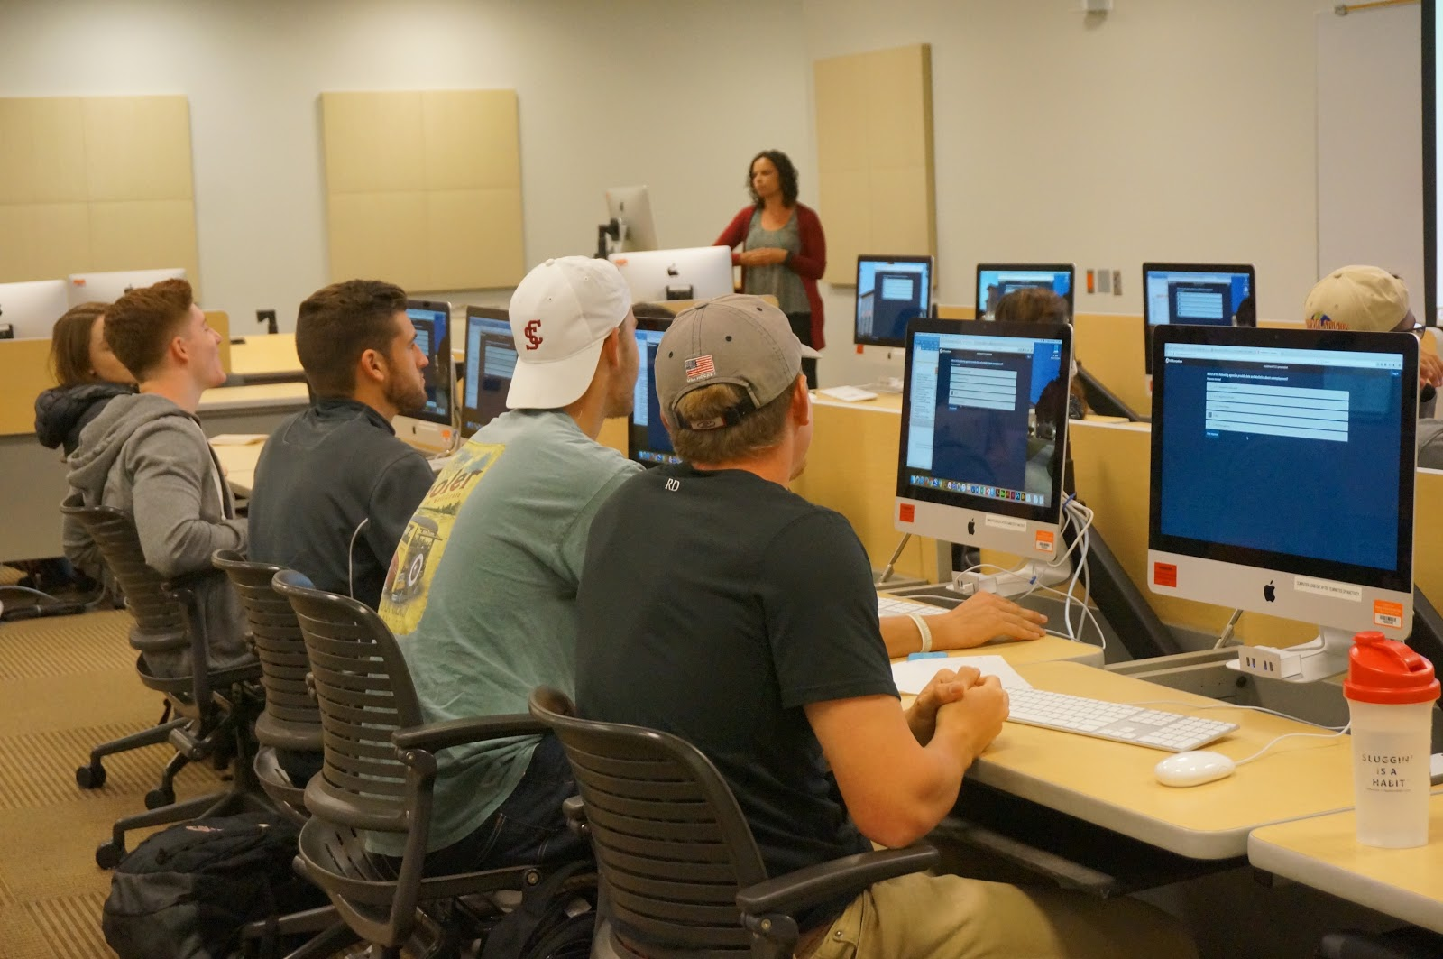
Partnership - SCU
Searching is Strategic
Imagining data sources
Navigating census data
Navigating school data
Authority is Constructed & Contextual
Critiquing data & sources
Navigating census & school data
Information Has Value
Conditions/needs (health, transportation, employment, etc.)
Community assets (people, places, characteristics, etc.)
Independent exploration
Notes:
So this is a breakdown of the three workshops and what they covered. The students first looked to find data on the high school they attended. Then they looked at some examples of how data is used and cited and discussed gaps and what is missing. Then they looked at data for the schools where they would be doing their service and compared that to the data they found for the school they attended.
Active learning including:
Individual and group work
Research on both schools and communities/neighborhoods
Use of government databases
Framing where and how to find information--from guided searches to independent exploration
Making a program or policy “pitch” at the community level

Slide 7
Examples of partnerships
University of Michigan
Library Student Mini-Grants

Slide 8
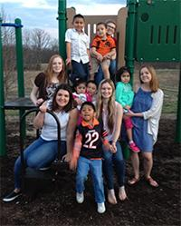
Partnership - UMich
Grants of up to $1,000 are awarded to students to support innovative and collaborative projects
Projects must strengthen community partnerships, enhance global scholarship, and/or advocate for diversity and inclusion
74 projects have been funded
An end-of-year symposium gave the students an opportunity to present posters on their work
https://engage.lib.umich.edu/mini-grants/
Librarian: Amanda Peters
Notes:
The University of Michigan Library has an ongoing mission to remain responsive to University trends. One such trend is an increased integration of service learning into the curriculum.
In addition to a more programmatic approach of supporting this work through course integrated instruction, the library wanted to build in a student-driven component to their support.
In fall 2015 they offered a student mini-grant initiative.
A sample project is by Parisa Soraya, who completed a Master of Health Informatics in 2017. She was awarded a mini grant in the program’s second year for her project to develop an app that connects people living with the same chronic illness so they can obtain local, timely, in-person support.
Soraya’s library mentor was Patricia Anderson. As emerging technologies informationist at the Taubman Health Sciences Library, Anderson is particularly well-informed about the question animating Soraya’s work in her current project and beyond: How can we use information and technology to improve patients’ lives? She immediately understood the project’s goals, and was able to connect the team to resources documenting the scope and impact of a vast range of chronic health conditions. This is the solid foundation that enables Soraya to state with confidence that “50% of adults live with at least one diagnosed chronic health condition,” among other facts now at her fingertips.
Anderson is also deeply embedded in the university and the community, and was able to introduce Soraya’s team to interested campus councils, university administrators, and to students and community members that live with chronic illness. One of these introductions led to Soraya’s team obtaining an additional grant to support their effort to make sure the app would be accessible to people with disabilities.
And then, during Soraya’s grant wrap-up presentation Anderson—a very active social media user—live-tweeted a picture of one of Soraya’s slides. The tweet caught the eye of Susannah Fox, Chief Technology Officer of the U.S. Department of Health and Human Services (HHS) during the Obama administration, who describes her role there as “helping HHS harness the power of data and technology to improve the health and welfare of the nation.”
Other projects have included strengthing the library collection at a youth detention center and breaking the barriers of “voluntourism” to help students volunteer teach abroad

Slide 9
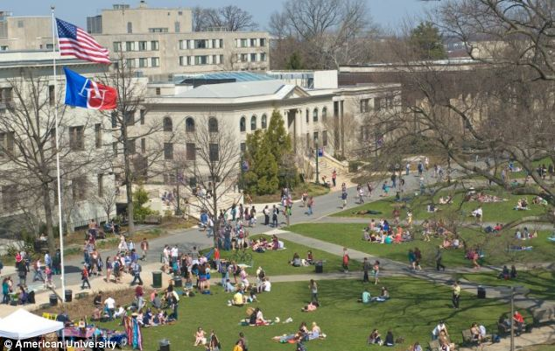
Examples of partnerships
American University
Center for Community Engagement & Service

Slide 10
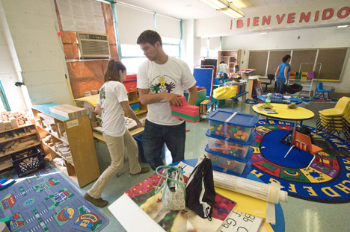
Partnership - AU
Librarians Alex Hodges (now at Harvard) and Olivia Ivey
Faculty Fellows Institute
Intercultural communication training
Instructional design support
Community site visits
Information literacy integration work
Cohort engagement
Notes:
At American University before a faculty member begins teaching a service learning or community-based learning course, they attend the faculty fellows institute. The institute is a collection of one-day and two-day workshops that allow faculty to come together across disciplines around the common interest of community-based learning as a teaching pedagogy.
The institute has been held since 2015 and you can see what is covered here. In 2016 Alex began integrating information literacy. This is a great opportunity if your campus has a similar type of program to have faculty think about the information needs of themselves and their students in service learning courses.
The librarians were given time on the agenda at the end of the first day. We were proceeded by Learning Outcomes and Preparation for Community Entry, so the librarians divided their time into talking about information literacy as a learning outcome and how service learning can play a role and library resources that can help students learn about communities before going out. Not only was the information literacy framework but also specific databases, from GuideStar (for learning about non-profit organizations) to Social Explorer and PolicyMap (for creating customized maps to paint a demographic picture of a specific neighborhood). Many faculty were interested in following up with library instruction targeted towards their service learning classes.
Alex also attended the institute as a faculty member being trained, because he taught a credit-bearing educational technology course for undergraduate and graduate teacher education students that was designated as a "CB" course. The first day of the institute involved training on campus through a series of workshops and the second day was a field trip to a service learning site (a public charter school), where the director arranged for a variety of non-profits to pitch their organizations to the faculty as potential SL sites for their students' work.
At the end of the semester, the director and her team ran an assessment/loop-back workshop to gauge their experiences and reinforce their knowledge as they prepared for the spring semester.
Alex wrote: “My first semester as a CB-designated course professor was one of the most rewarding in my career. I had a much closer rapport with my students because I was also coaching their involvement in their sites. My student evaluations of my teaching reflected my students' confidence in me as my scores were pretty high and the written feedback was very dear.”

Slide 11
Example of partnerships
University of Montana
Sociology 442 – Service Learning

Slide 12
Partnership – U of Montana
Librarian: Megan Stark
Assignment on refugee resettlement in Missoula, MT
The scholarly literature, accessed via traditional searching methods, prepared students to approach this issue with broad understanding in an academic way.
Utilizing community information, accessed via more novel searching methods, augmented students’ broad understanding with nuance and a local focus.
Notes:
The assignment had students investigating refugee resettlement in Missoula.
Approaching this topic via traditional information literacy instruction was useful in shaping the students fundamental understanding. But they demonstrated a need for a more sophisticated understanding of the issue in Missoula--the unique nature of the school system, the stakeholders, etc. By working through a different search process they were able to identify how to increase their sophistication not just with the content but with the information ecosystem and constructs. It’s a good thing to push students toward points of “troublesome knowledge” that encourages them to manage divergent or dissonant information. Service learning environments, in particular, are fruitful sites for this type of thinking.
Her experience at UM indicated that service learning students and faculty approached research though the additional lens of community, or real world, information. They often brought to the project a heightened sense of whether the information they had encountered via the databases was “true” or would “bear out” in the environment in which they were engaged. They were often frustrated by the lack of dialogue between academic information and the information with which they were engaging. (From text): This is not surprising—students engaged in service environments are grappling with many factors (personal feelings, discomfort with prejudice, bias, inequity and responding to some of the biggest challenges facing individuals—homelessness, poverty, mental health, injustice, etc.) and may have begun to notice the tensions between what they learn in a classroom, course readings, lectures, etc. and what they learn from their experience actively participating in the community.

Slide 13
Partnership – U of Montana
Integrating and citing community information alongside academic information requires instructional modeling, sharing examples and rewarding students for work done well.
Once academic libraries actively partner with our communities to highlight the value their data brings to our students we might begin to ask how we could help make it easier to find and use.
Academic librarians could refine our collection assessment tools beyond peer-to-peer comparisons to capture and promote the unique local information available in our communities.
Our general collections should contain community knowledge because of its legitimate research value for students.
Notes:
If you’re interested in exploring this particular issue further, Megan wrote an excellent chapter on information in the real world that appears in Service Learning, Information Literacy, and Libraries which came out in 2016.

Slide 14
Colloquium on Libraries & Service Learning
Date: August 9-10, 2018 at American University in Washington, DC
Theme: Critically engaged librarianship: Exploring service learning and community involvement
Website: https://scholarcommons.scu.edu/libraries-and-service-learning/2018/
Twitter: @CLSL2018

Slide 15
Engaged library listserv
The listserv provides an opportunity for participants to engage in the sharing of research, ideas, perspectives, and best practices in library engagement with service learning.
To subscribe to engagedlibrary-l, simply do the following:
Send a message to list@list.indiana.edu from the address you want to subscribe to the list.
In the subject line of your message, type in: subscribe engagedlibrary-l Firstname Lastname
Leave the message body blank.

Slide 16
Questions?

