Slide 1
New Jobs for Librarians Loyola University Chicago
Marianne Ryan
AJCU Annual Conference – Loyola Marymount University
March 19, 2018

Slide 2
Why?
Lens of new leadership
Opportunity of vacant positions
Alignment with evolving academic library directions
Alignment with university’s strategic plan and priorities
Expectations of university administration

Slide 3
Human Capital Management
Current Organizational Structure Analysis
FY 2019 Staffing Plan

Slide 4
current organizational structure
Organizational Chart Review
Any expected transitions (retirements, transfers)?
Are new hires going to replace current employees or go into new types of jobs?
Do any positions have additional capacity?
Which positions could be shared with another division/school?
Can managers increase span of control (i.e., manage more staff)?
Is centralizing the functions of a position (along with other existing like positions) an option to reduce duplication and costs?
Which positions are mission critical?
Is the scope of the position clearly defined so that it does not overlap with other positions?
Is improvement in performance needed?

Slide 5
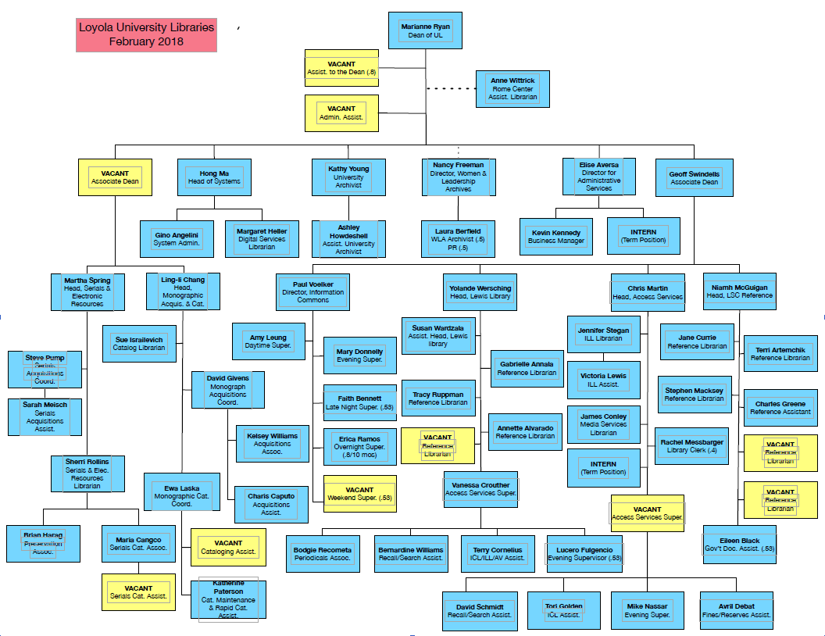

Slide 6
How?
Grounding in reasonable goals identified by library-wide participation
Framing within the university’s strategic vision and HCMI
Investing in staff and committing to make the libraries more vibrant, equitable, collaborative, and distinctive

Slide 7
Old becomes new
Reference & Instruction Librarian – Government Information
→ Civic Engagement Coordinator
Reference & Instruction Librarian – Chemistry & Nursing
→ Assessment Coordinator
Reference & Instruction Librarian – Math & Computer Science
→ Organizational Development Specialist
Cataloging Assistant and Serials Assistant
→ combined to become Metadata Librarian

Slide 8
Challenges
Being short staffed as (at least) a short-term way of life
“I didn’t think this included my department.”
You can’t please everyone . . .
Waiting for the other shoe to drop
“Will we have to apply for our jobs?”
Diversity and inclusion—except . . .

