Slide 1
State of the Art:
Libraries & Digital Humanities, Right Now
Miriam Posner, University of California, Los Angeles
Slides & links: bit.ly/posnerajcu

Slide 2
What is digital humanities?

Slide 3
www.whatisdigitalhumanities.com

Slide 4
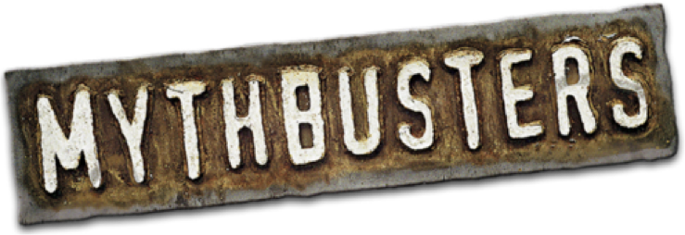

Slide 5
Myth:
Digital humanities= big data
Interfaces
Archives, exhibits, and editions
Experiments with access
Maps
Visualizations

Slide 6
Myth:
The goal of digital scholarship is to use a machine to discover the truth.

Slide 7
Digital humanities projects consist of…
sources, processed and presented.

Slide 8
Sources
Files
Images
Sound
Text
Numbers
Documents
Artifacts
Letters
Books
...et cetera!

Slide 9
Processed
Organized
Edited
Corrected
Queried
Scanned
Enhanced
Augmented
Digitized
Photographed
...et cetera!

Slide 10
Presented
Visualized
Made web-accessible
Mapped
Made searchable
Made interactive
Rendered in 3D
Incorporated in a multimedia story
Deformed
Incorporated in an article
...et cetera!

Slide 14
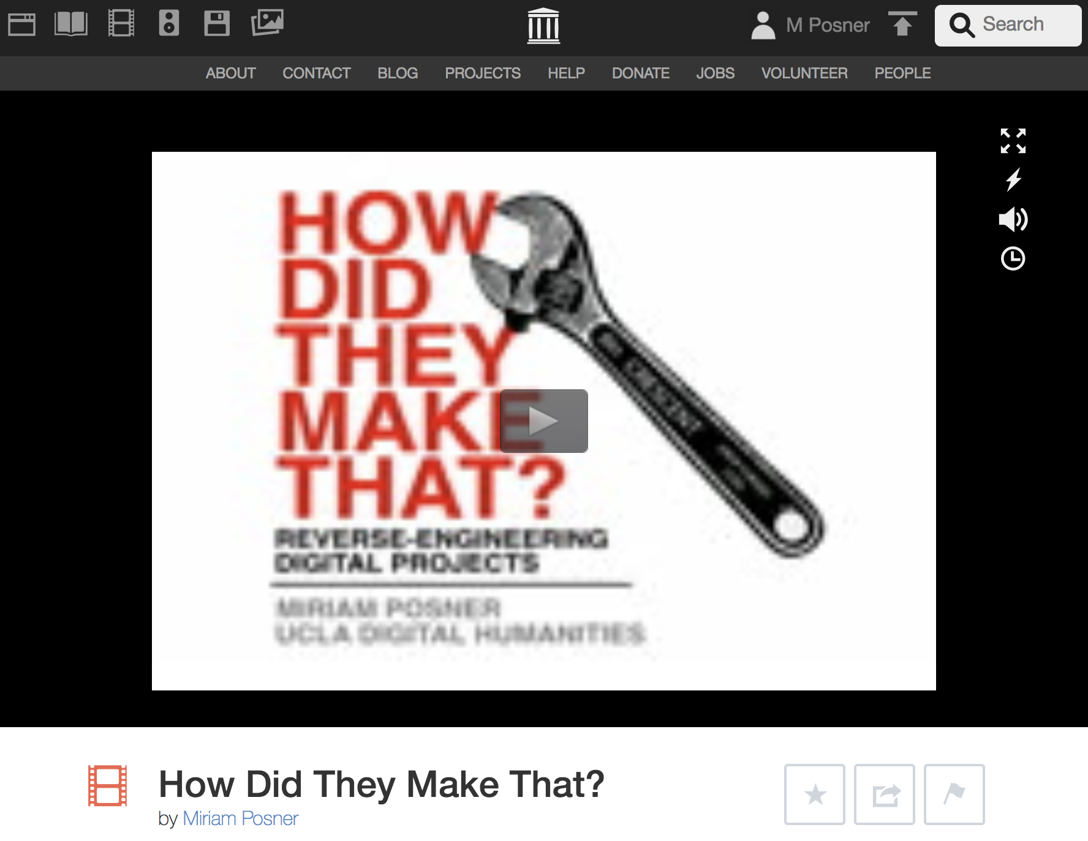
https://archive.org/details/howdidtheymakethat

Slide 15
How do libraries do digital humanities?

Slide 16
Models
Dedicated center and staff
Distributed approach (multiple hubs)
One expert
Distributed expertise

Slide 17
Activities
Workshops
Provision of data
Data curation
Consultations
Project partnerships
Grantwriting & advice
Preservation
Infrastructure
Lab space
Fellowships
Events/speakers
Digitization
Repository services

Slide 18
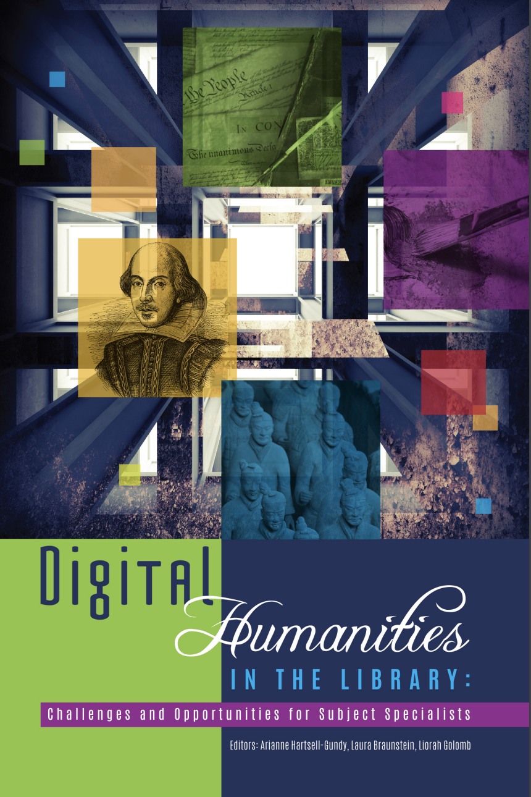
ACRL Open-Access Ebook

Slide 19
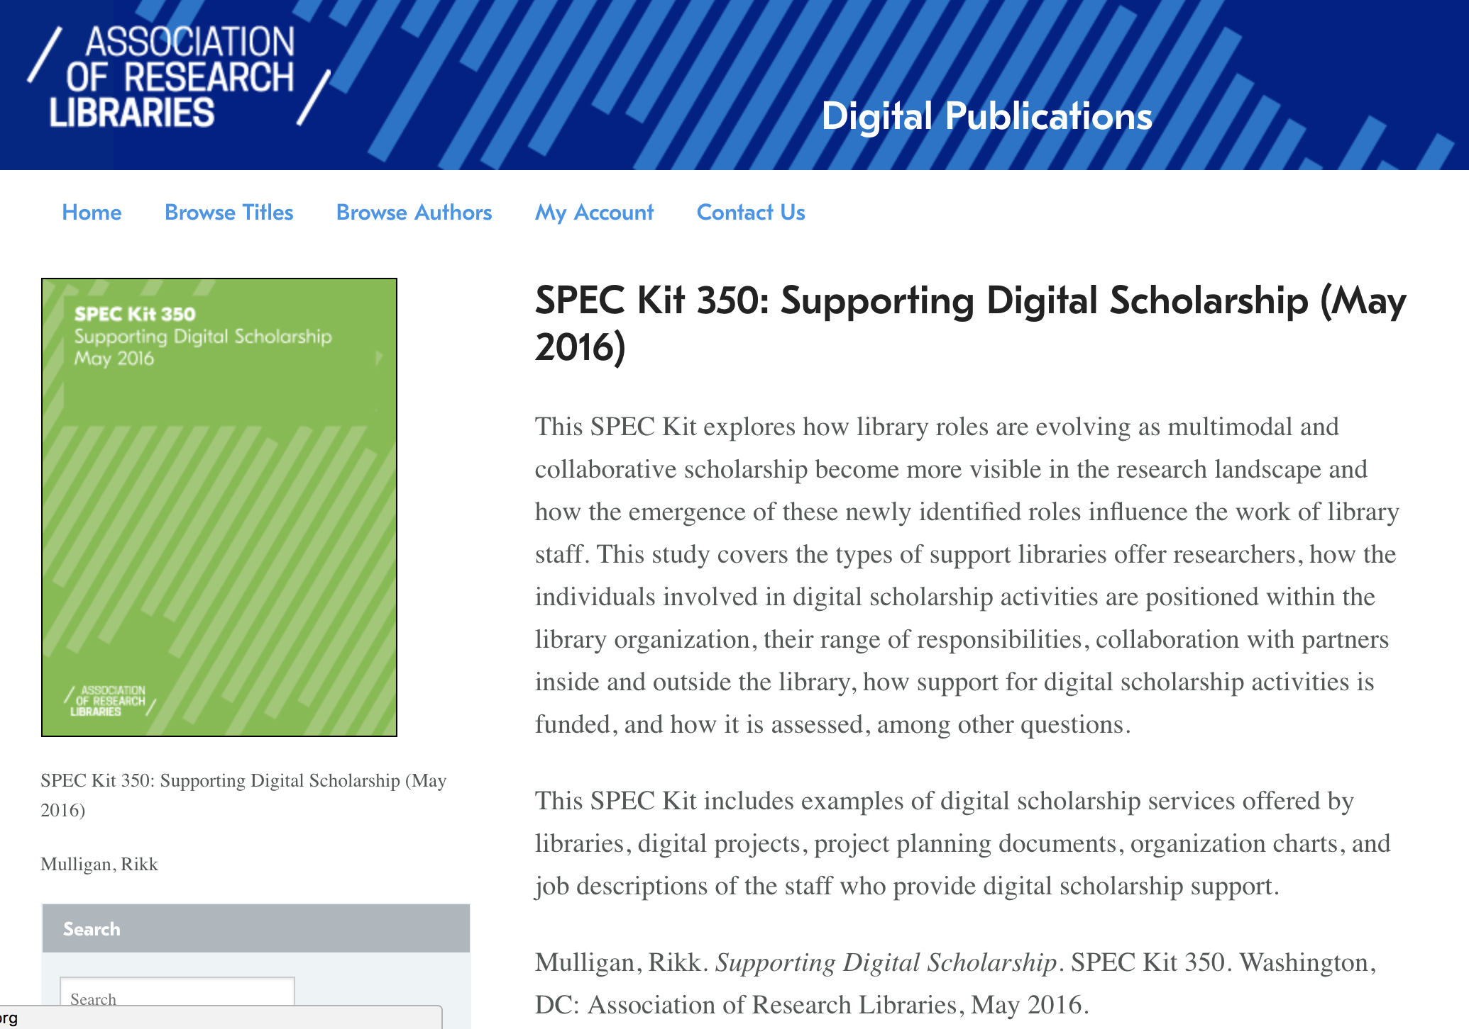
ACRL SPEC Kit #350

Slide 20
What digital humanities librarians want you to know about how to help them do their jobs

Slide 21
What makes it hard for DH librarians to do their jobs?
Insufficient training opportunities
Lack of support for librarian-conceived initiatives
Too many tasks, too little time
Responsibility, but not authority (or resources)
Inflexible IT infrastructure
Lack of incentive to take risks
Challenge of faculty collaborations
Diffusion of efforts
Lack of an institutional commitment

Slide 22
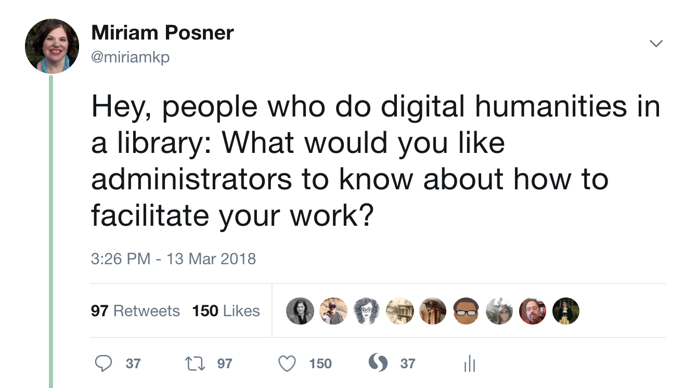

Slide 23
“Take something off our plate.”

Slide 24
“We need backup when working with faculty.”

Slide 25
“It helps if you understand our field.”

Slide 26
“Small projects can be great investments!”

Slide 27
“We all need to be thinking seriously, from the start, about sustainability.”

Slide 28
“No one person can do everything!”

Slide 29
“We need to be written into grants and given credit for our work.”

Slide 30
“People are way more important than stuff.”

Slide 31
“Everything takes longer than you think it will.”

Slide 32
“Beware the lure of shiny objects.”

Slide 33
The short version:
Trust your experts, learn what they need, and be unwavering about priorities.

