Slide 1
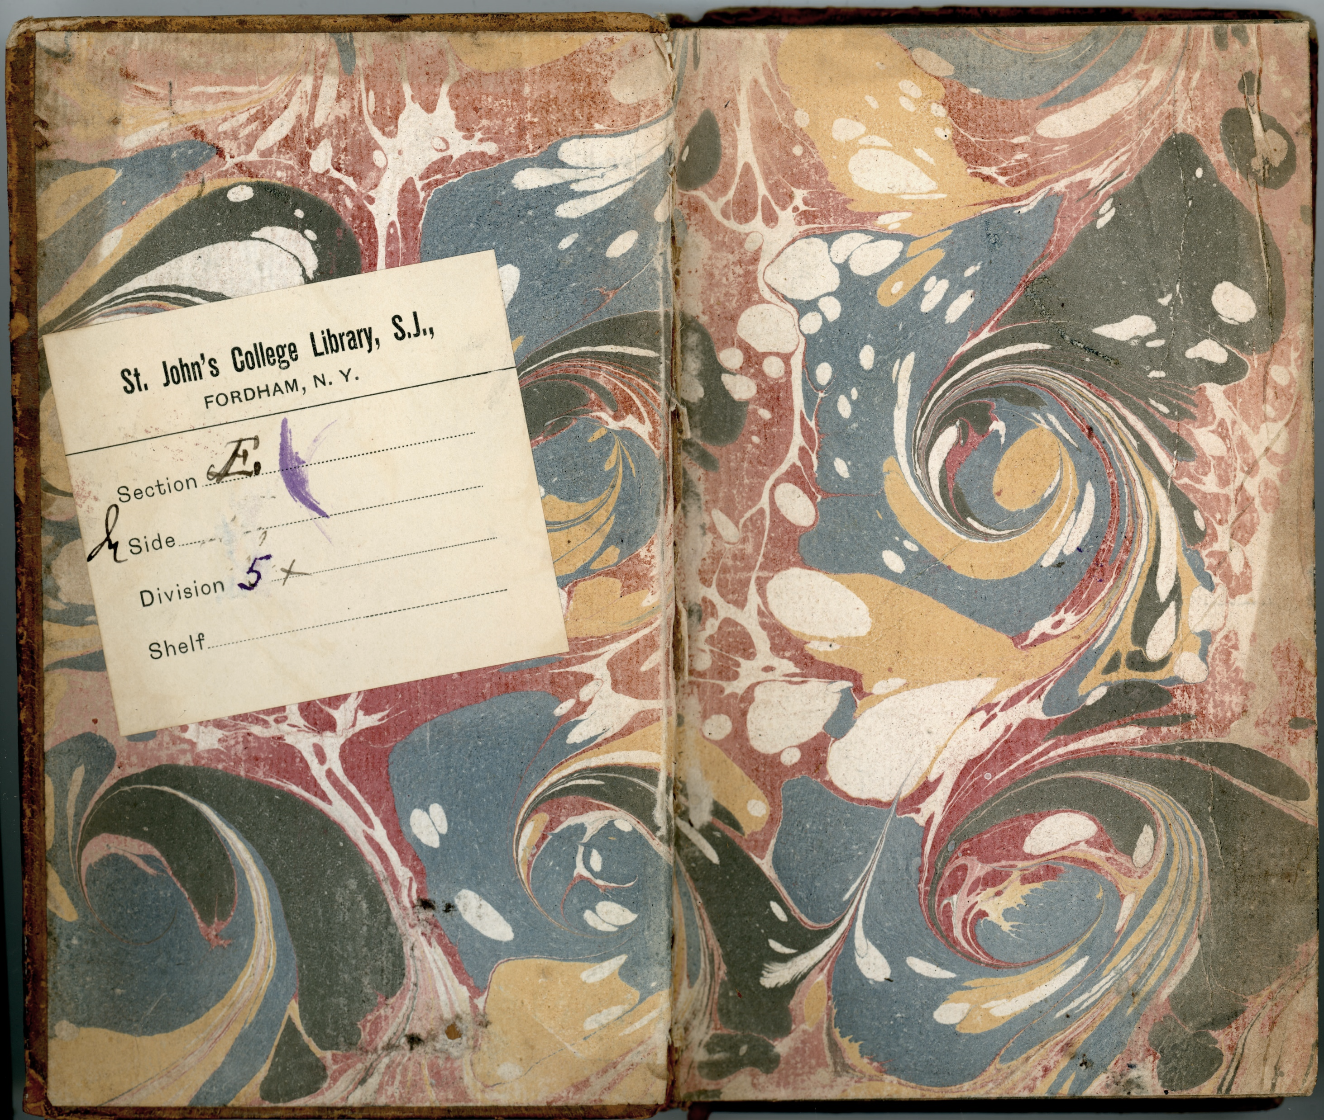
Digital Humanities and the Fordham University Library
The Latest……

Slide 2
Fordham University librarians and faculty participated in the annual
New York City Digital Humanities
a consortium of galleries, libraries, archives, and museums that puts together trainings and lectures for those interested in digital humanities in the metro New York area.

Slide 3
At NYCDH Fordham’s Digital Humanities librarian gave a Lightning Talk
about using resources in
to develop digital projects about
poor and working-class women, immigrants, people of color, and the disabled in the 19th century.

Slide 4
Fordham Reference librarians conducted an environmental scan
of software available on campus in various computer labs
and sent out a survey to graduate students inquiring
about their software needs to conduct their scholarship.

Slide 5
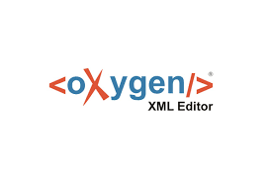
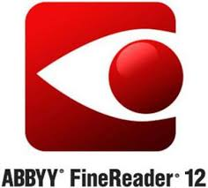
This data collection effort resulted in designating one computer workstation in the Reference Department as
Digital Scholarship Workstation
which offers an array of open source applications as well as
the most requested proprietary items:

Slide 6
Fordham’s Head of Reference and Information Services
is a member of the University’s
Digital Humanities Steering Committee
a group of faculty and administrators aiming to increase engagement of faculty working on digital humanities projects through their research and teaching.

Slide 7
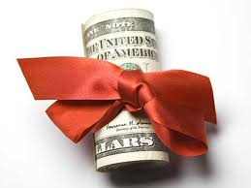
This group was awarded
from the Fordham Office of Research
for their proposal entitled:
Strategic Research Consortium on Digital Scholarship
$30K
Inspired by the directives in the University’s strategic plan, stating digital scholarship as a top priority, this grant will be used in part to organize a conference in Spring 2019.

Slide 8
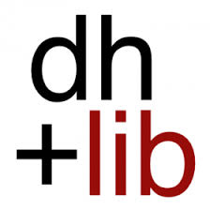
Fordham’s Digital Humanities librarian agreed to serve as an Editor-at-Large for dh + lib Review during the Fall semester. This work consisted of scouring the web on a daily basis searching for articles about the intersection between libraries and digital humanities. These items were then submitted for review by other librarians in order to select items for inclusion on the dh + lib Review blog.

Slide 9
Migration to the hosted instance of has improved the functionality of our digital collections.
Fordham’s Metadata Librarian led a discussion Metadata in the Post-Truth Era for the
ALCTS-Creative Ideas in Technical Services Interest Group at ALA Midwinter.

Slide 10
The grant covered:
4 medieval manuscripts
2 manuscript sermons from
18th century Mexico
3 early twentieth century
hand-copied Fordham
student periodicals
& selections from Fordham’s
Judaica collection.
Fordham University Library received its second digital conversion grant
in as many years.

Slide 11
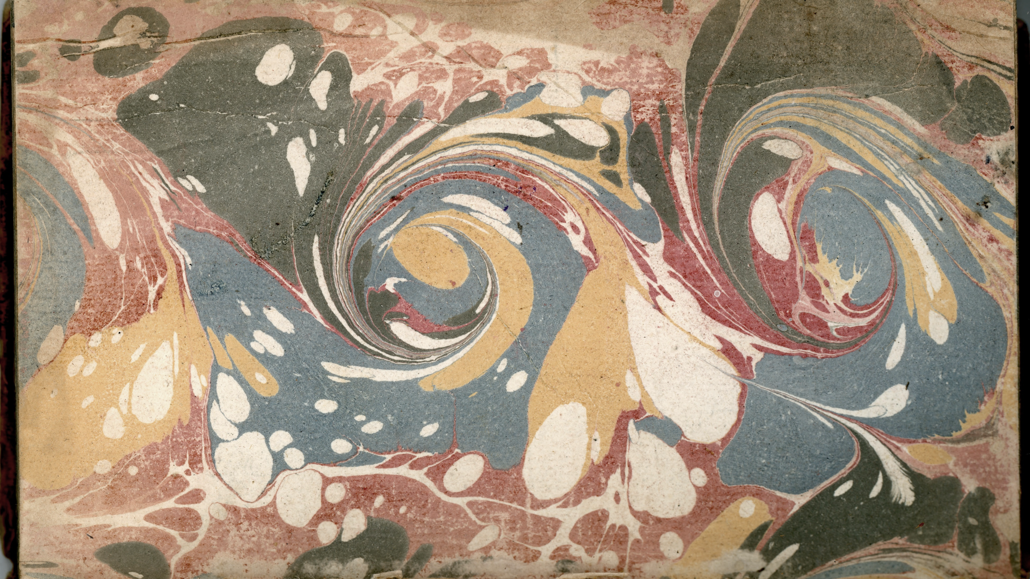
Materials are currently available on
but will be uploaded to
Fordham’s digital collection
within the next few months.

Slide 12
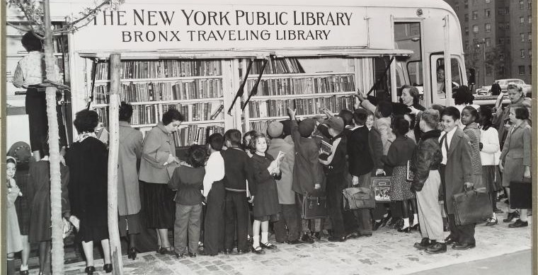
We keep on moving forward!

