Slide 1
2018 AJCU Virtual Reference (VR) Project
Deans and Directors Report
Our 19 Consortium Members
Boston College | Marquette University
Fairfield University | Regis University
Fordham University | Rockhurst University
Gonzaga University | Saint Joseph's University
Holy Cross | Santa Clara University
Le Moyne College | Seattle University
Loyola Marymount University | University of Scranton
Loyola / Notre Dame Library | University of Detroit Mercy
Loyola University, New Orleans | University of San Francisco
Loyola University, Chicago
https://tinyurl.com/y9zaqgjl

Slide 2
Member Library Commitments
Member libraries must have an active LibraryH3lp subscription (FTE based pricing)
Requires ability to embed chat widgets at point of need on your web pages
FTE based contribution toward cost of Chatstaff (24/7 staffing solution and covers select
holidays). We’ve moved to a 3-year contract with Chatstaff, but new schools are welcome.
Contribution toward weekly coverage of shared chat queue of 4, 6, or 8 hours per week
(comprised of business and nonbusiness, evening and/or weekend, hours)
Librarian to serve as the VR Coordinator for your library (acts as a representative in the
consortium) and to attend AJCU VR annual meeting virtually or in person
Nominal annual fee for WhenToWork.com scheduling software ($10 per year)
Would you like to join the AJCU VR Project for 2018/2019? Other questions or concerns? Please review the member commitments above and contact the AJCU VR Steering Committee Chair by May 1, 2018:
Amy Gilgan akgilgan@usfca.edu

Slide 3
Usage
Chats by Operator 2016-2017 (July-February)
AJCU Librarians 16,862
ChatStaff Librarians 6,278
Total: 23,140
Chats by Operator 2017-2018 (July-February)
AJCU Librarians 16,491
ChatStaff Librarians 7,243
Total: 23,734
Summary
AJCU chat coverage decreased by 2% and Chatstaff coverage increased by 14%. Our contract with ChatStaff, our 24/7 staffing solution that provides backup staffing and select holiday coverage, allows consortium schools to keep the same rate for three years if we maintain approximately 70% chat coverage. As of the end of February 2018, AJCU has covered 69% of chats. If the percentage split stays the same, there will be an added charge of $1,375 at the end of this year. In the event of an overage, the cost would be split amongst the consortium in accordance to FTE tier. To reduce the likelihood of an overage, we have been exploring changing the hours that the AJCU consortium covers over the holiday and summer breaks. During the 2017-2018 winter break, we shifted our December consortium coverage one week later, which resulted in a 13% decrease in the number of chats handled by Chatstaff over the winter break.
Our current contract will end on June 30th, 2019. We will begin negotiating a new 3 year contract in Fall 2018, and we will provide more detailed information about the proposed contract at the 2019 Library Deans and Directors meeting.
As reported at the 2017 Deans and Directors meeting, the AJCU Virtual Reference Project completed a consortium-wide assessment in 2016. The complete results of the user survey are attached to this report.

Slide 4
Default Report
AJCU VR Assessment
December 12th 2016, 5:08 pm MST
Q1 - What is the name of your institution?
# | Answer | % | Count
 | Total | 100% | 230

Slide 5
The Data
Text-Mining Chat Reference Interviews:
A research project at LMU
Two LMU reference librarians used six semesters’ worth of chat transcripts as a corpus for a variety of text analysis research.
January 2014 to December 2016
Over 10,000 conversations

Slide 6
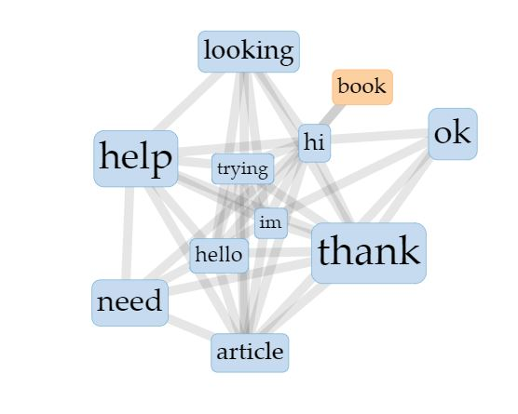
The Research Questions
R1: What terminology and vocabulary do students use to describe research tools and resources (compared to librarian terminology)?
R2: What feelings or sentiments are conveyed by students during chat?
R3: What are the frequent question parameters and categories, and what drives traffic?

Slide 7
Tools and methodology
Lexos
Voyant
Subjectivity Lexicon
LIWC2015
Topic Modeling Tool
We were supplied with anonymized copies of transcripts in the form of two distinct corpuses, “librarian” and “student”
We used Lexos and Voyant software to extract words and phrases from the chat transcripts and to establish word counts and frequencies for student vocabulary vs. librarian vocabulary
The Subjectivity Lexicon gave us a way to use Lexos again, by filtering for the designated sentiment word lists. Also used LIWC.
Input all transcripts (not separated- just one big file) into Topic Modeling Tool

Slide 8
Student Research Vocabulary: Top 11 Terms
Research Term | Times Mentioned
1. Article | 5039
2. Book | 3644
3. Journal | 1506
4. Link | 1437
5. Database | 1304
6. Online | 1198
7. Topic | 728
8. Cite | 667
9. Scholarly | 539
10. Primary | 530
11. Website | 515

Slide 9
Applications from what was learned
Improving description of library resources in LibGuides with terminology students will recognize
Improving positive atmosphere in chat by aligning provider vocabulary with terms favored by students (e.g. perfect, awesome, amazing)
Frequent subjects included Business, Theology, Education, History, and Psychology (outreach implications to more departments)
We will use frequent topics to improve library FAQs, navigation cues, and access issues

