Slide 1
EDS in FYE at DUB-C
aka Integrating a Discovery Layer into First-Year Instruction at Whittier College

Slide 2
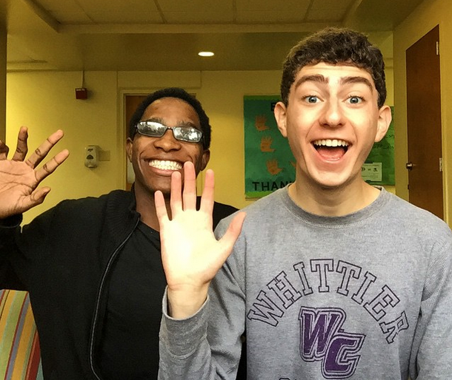
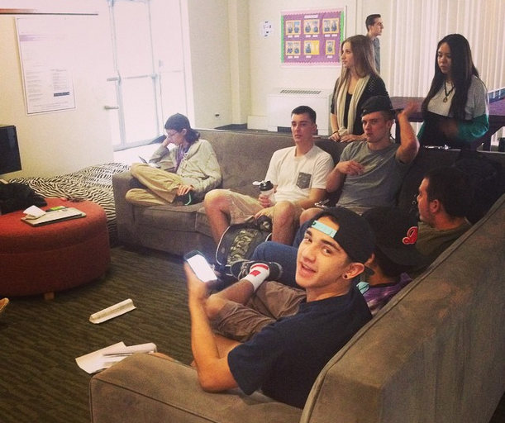
The First-Year Experience at Whittier College
INTD 100 College Writing Seminar required
Linked to another course (e.g. PSYC 100)
Same dorms, same peer mentors, same advisors
Fall 2014: 380 FYs in 28 sections (15 cap)
Notes:
Replace all text with “Community”?

Slide 3
Pre-First Semester Marketing

Slide 4
Notes:
Summer 2014

Slide 5
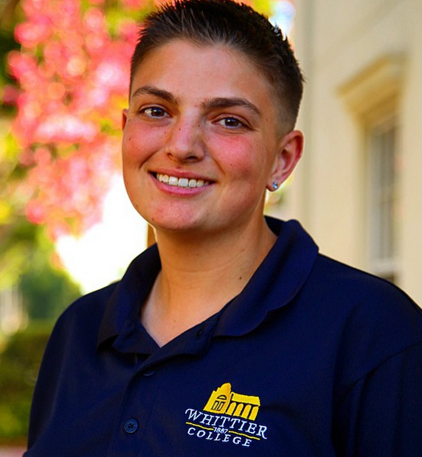
Notes:
Spoke with director of campus tours
Built relationships with individual tour guides
Somewhat for the benefit of guests, but more for the benefit of students in earshot.

Slide 6
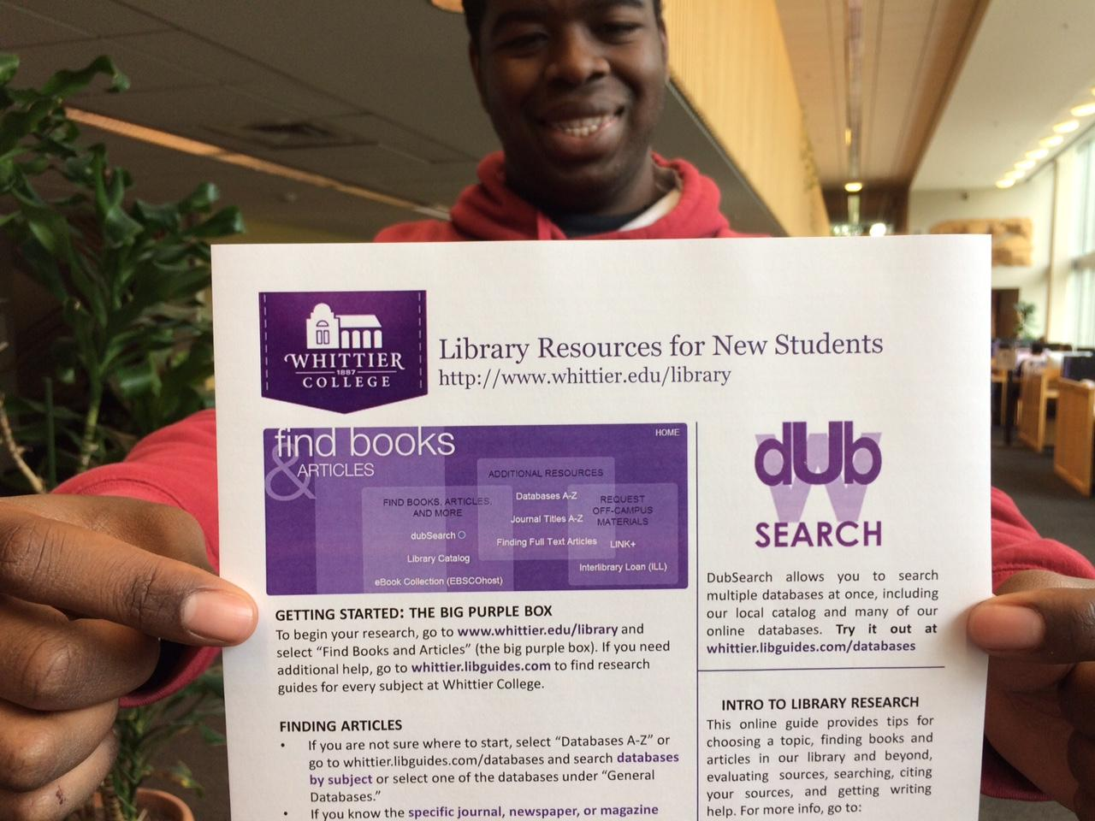

Slide 7
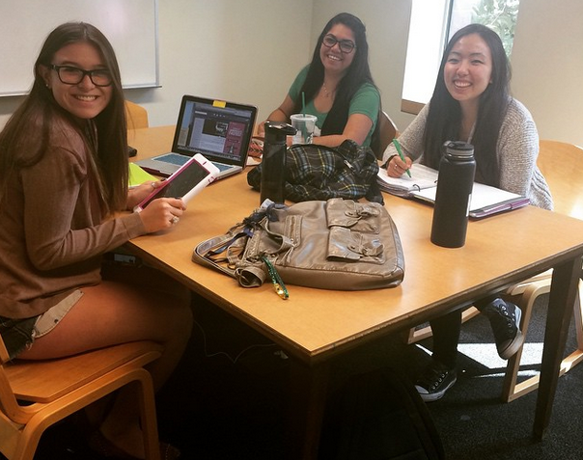
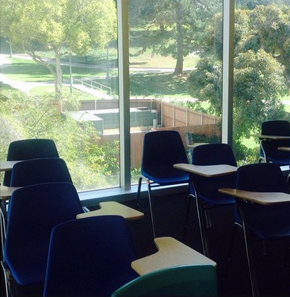
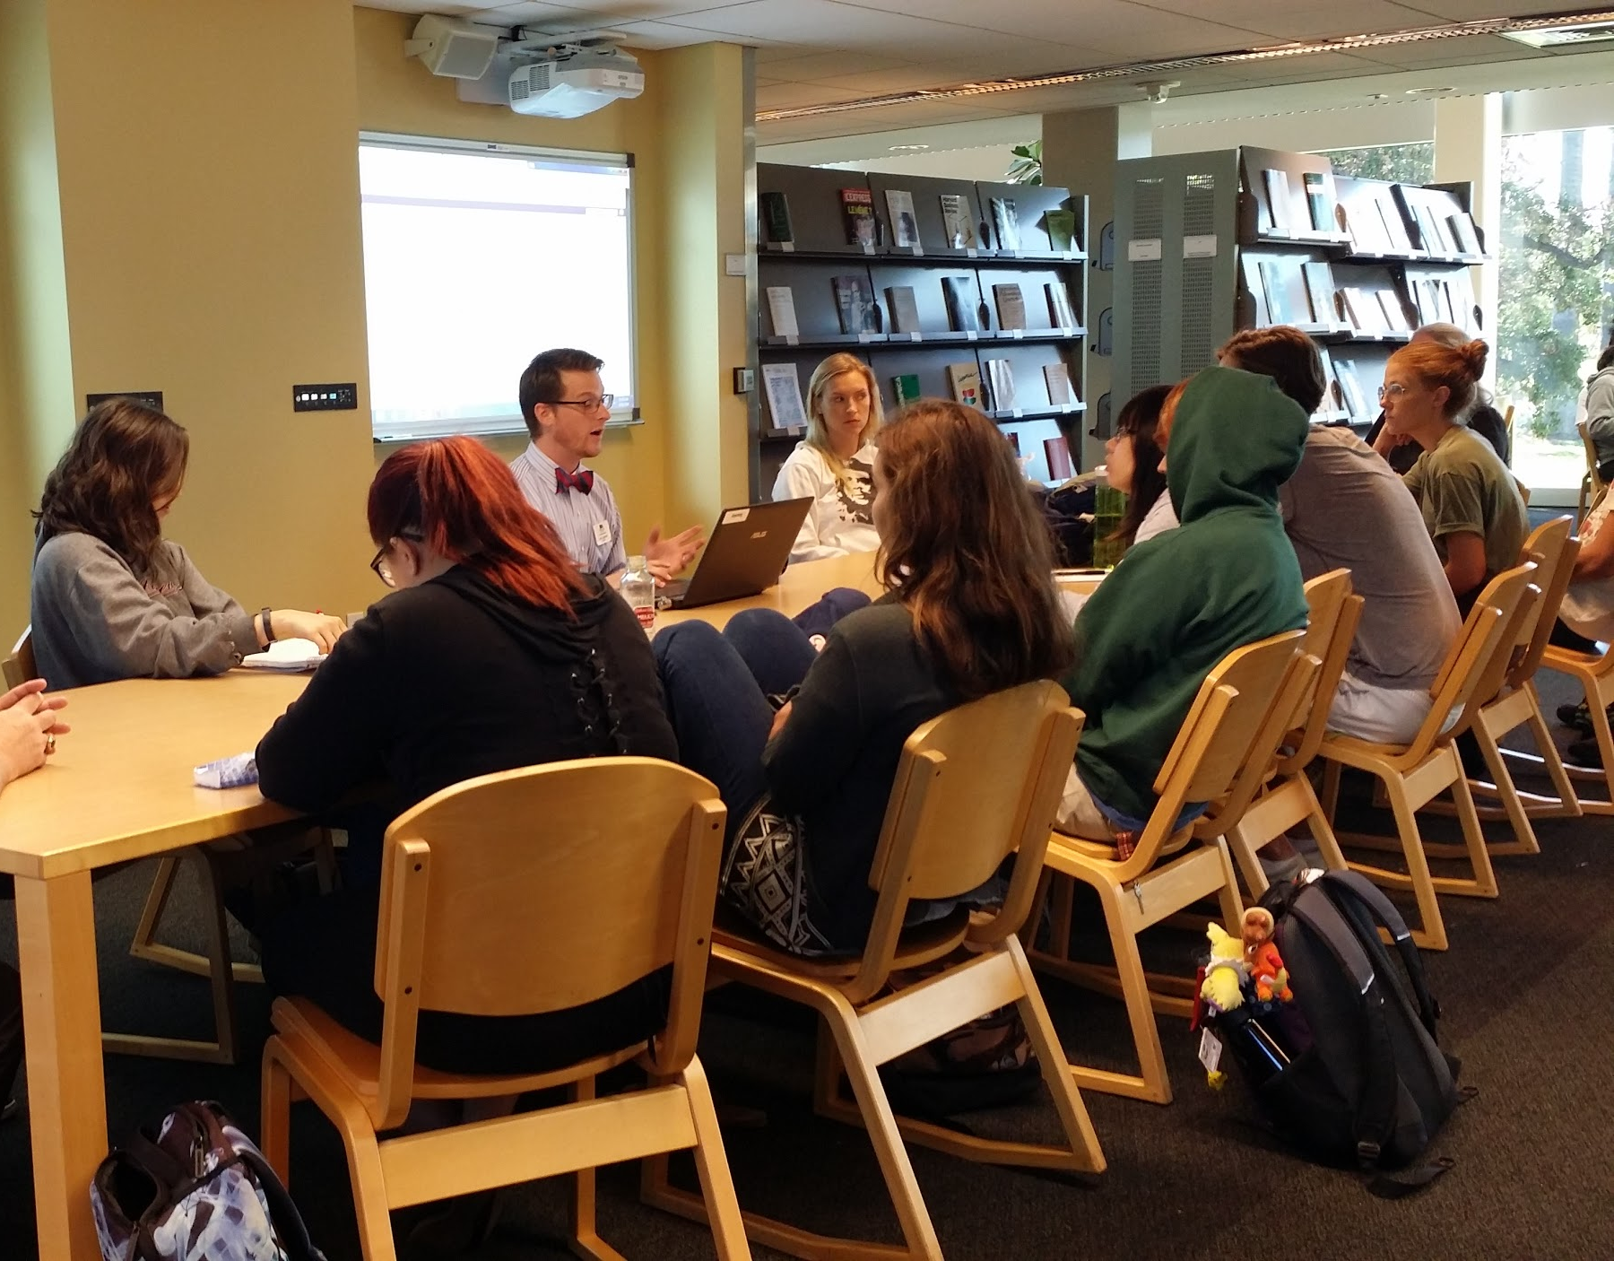
Learning Objectives for INTD 100
Students will be able to form useful questions and strategies for research inquiry.
Students will identify the library/librarians as a source for research help.
Students will be able to articulate the expectations of college-level research.
Notes:
Point out specifically how dubSearch helped to meet each of these goals.

Slide 8
Preparing the Mind for Discovery
Notes:
Asked students “How do you define research” and “if research is not about finding answers, what is it about?”

Slide 9
“
”
Research in not about finding answers
Notes:
Not research, but “discovery.”
But discovery can be difficult in today’s information environment...

Slide 10
Contextualizing Google
Notes:
Talk about the contents of the spiel (get through this quickly).
the filter bubble and the ethics of algorithms
market influence on search results
the hidden web and paywalls
accessing information that wasn’t made for the web or has yet to be digitized
the departmentalization of information resources (siloing)

Slide 11
Notes:
Introduced the discovery layer as a Google alternative.
You control the filtering process
Overcomes the soloing of information resources

Slide 12
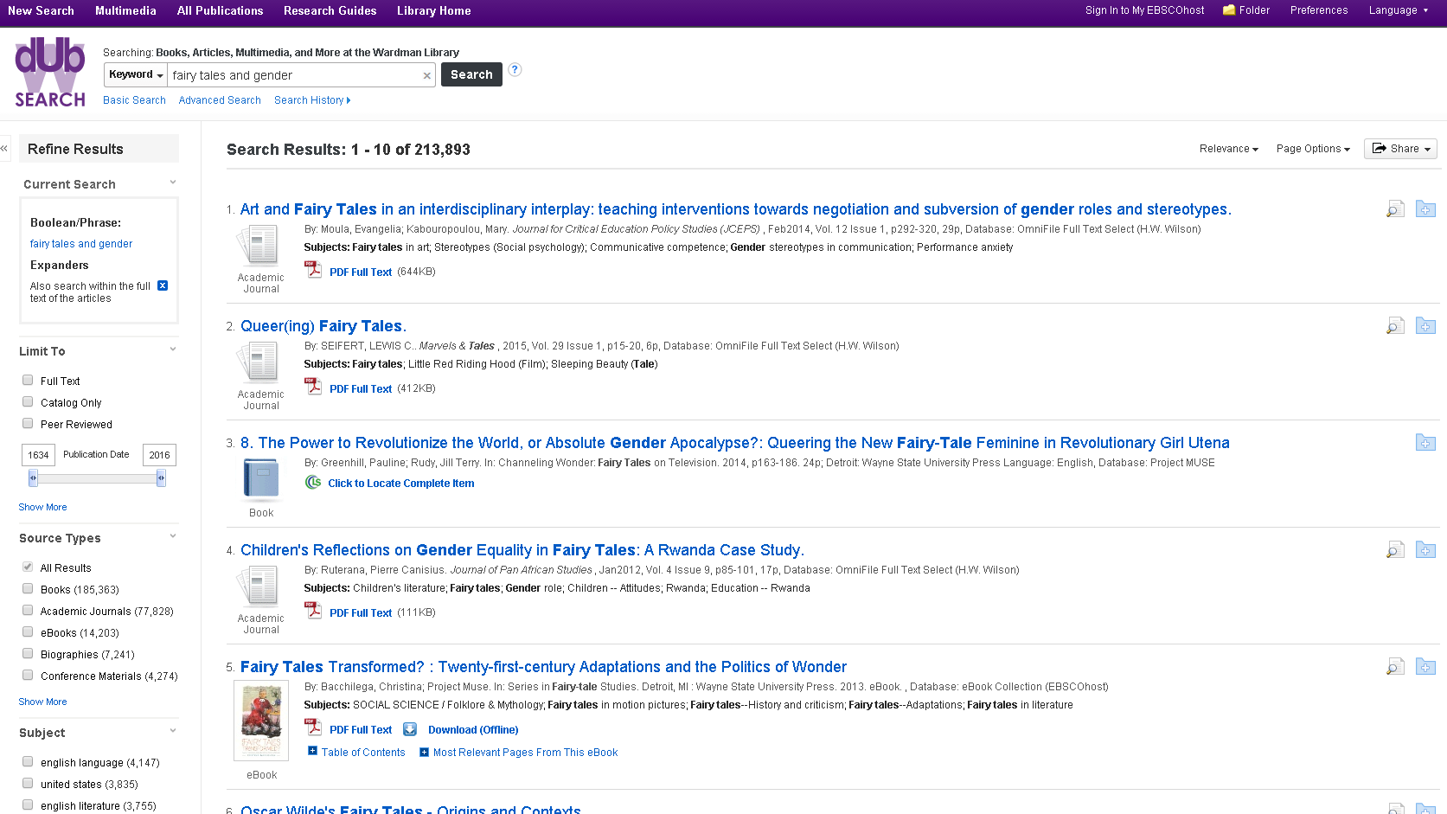
Guide on the Side[bar]
Notes:
Last 20 minutes of class (plus 5 minutes for addressing problems)
Teaching from the sidebar (or having students change settings in each section and talk about how results changed - start by limiting to full text):
With no prep, we just let the students discover the EDS interface.
Step 1: Search for your topic using two terms (A and B)
Step 2: Use the sidebar and change one of the following options. Toggle between on and off and tell me about the results. What can you learn about your topic from changing these settings? or What can you learn about library resources from changing these settings?
Peer review
Source Types
Publisher and Publication (authority)
Have students report out on what they found.
Using the subject list to narrow your topic or find an area of interest.
Deep dig: how to read metadata record (simultaneously compare both books and articles)

Slide 13
What are three strategies/tips for doing college-level research?
“Start by using dubSearch, because it allows you to narrow down your results as you get a better idea of what you want to research”
“Find the hidden internet through dubSearch”
“USE DUBSEARCH”
“DubSearch is a great way to find both electronic and physical texts for research”
“DubSearch should be permanent not temporary! It’s so much better!! We need it!!!”
Notes:
1 out of every 3 INTD 100 students specifically mentioned dubSearch in post-session feedback. Not a surprise really, but look how they mentioned it...
We’re seeing the effects of this now. When students come to the reference desk and we ask them, “where have you searched already?” more of them are saying dubSearch and more of them already have at least a few articles in hand.

