Slide 1
The Shortest Distance between Two Points:
Using EDS in Distance Learning Library Instruction
Presented by Lugene Rosen
Coordinator of Brandman University Library Services
Chapman University

Slide 2
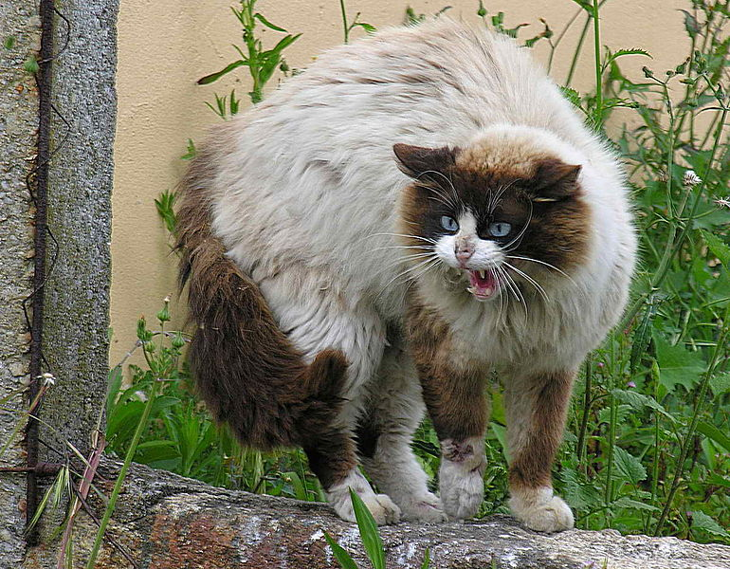
The Problem
Technical issues
Lack of support
Isolation
Assumptions
Fear of librarians
By [dead link Luis Miguel Bugallo Sánchez from Santiago de Compostela, Galicia] (Flickr) [CC BY 2.0 (http://creativecommons.org/licenses/by/2.0)], via Wikimedia Commons

Slide 3
The Solution?
EBSCO Discovery Service!

Slide 4
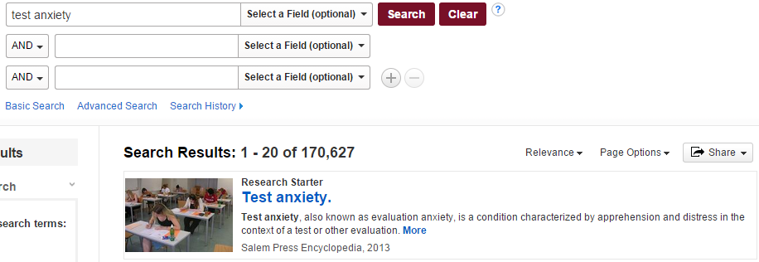
What you can accomplish in a single session
Background information using Research Starters

Slide 5
What you can accomplish in a single session
Learn the difference between keyword and subject searching

Slide 6
What you can accomplish in a single session
Add search terms and narrow to phrase searching

Slide 7
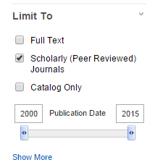
What you can accomplish in a single session
Use limiters for peer-reviewed, date ranges, language, or subject

Slide 8
What you can accomplish in a single session
Save materials to a folder

Slide 9
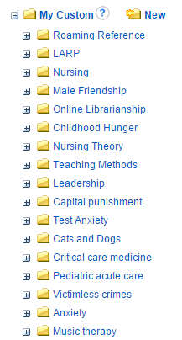
What you can accomplish in a single session
Create and manage folders in My EBSCOhost

Slide 10
What you can accomplish in a single session
Save search histories

Slide 11
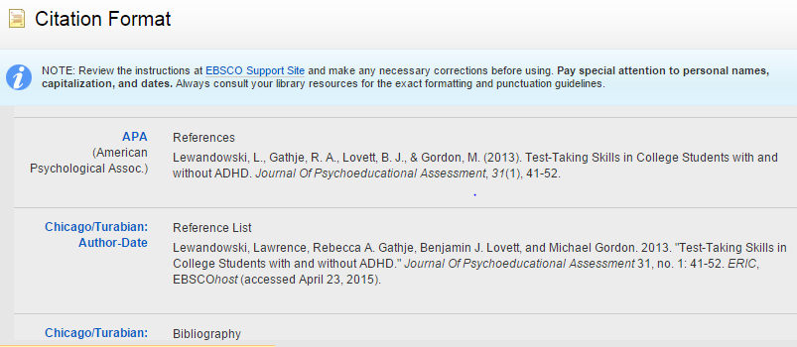
What you can accomplish in a single session
Introduce citation formatting

Slide 12
The Student takeaway
EBSCO Discovery Service can. . .
Make searching easier
Save frustration
Save time
By Yumi Kimura from Yokohama, JAPAN (so happy smiling cat) [CC BY-SA 2.0 (http://creativecommons.org/licenses/by-sa/2.0)], via Wikimedia Commons

