Slide 1
(FORM)ATIVE ASSESSMENT:
USING FORMS TO
EVALUATE ACTIVE LEARNING
Katherine Donaldson
Librarian-in-Residence
&
Elisa Acosta
Instruction Coordinator
Loyola Marymount University

Slide 2
FORMATIVE ASSESSMENT
SUMMATIVE
ASSESSMENT
Assessment that takes place during instruction; designed to make continuous improvement
Discussing responses from Google Forms in class; modifying instruction on-the-spot
Assessment that takes place once instruction is complete; designed to be a final evaluation
Rubric
Definitions from:
Grassian, E.S., & Kaplowitz, J.R. (2001), Information Literacy Instruction. New York: Neal-Schuman.
Notes:
Formative
“Which parts of the instruction went well?” and “Which parts of the instruction need improvement?” how well students succeed on in-class exercises, or noting students’ questions and comments as instruction progresses
Summative
“Should the instruction in its present form continue?” Were the learning outcomes met?

Slide 3
RHETORICAL ARTS

Slide 4
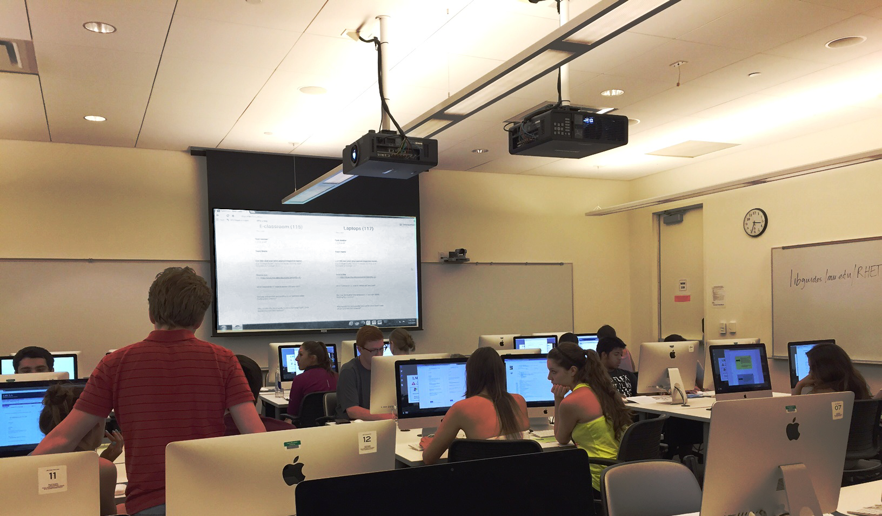
ACTIVE LEARNING ACTIVITY

Slide 5
Course LibGuide

Slide 6
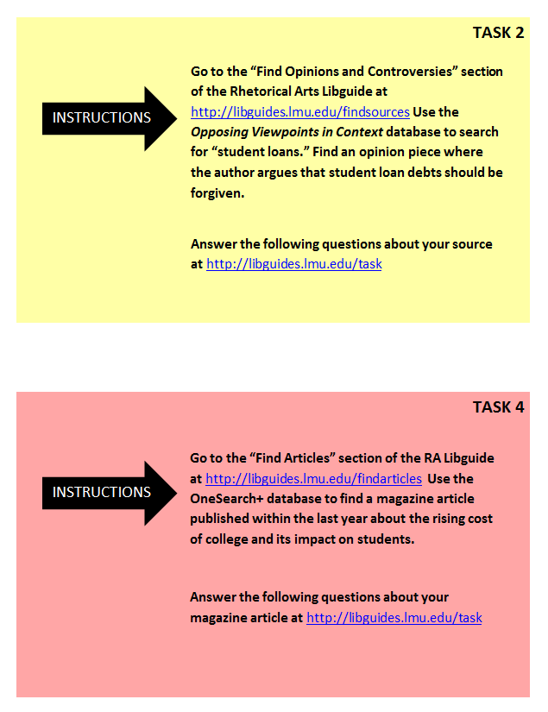
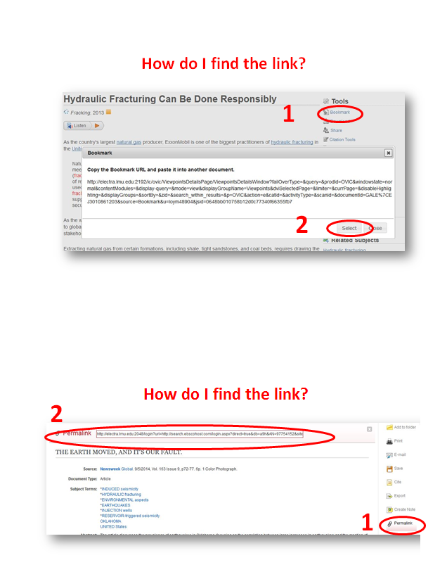

Slide 9
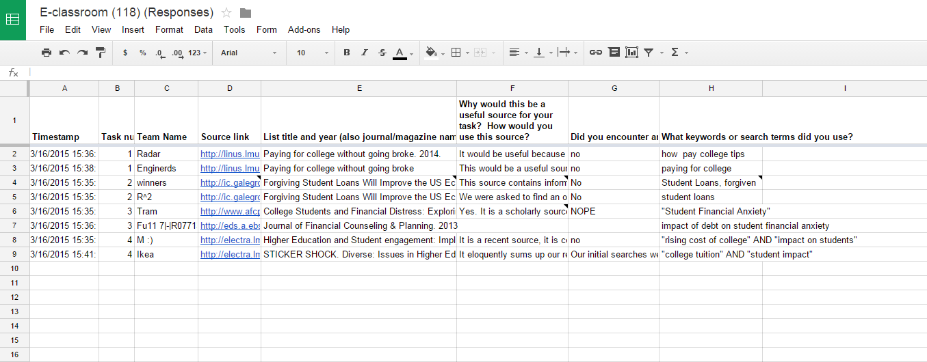

Slide 11
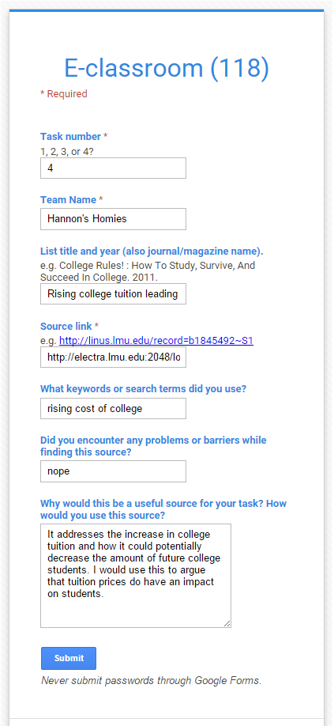
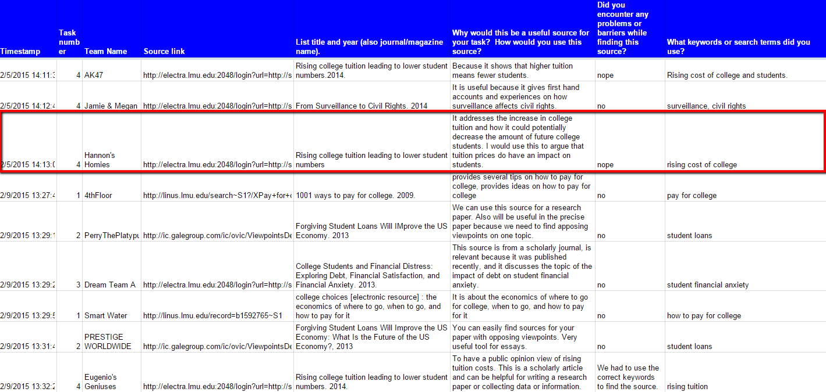

Slide 12
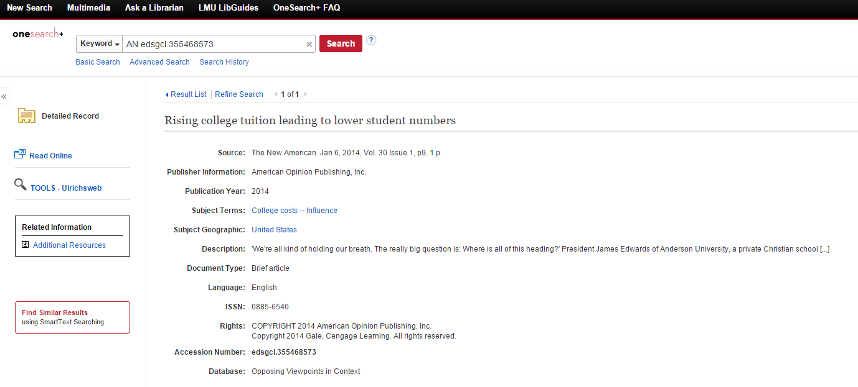
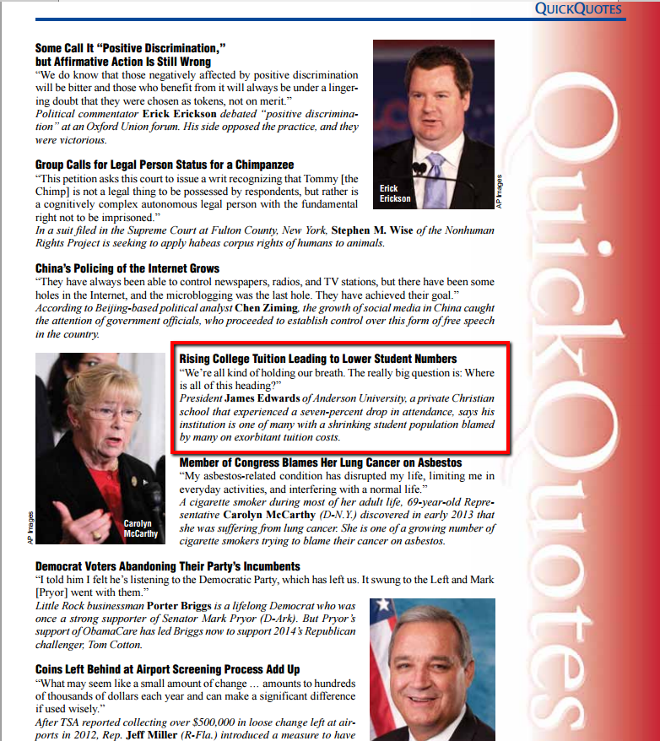
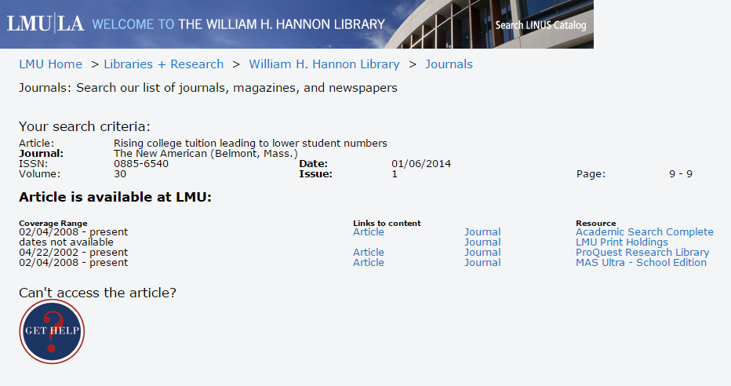

Slide 13
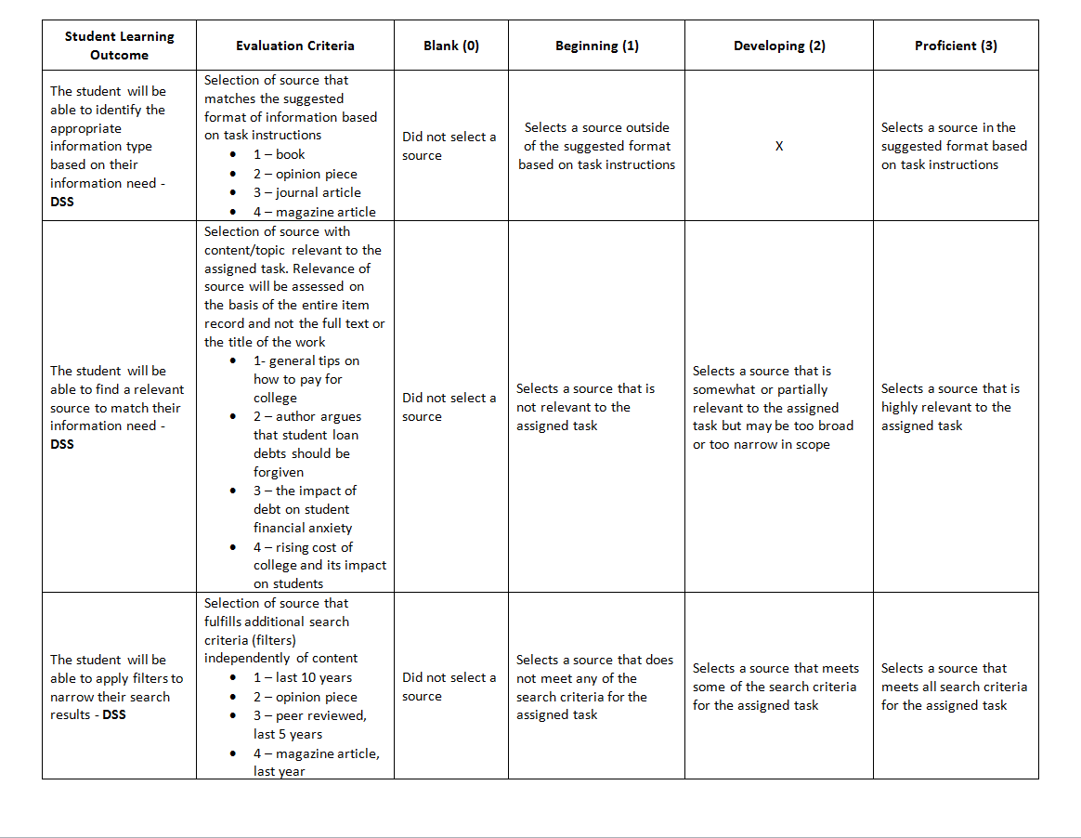
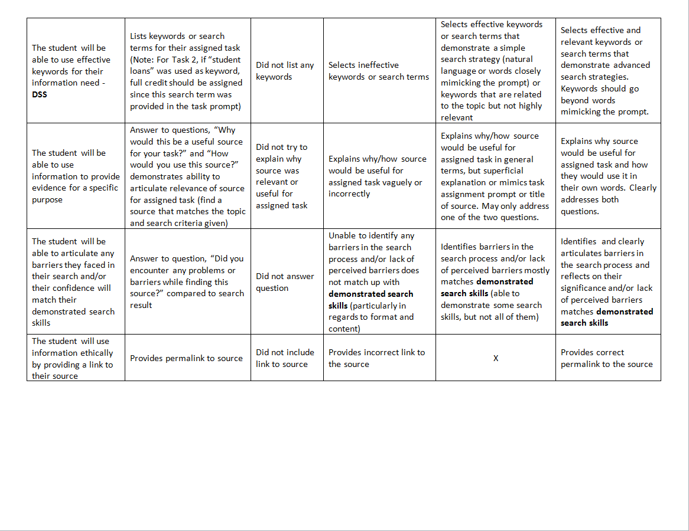
RUBRIC

Slide 14
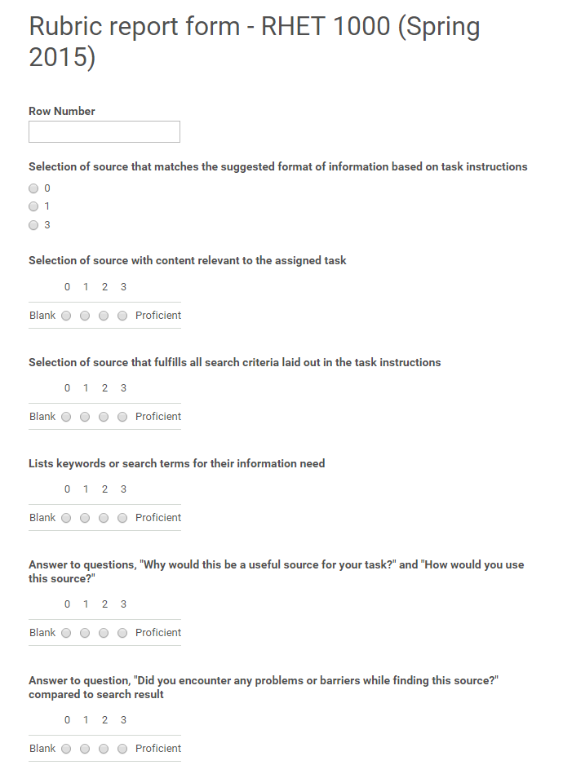
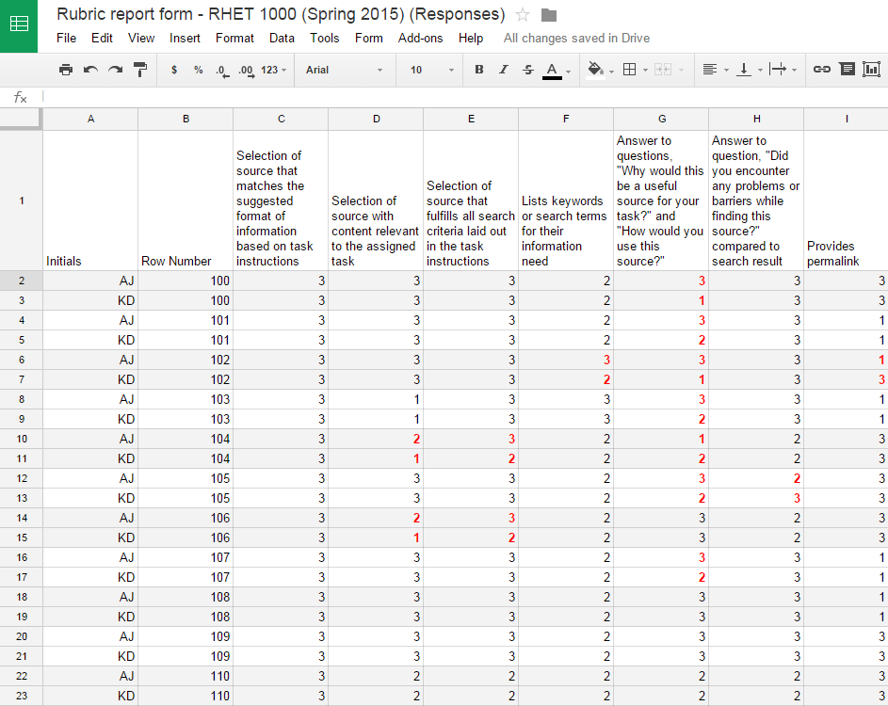
CALIBRATION

Slide 15
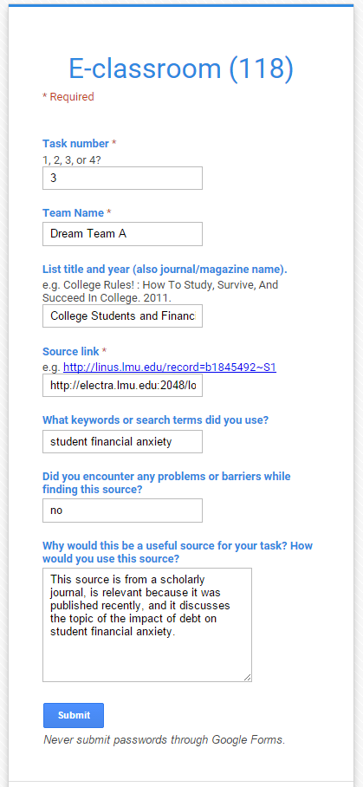
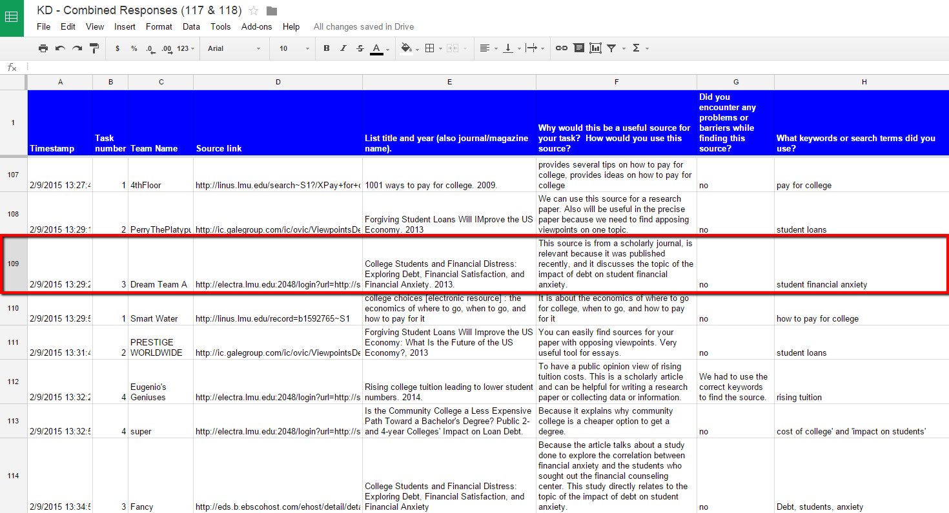

Slide 16
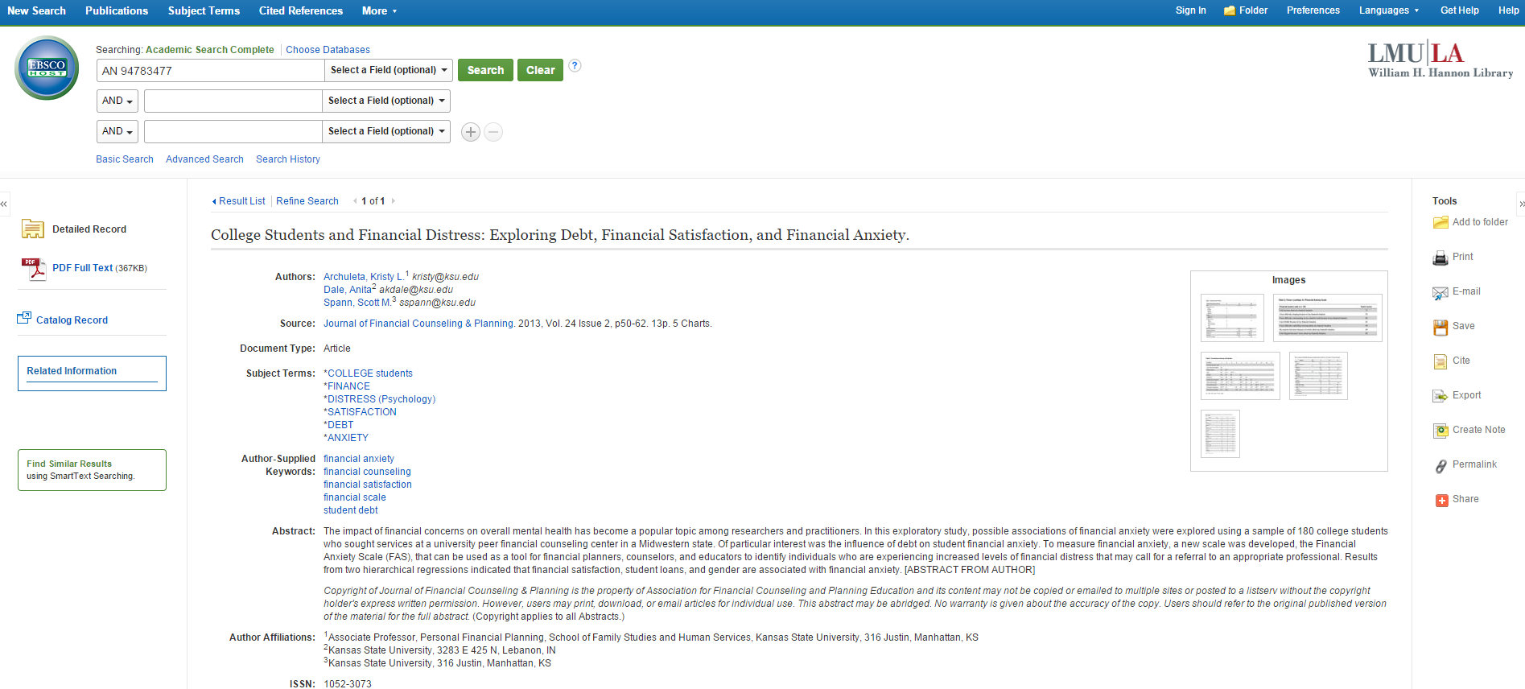

Slide 17
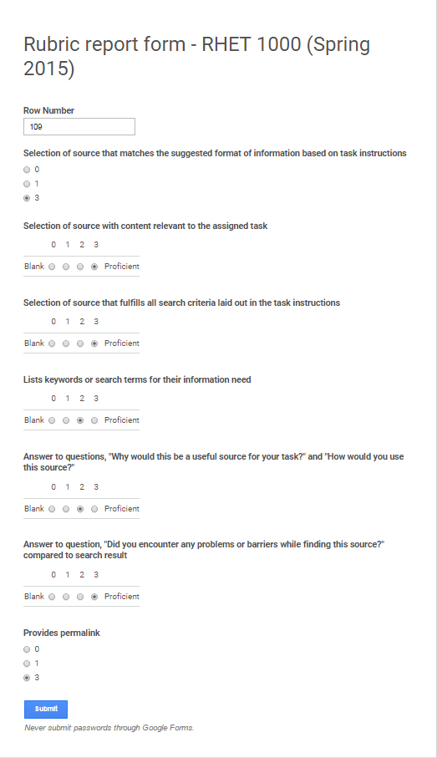

Slide 18
NEXT STEPS
Image by Andreas Levers (Flickr)

Slide 19
LINKS
Rhetorical Arts LibGuide:
http://libguides.lmu.edu/RHET1000
Google Task Forms:
http://libguides.lmu.edu/task
Task Cards:
http://libguides.lmu.edu/taskcards

Slide 20
QUESTIONS

