Slide 1
Close Encounters of the Digital Kind:
Designing Effective Online Tutorials
SUSAN [GARDNER] ARCHAMBAULT
LOYOLA MARYMOUNT UNIVERSITY | 2013 IFLA PRE-CONFERENCE

Slide 2
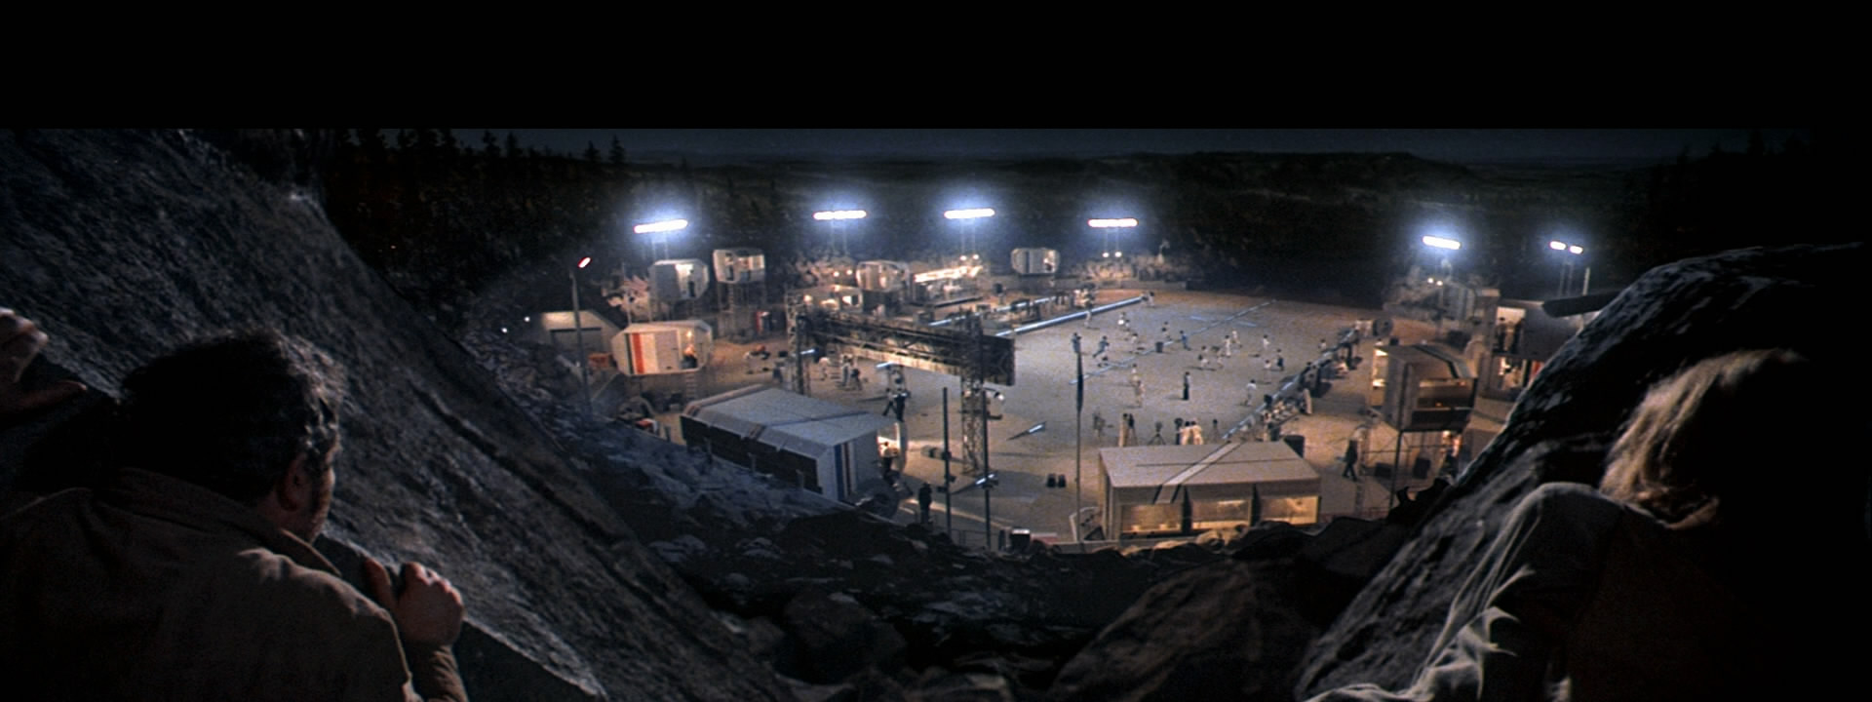
Research Questions
How do you transform traditional face-to-face library instruction to the digital environment?
What are the “best practices” in the design of information literacy tutorials?

Slide 3
Methodology
Multidisciplinary review of the literature (library science, instructional design, web design and development, human computer interaction fields)
Content analysis of “basic research” online tutorials from last 10 years within PRIMO database

Slide 4
Results PART 1

Slide 5
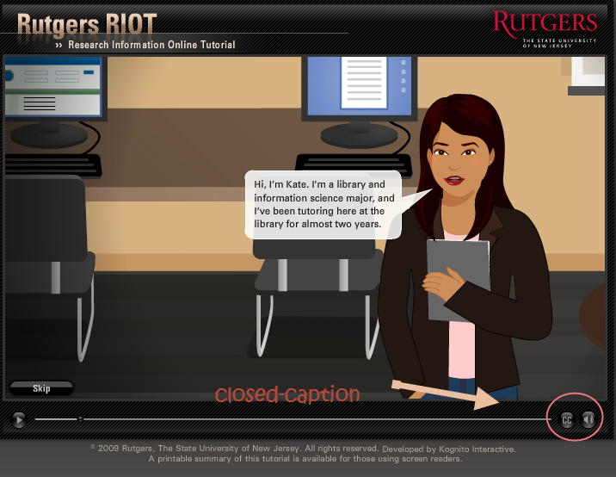
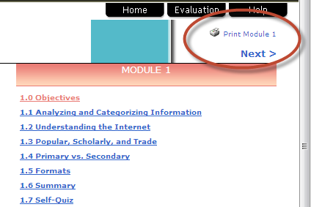
User Control
Users of a tutorial should have some control over how they use it based on their own needs and learning style.
Multiple content formats
Show user progress
Call-outs for additional information
Visible way to get help

Slide 6
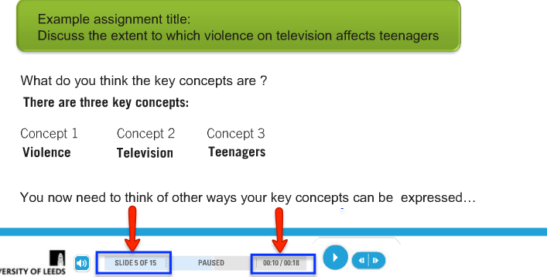
User Control
Users of a tutorial should have some control over how they use it based on their own needs and learning style.
Multiple content formats
Show user progress
Call-outs for additional information
Visible way to get help

Slide 7
User Control
Users of a tutorial should have some control over how they use it based on their own needs and learning style.
Multiple content formats
Show user progress
Call-outs for additional information
Visible way to get help

Slide 8
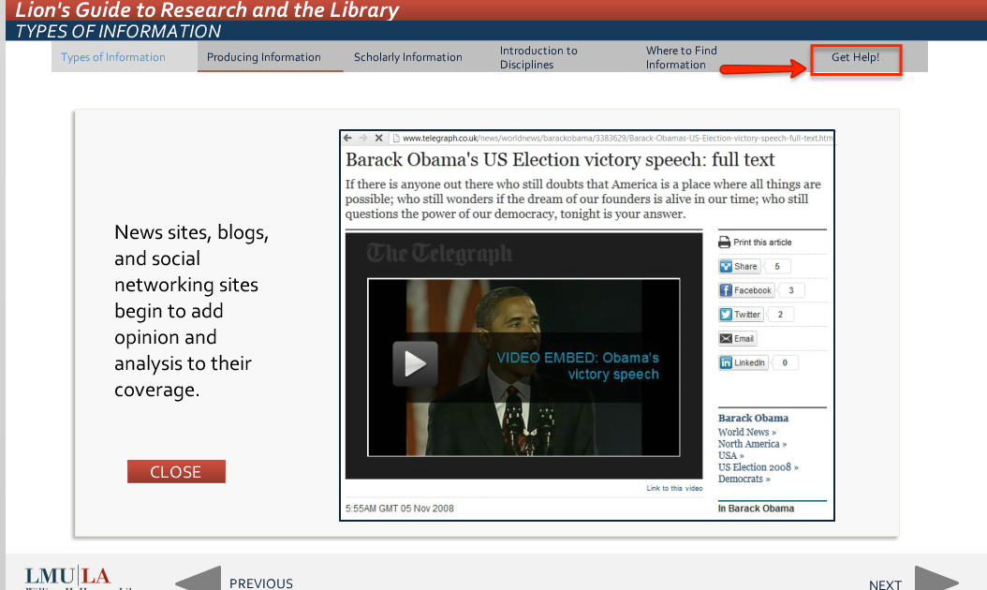
User Control
Users of a tutorial should have some control over how they use it based on their own needs and learning style.
Multiple content formats
Show user progress
Call-outs for additional information
Visible way to get help

Slide 9
Visual Clarity
The design of the tutorial should be minimal, clear, and visually consistent throughout. This enables the learner to focus on learning the content.
Use library or institutional branding
Apply consistent and limited color
Create consistent template
Use graphics to facilitate learning
Use visual cues to draw attention to content
Use descriptive links (not URLs)

Slide 10
Visual Clarity
The design of the tutorial should be minimal, clear, and visually consistent throughout. This enables the learner to focus on learning the content.
Use library or institutional branding
Apply consistent and limited color
Create consistent template
Use graphics to facilitate learning
Use visual cues to draw attention to content
Use descriptive links (not URLs)

Slide 11
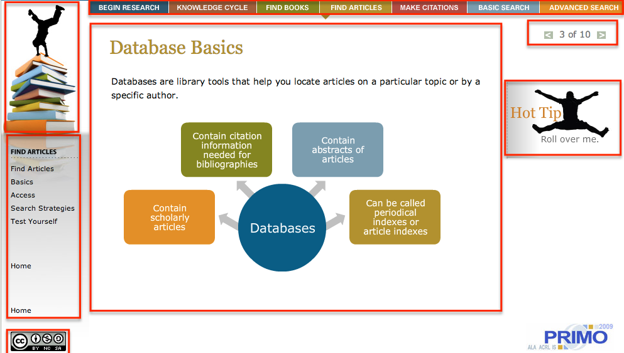
Visual Clarity
The design of the tutorial should be minimal, clear, and visually consistent throughout. This enables the learner to focus on learning the content.
Use library or institutional branding
Apply consistent and limited color
Create consistent template
Use graphics to facilitate learning
Use visual cues to draw attention to content
Use descriptive links (not URLs)

Slide 12
Visual Clarity
The design of the tutorial should be minimal, clear, and visually consistent throughout. This enables the learner to focus on learning the content.
Use library or institutional branding
Apply consistent and limited color
Create consistent template
Use graphics to facilitate learning
Use visual cues to draw attention to content
Use descriptive links (not URLs)

Slide 13
Visual Clarity
The design of the tutorial should be minimal, clear, and visually consistent throughout. This enables the learner to focus on learning the content.
Use library or institutional branding
Apply consistent and limited color
Create consistent template
Use graphics to facilitate learning
Use visual cues to draw attention to content
Use descriptive links (not URLs)

Slide 14
Visual Clarity
The design of the tutorial should be minimal, clear, and visually consistent throughout. This enables the learner to focus on learning the content.
Use library or institutional branding
Apply consistent and limited color
Create consistent template
Use graphics to facilitate learning
Use visual cues to draw attention to content
Use descriptive links (not URLs)

Slide 15
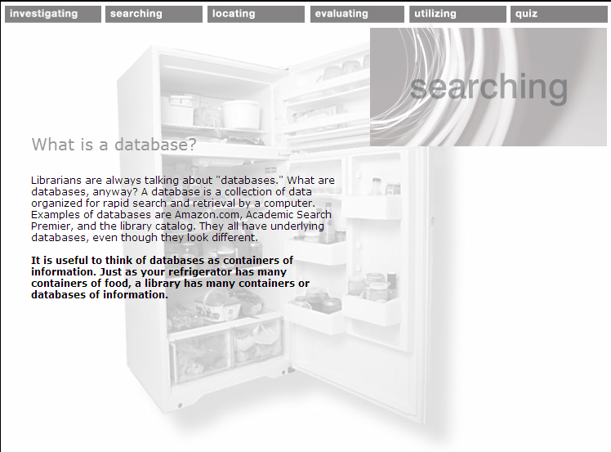
Information Clarity
Users of the tutorial should be presented with clear and concise information throughout the tutorial.
Present only 1 idea per screen
Use bullet points and visuals
Summarize and review key points at the end
Keep videos short

Slide 16
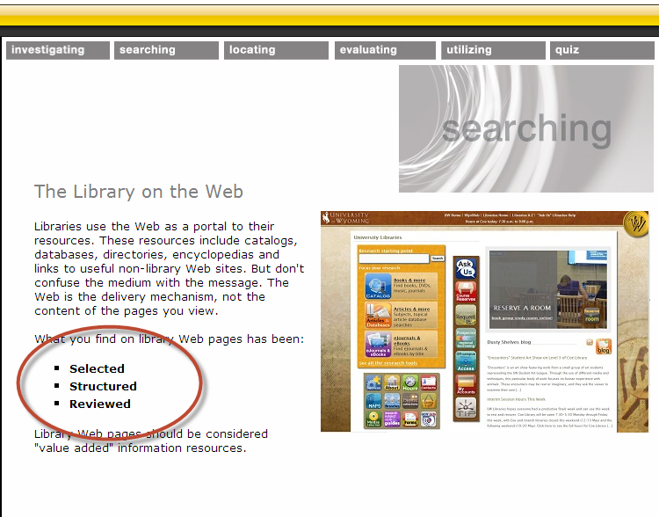
Information Clarity
Users of the tutorial should be presented with clear and concise information throughout the tutorial.
Present only 1 idea per screen
Use bullet points and visuals
Summarize and review key points at the end
Keep videos short

Slide 17
Information Clarity
Users of the tutorial should be presented with clear and concise information throughout the tutorial.
Present only 1 idea per screen
Use bullet points and visuals
Summarize and review key points at the end
Keep videos short

Slide 18
Information Clarity
Users of the tutorial should be presented with clear and concise information throughout the tutorial.
Present only 1 idea per screen
Use bullet points and visuals
Summarize and review key points at the end
Keep videos short

Slide 19
Clear Navigation
Consistent, clear, and highly visible navigation is essential. Users should be able to move through the tutorial both linearly and non-linearly.
Create an outline
Use consistent and visible navigation
Use meaningful headings
Separate navigational elements from content

Slide 20
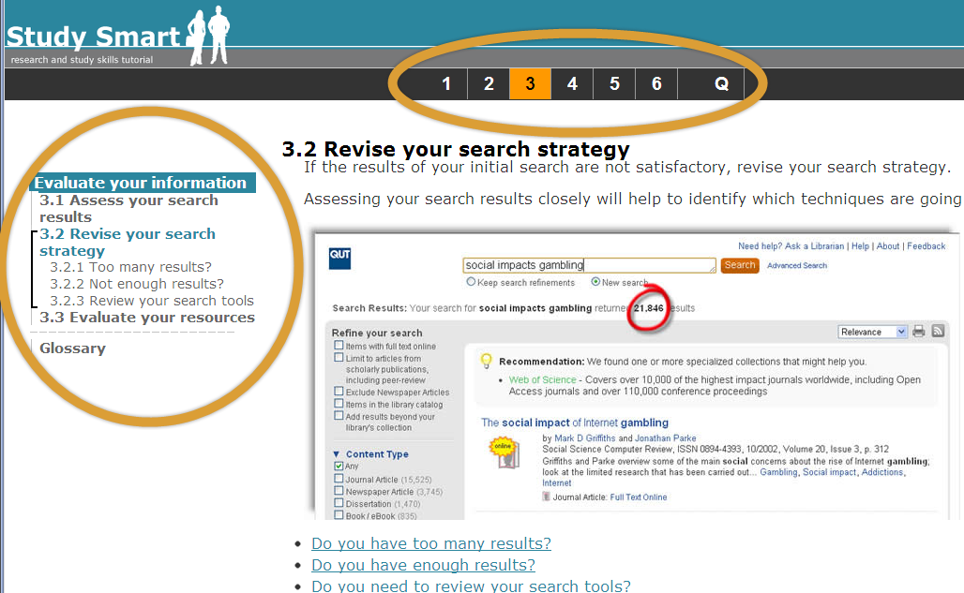
Clear Navigation
Consistent, clear, and highly visible navigation is essential. Users should be able to move through the tutorial both linearly and non-linearly.
Create an outline
Use consistent and visible navigation
Use meaningful headings
Separate navigational elements from content

Slide 21
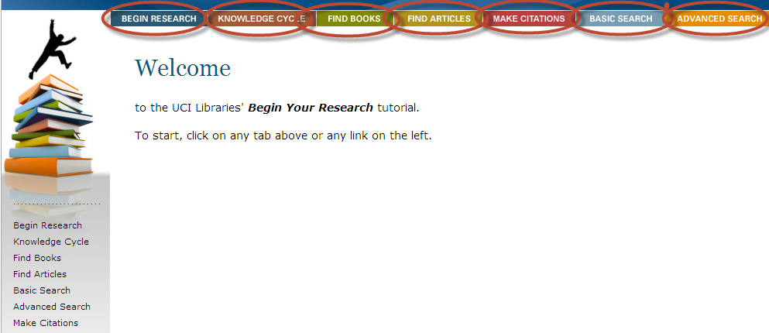
Clear Navigation
Consistent, clear, and highly visible navigation is essential. Users should be able to move through the tutorial both linearly and non-linearly.
Create an outline
Use consistent and visible navigation
Use meaningful headings
Separate navigational elements from content

Slide 22
Clear Navigation
Consistent, clear, and highly visible navigation is essential. Users should be able to move through the tutorial both linearly and non-linearly.
Create an outline
Use consistent and visible navigation
Use meaningful headings
Separate navigational elements from content

Slide 23
Accessibility
The tutorial should be accessible to all potential users. Strive for both front-end and back-end accessibility.
Adhere to ADA guidelines
Quiz software should be SCORM-compliant
Include alt tags for images
Provide captions for videos and transcripts

Slide 24
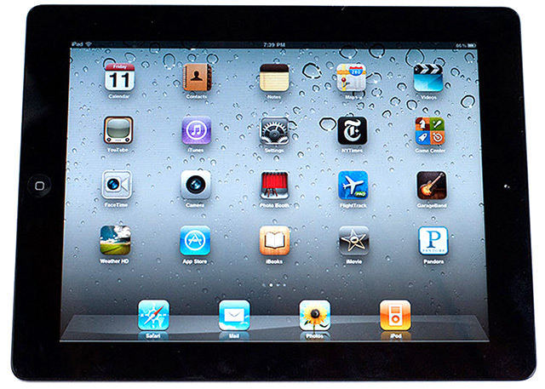
Technical Considerations
The tutorial should function properly in as many technological environments as possible.
Make sure plugins are free
Conform to web video compression guidelines
Locate and maintain enough server space
Test on multiple browsers and devices
Watch file types

Slide 25
Results PART 2

Slide 26
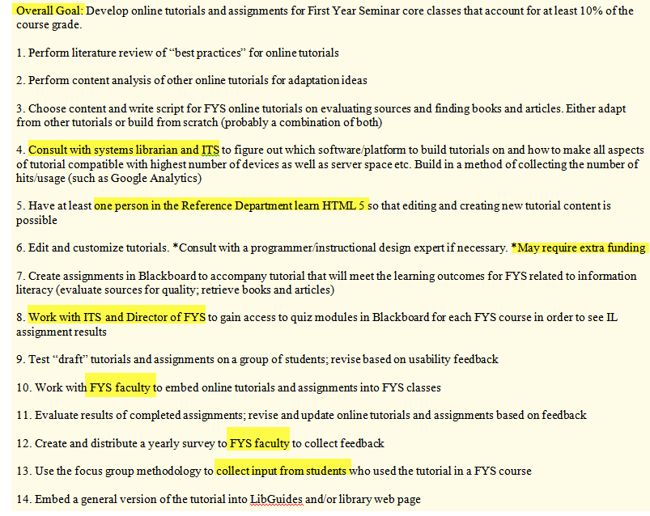
Planning
Advance planning is essential when developing online tutorials. Tutorials are difficult to overhaul once they are finished.
Identify all stakeholders early on
Create a team/committee
Verify funding sources
Verify the selected technology
Develop learning outcomes
Use storyboards for organization and outlining

Slide 27
Planning
Advance planning is essential when developing online tutorials. Tutorials are difficult to overhaul once they are finished.
Identify all stakeholders early on
Create a team/committee
Verify funding sources
Verify the selected technology
Develop learning outcomes
Use storyboards for organization and outlining

Slide 28
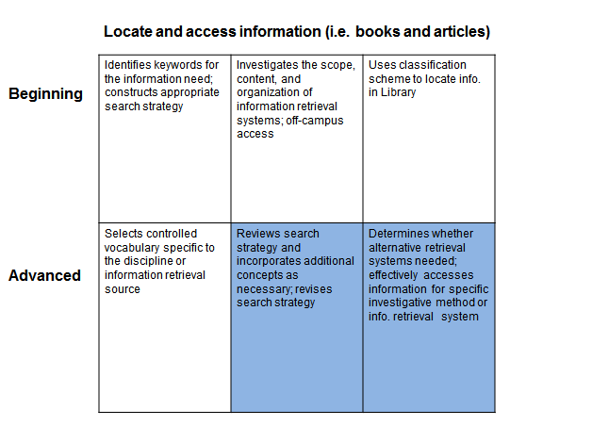
Planning
Advance planning is essential when developing online tutorials. Tutorials are difficult to overhaul once they are finished.
Identify all stakeholders early on
Create a team/committee
Verify funding sources
Verify the selected technology
Develop learning outcomes
Use storyboards for organization and outlining

Slide 29
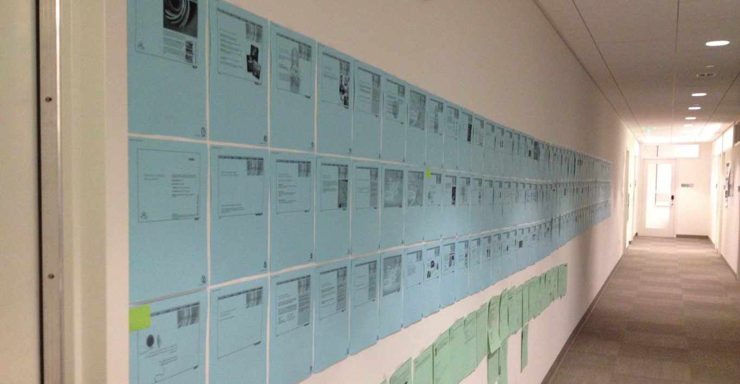
Planning
Advance planning is essential when developing online tutorials. Tutorials are difficult to overhaul once they are finished.
Identify all stakeholders early on
Create a team/committee
Verify funding sources
Verify the selected technology
Develop learning outcomes
Use storyboards for organization and outlining

Slide 30
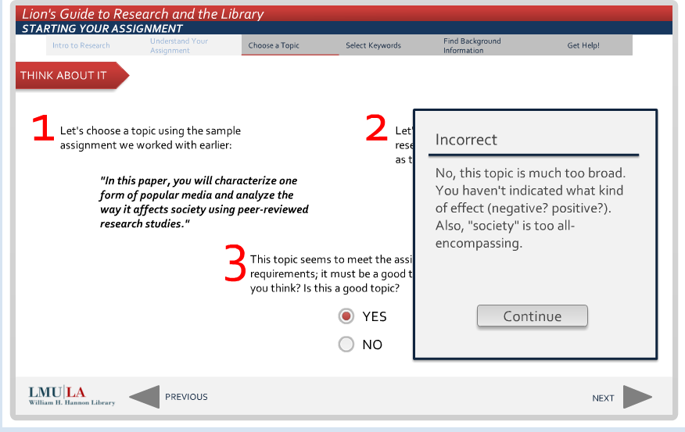
Embedding Communication
Embed multiple forms of communication within the tutorial. This can range from getting help, to providing feedback on the tutorial, to commenting publicly.
Provide feedback for learning
Embed help within tutorial
Solicit usability feedback
Let users leave tips

Slide 31
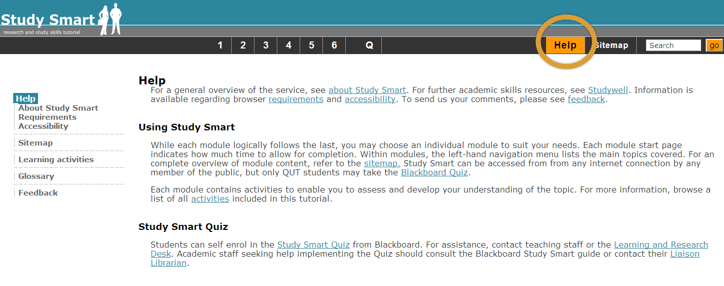
Embedding Communication
Embed multiple forms of communication within the tutorial. This can range from getting help, to providing feedback on the tutorial, to commenting publicly.
Provide feedback for learning
Embed help within tutorial
Solicit usability feedback
Let users leave tips

Slide 32
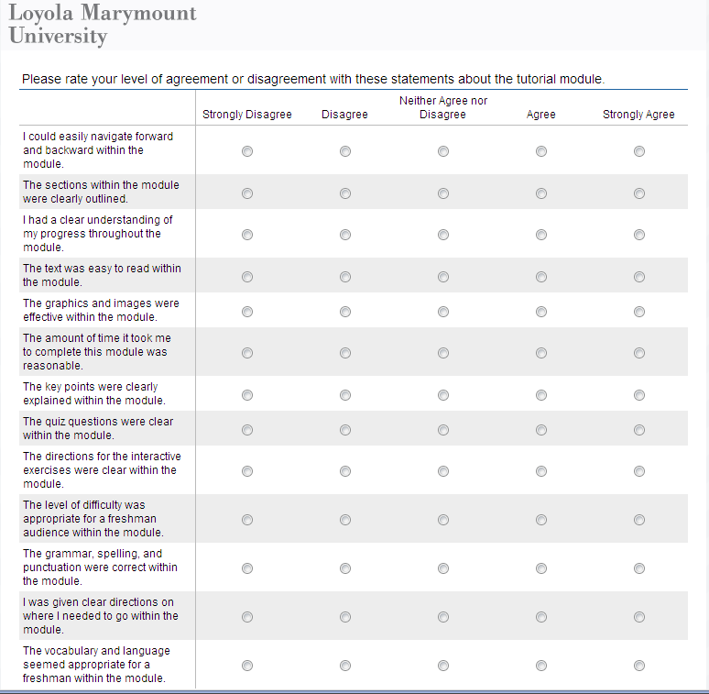
Embedding Communication
Embed multiple forms of communication within the tutorial. This can range from getting help, to providing feedback on the tutorial, to commenting publicly.
Provide feedback for learning
Embed help within tutorial
Solicit usability feedback
Let users leave tips

Slide 33
Embedding Communication
Embed multiple forms of communication within the tutorial. This can range from getting help, to providing feedback on the tutorial, to commenting publicly.
Provide feedback for learning
Embed help within tutorial
Solicit usability feedback
Let users leave tips

Slide 34
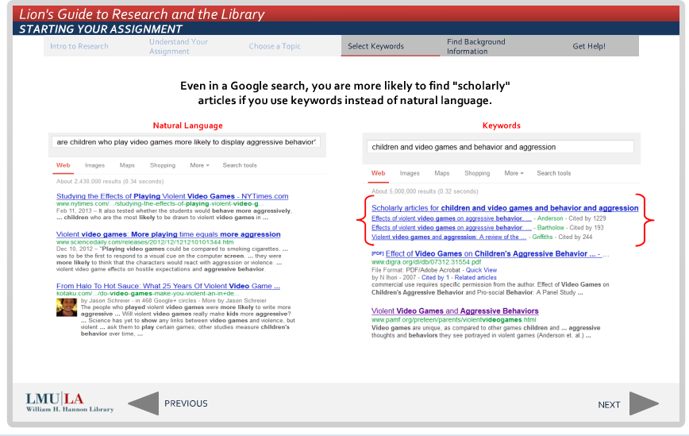
Instruction
The basic principles of good library instruction in F-2-F environments are transferrable to online tutorials.
Teach concepts, not mechanics
Offer multiple examples in different contexts
User metaphors and analogies
Promote critical thinking
Personalize the experience

Slide 35
Instruction
The basic principles of good library instruction in F-2-F environments are transferrable to online tutorials.
Teach concepts, not mechanics
Offer multiple examples in different contexts
User metaphors and analogies
Promote critical thinking
Personalize the experience

Slide 36
Instruction
The basic principles of good library instruction in F-2-F environments are transferrable to online tutorials.
Teach concepts, not mechanics
Offer multiple examples in different contexts
User metaphors and analogies
Promote critical thinking
Personalize the experience

Slide 37
Instruction
The basic principles of good library instruction in F-2-F environments are transferrable to online tutorials.
Teach concepts, not mechanics
Offer multiple examples in different contexts
User metaphors and analogies
Promote critical thinking
Personalize the experience

Slide 38
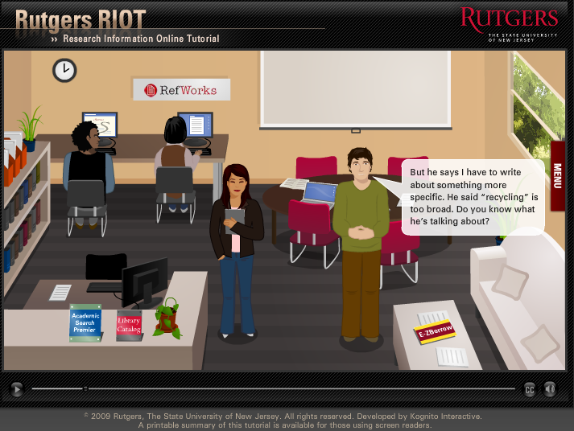
Instruction
The basic principles of good library instruction in F-2-F environments are transferrable to online tutorials.
Teach concepts, not mechanics
Offer multiple examples in different contexts
User metaphors and analogies
Promote critical thinking
Personalize the experience

Slide 39
Assessment
When including tests in an online tutorial, it is important to follow best practices for construction of test questions in order to have the greatest impact on learning.
True/False question rules
Multiple choice question rules
Matching item rules
Avoid using negatives

Slide 40
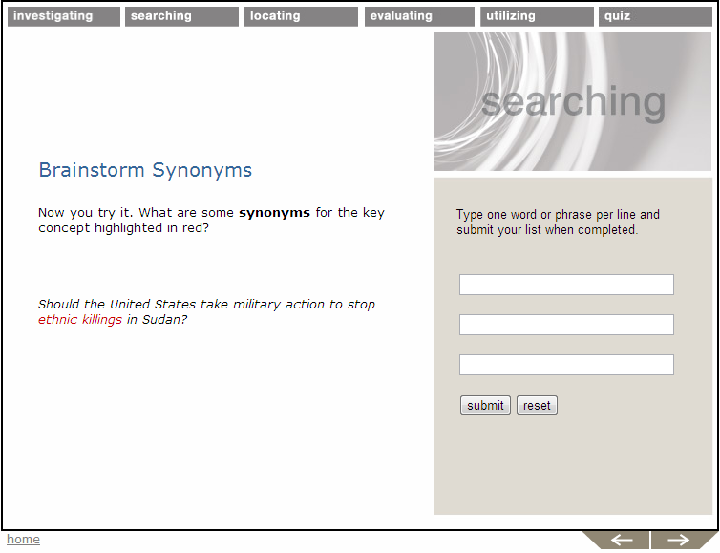
Active Learning
Tutorials should include interactive exercises such as simulations or quizzes.
Free text or fill-in-the-blank
Mouse-over or “click on”
Drag and drop
Hot spots
Simulation/Guided search
Multiple choice or True/False
Short videos or screen captures

Slide 41
Active Learning
Tutorials should include interactive exercises such as simulations or quizzes.
Free text or fill-in-the-blank
Mouse-over or “click on”
Drag and drop
Hot spots
Simulation/Guided search
Multiple choice or True/False
Short videos or screen captures

Slide 42
Active Learning
Tutorials should include interactive exercises such as simulations or quizzes.
Free text or fill-in-the-blank
Mouse-over or “click on”
Drag and drop
Hot spots
Simulation/Guided search
Multiple choice or True/False
Short videos or screen captures

Slide 43
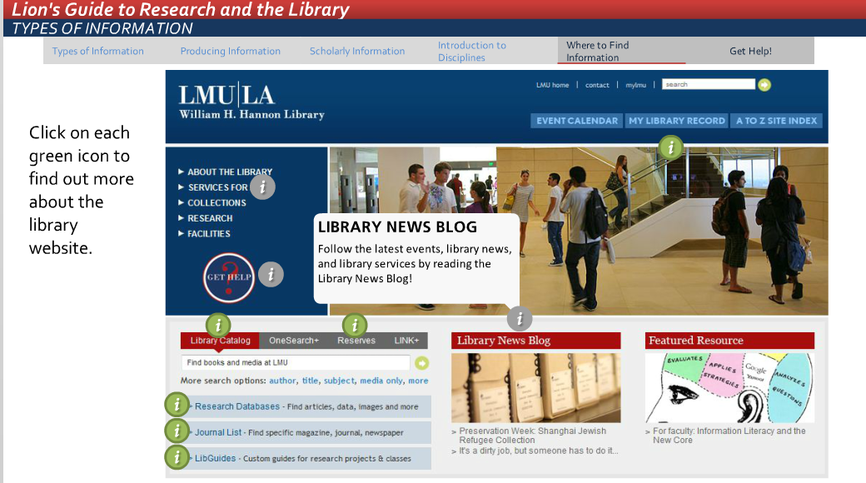
Active Learning
Tutorials should include interactive exercises such as simulations or quizzes.
Free text or fill-in-the-blank
Mouse-over or “click on”
Drag and drop
Hot spots
Simulation/Guided search
Multiple choice or True/False
Short videos or screen captures

Slide 44
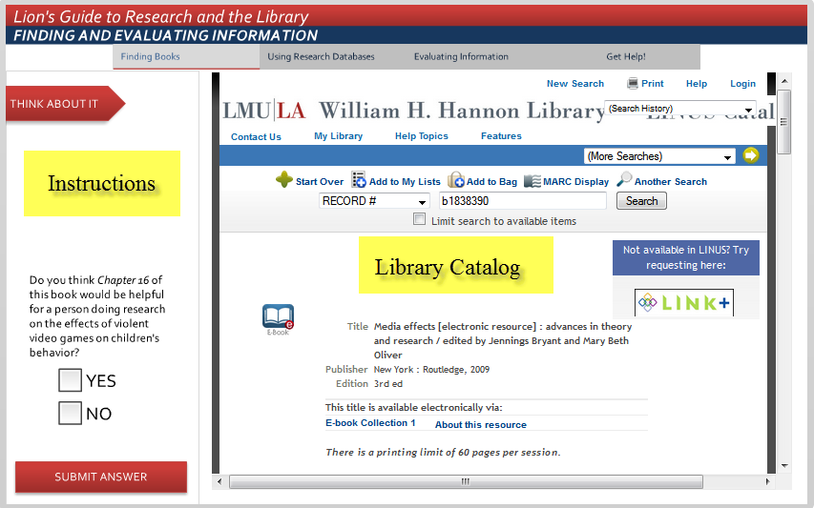
Active Learning
Tutorials should include interactive exercises such as simulations or quizzes.
Free text or fill-in-the-blank
Mouse-over or “click on”
Drag and drop
Hot spots
Simulation/Guided search
Multiple choice or True/False
Short videos or screen captures

Slide 45
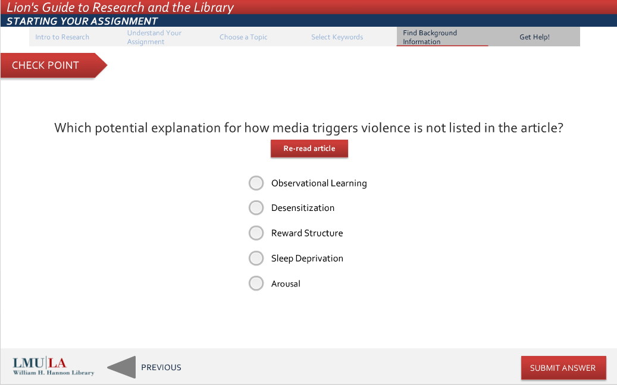
Active Learning
Tutorials should include interactive exercises such as simulations or quizzes.
Free text or fill-in-the-blank
Mouse-over or “click on”
Drag and drop
Hot spots
Simulation/Guided search
Multiple choice or True/False
Short videos or screen captures

Slide 46
Active Learning
Tutorials should include interactive exercises such as simulations or quizzes.
Free text or fill-in-the-blank
Mouse-over or “click on”
Drag and drop
Hot spots
Simulation/Guided search
Multiple choice or True/False
Short videos or screen captures

Slide 47
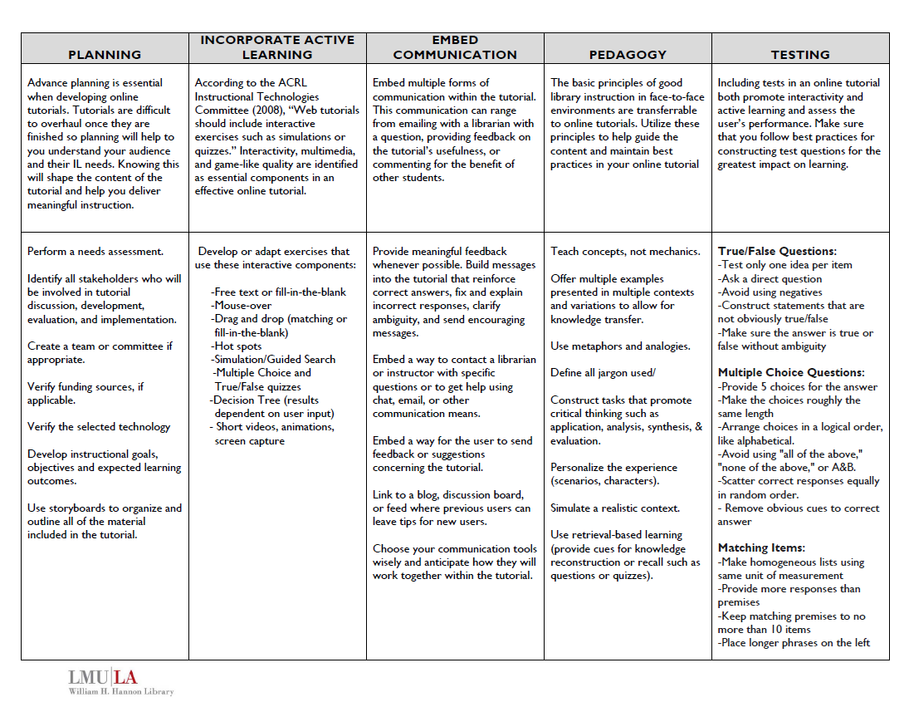
Summary: Design Tips for Visual & Technical Elements
TEACHING IN
AN ONLINE
ENVIRONMENT

Slide 48
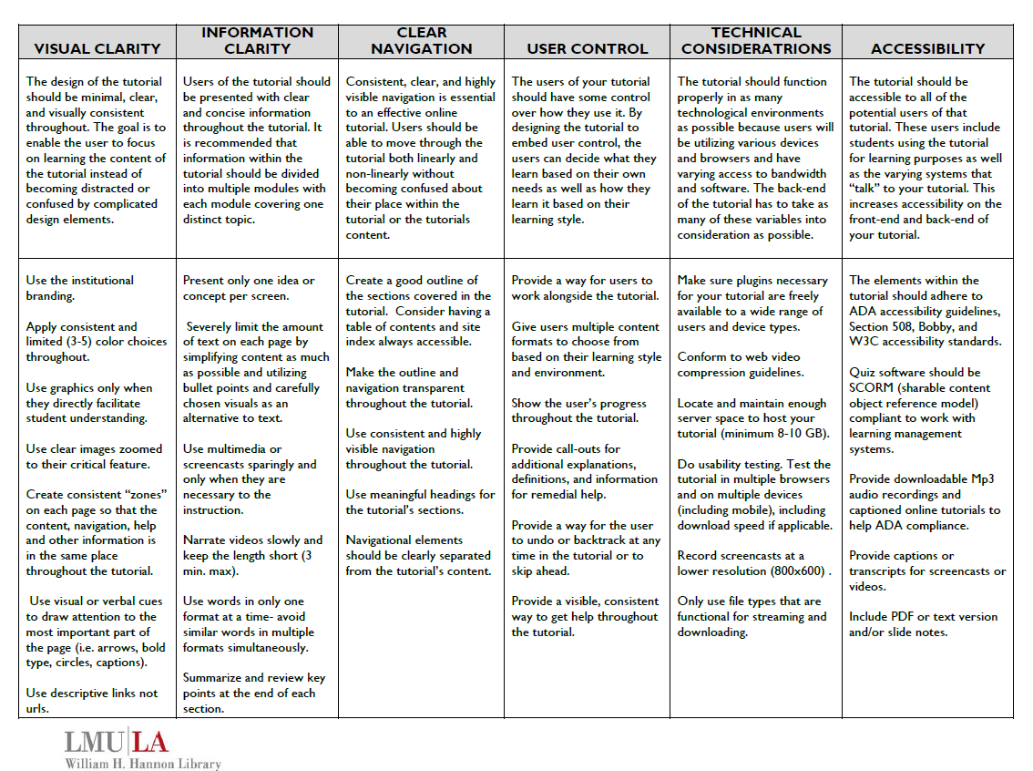
Summary: Best Pedagogical Practices in Online Instruction
TEACHING IN
AN ONLINE
ENVIRONMENT

Slide 49
Tutorial Credits
Above and Beyond | University of Leeds | Slide 6
Information Literacy tutorial | University of Idaho | Slide 5
Lion’s Guide to Research and the Library | Loyola Marymount University | Slides 7,8,12,13,14,22,30,33,34,35,36,37,41,42,43,44,45,46
RIOT (Research Information Online Tutorial) | Rutgers University | Slides 5,38

Slide 50
Tutorial Credits
Study Smart | Queensland University of Technology | Slides 19,20,32
The Information Process | University of California, Irvine | Slides 9,11,21
The Skunk Ape Tutorial | Florida Gulf Coast University | Slide 18
Tutorial of Info Power (TIP) | University of Wyoming | Slides 10,15,16,17,40

Slide 51
Bibliography (pt.1)
Appelt, K.M. & Pendell, K. (2010). Assess and invest: Faculty feedback on library tutorials. College & Research Libraries, 71(3), 245-253.
Blummer, B. A., & Kritskaya, O. (2009). Best practices for creating an online tutorial: A literature review. Journal of Web Librarianship, 3(3), 199-216.
Bowles-Terry, M., Hensley, M.K., & Hinchliffe, L. (2010). Best practices for online video tutorials: A study of student preferences and understanding. Communications in Information Literacy, 4(1), 17-28.
Bradley, C., & Romane, L. (2007). Changing the tire instead of reinventing the wheel: Customizing an existing online information literacy tutorial. College & Undergraduate Libraries, 14(4), 73-86.
Breitbach, A.P. (2010). Creating effective multiple choice items. Athletic Therapy Today 18-22.
Conderman, G. & Koroghlanian, C. (2002). Writing test questions like a pro. Intervention in School and Clinic, 38(2), 83-87.

Slide 52
Bibliography (pt.2)
Dewald,N.H.(1999) Transporting good library instruction practices into the web environment: An analysis of online tutorials. The Journal of Academic Librarianship, 25(1), 26-31.
Ganster, L. A., & Walsh, T. R. (2008). Enhancing library instruction to undergraduates: Incorporating online tutorials into the curriculum. College & Undergraduate Libraries, 15(3), 314-333.
Karpicke, J.D. (2012). Retrieval-based learning: active retrieval promotes meaningful learning. Current Directions in Psychological Science, 21(3), 157-163.
Lo, L. S., & Dale, J. M. (2009). Information literacy “learning” via online tutorials: A collaboration between subject specialist and instructional design librarian. Journal of Library & Information Services in Distance Learning, 3(3), 148-158.
Mehlenbacher, B, et al. Usable e-learning: A conceptual model for evaluation and design. Proceedings of the HCI International 2005: 11th International Conference on Human-Computer Interaction Volume 4- Theories, Models, and Processes. Las Vegas, NV. Retrieved from http://www4.ncsu.edu/~brad_m/research/elearning05.pdf
Mestre, L.S. (2012) Student preference for tutorial design: a usability study. Reference Services Review, 40(2), 258 -276.

Slide 53
Bibliography (pt.3)
Nielsen, J. (1994). Enhancing the explanatory power of usability heuristics. Proceedings of the SIGCHI Conference on Human Factors in Computing Systems: Celebrating interdependence, April 24-28, 1994, Boston, Massachusetts. Retrieved from http://www.cs.helsinki.fi/u/salaakso/kl2-2002/lahteet/Nielsen94-Enhancing-Heuristics.pdf
Nielsen, J. (2005). Ten usability heuristics for user interface design. Retrieved from http://www.useit.com/papers/heuristic/heuristic_list.html
Oud, J. (2009). Guidelines for effective online instruction using multimedia screencasts. Reference Services Review, 37(2), 164-177.
Plumb, T. K. (2010). Creating electronic tutorials: On your mark, get set, go! Journal of Electronic Resources Librarianship, 22(1), 49-64.
Reece, G. J. (2005). Critical thinking and cognitive transfer: Implications for the development of online information literacy tutorials. Research Strategies, 20(4), 482-493.
Roberts, G. (2003). The yin and yang of integrating TILT with blackboard. Computers in Libraries, 23(8), 10-56.

Slide 54
Bibliography (pt.4)
Somoza-Fernandez, M, & Abadal, E. (2009). Analysis of web-based tutorials created by academic libraries. Journal of Academic Librarianship, 35(2), 126-131.
Su, S. & Kuo, J. (2010). Design and development of web-based information literacy tutorials. Journal of Academic Librarianship, 36(4), 320-328.
Thornes, S. L. (2012). Creating an online tutorial to support information literacy and academic skills development. Journal of Information Literacy, 6(1), 82-95.
Tognazzini, B (2003). First principles of interaction design. Retrieved from http://www.asktog.com/basics/firstPrinciples.html
Tronstad, B., Phillips, L., Garcia, J., & Harlow, M. A. (2009). Assessing the TIP online information literacy tutorial. Reference Services Review, 37(1), 54-64.
Yang, S. (2009). Information literacy online tutorials: An introduction to rationale and technological tools in tutorial creation. Electronic Library, 27(4), 684-693.
Zhang, L. (2006) Effectively incorporating instructional media into web-based information literacy. Electronic Library, 24(3), 294-306.

Slide 55
Acknowledgements
Thank you:
Lindsey McLean
William H. Hannon Library Research Incentive Travel Grant

Slide 56
Questions?
Contact:
SUSAN [GARDNER] ARCHAMBAULT
Head of Reference & Instruction
William H. Hannon Library
Loyola Marymount University
susan.gardner@lmu.edu
Presentation Slides: bit.ly/close_encounters

