Slide 1
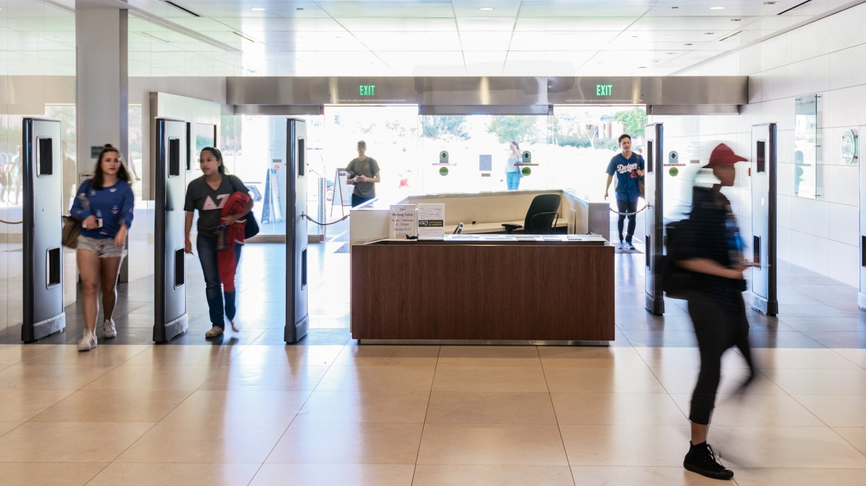
Forget Gate Counts
John Jackson
@johnxlibris @lmulibrary
Assessing Transformative Programming
Notes:
Hi, my name is John Jackson. I am the Outreach and Communications librarian for the William H. Hannon library at Loyola Marymount University in Los Angeles. This is a relatively new position for me. Before working in outreach full-time, I was an instruction librarian. My background in library school focused on instructional design and information literacy. When I graduated from San Jose State back in 2012, I was confident that what I would be doing for the next 10-15 years would be done in front of a classroom teaching undergraduates. Life didn’t turn out that way. I live not too far from the campus of Loyola Marymount University and I’ve long admired the work that the William H. Hannon Library did, especially with regard to its Jesuit mission of educating the whole person and the promotion of faith and justice. I’m not a particularly religious person myself, but I admired the way that LMU and, in particular the library, seamlessly melded its mission, its collections, and its programming. So when the job of “Outreach and Communications Librarian” opened up, I jumped on the opportunity to throw my hat in the ring. One year later, here I am. And I want to talk today about how we’ve applied a framework of instruction assessment to library programming.

Slide 2
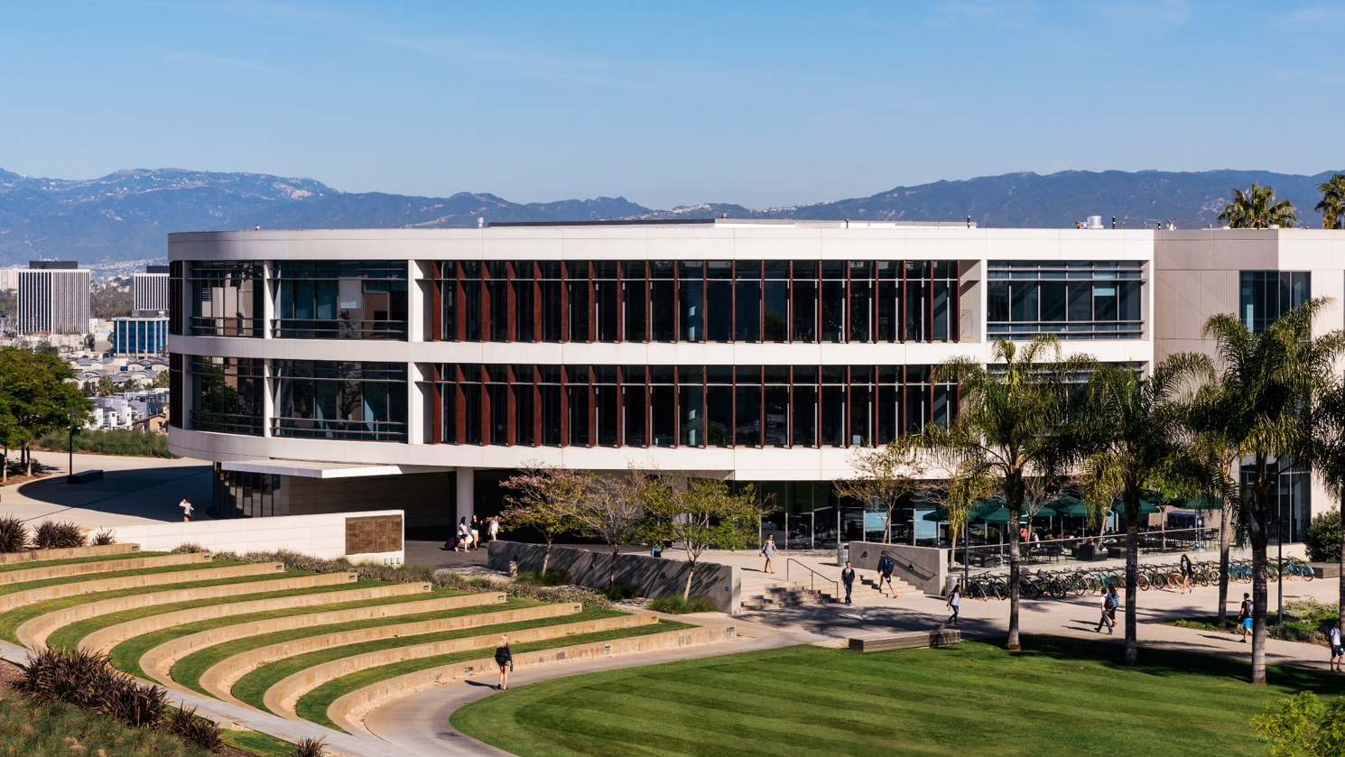
About WHHL & LMU
Notes:
The campus of LMU is located in West L.A. not too far from the LAX airport. It currently enrolls approximately 6,000 undergraduates and 2,000 graduates (not including its Law School campus) and offers 57 undergraduate majors, 43 masters degrees, and one education doctorate. Our curricular strengths include the liberal arts, fine arts, education, and film and television.
We are a single-library campus, housing more than half a million volumes, not including our archival or digital collections, and operated by 24 librarians and 29 paraprofessional staff. We are open 24 hours a day for 5 days a week, limited hours on the weekend, and receive on average about 625,000 visitors a year. Our total annual expenditures including operating, capital, and personnel expenses are just under $10 million dollars.
We are a relatively new building, the second newest building on campus having been built in 2009 and we are strategically located at a central hub of campus traffic. We also have a Starbucks.

Slide 3
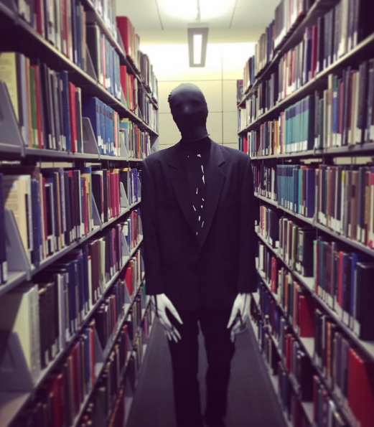
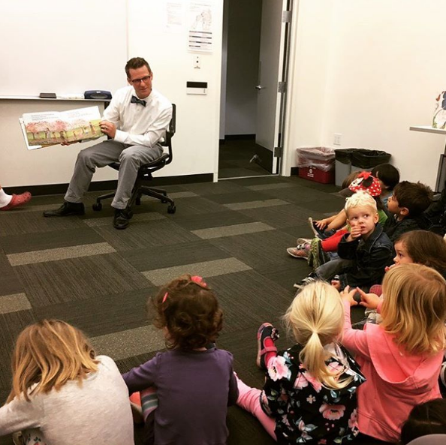
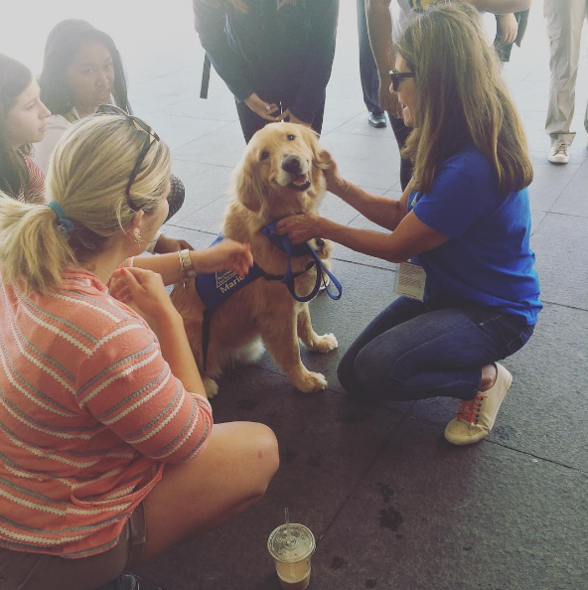
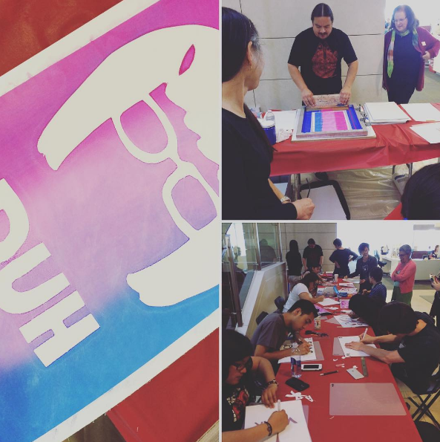
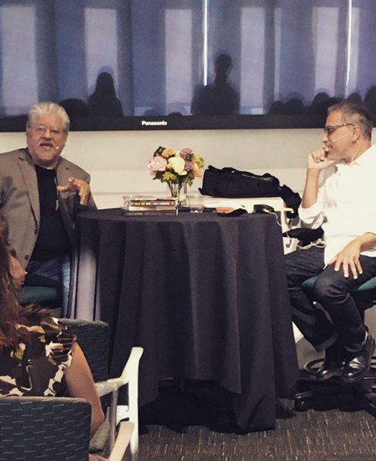
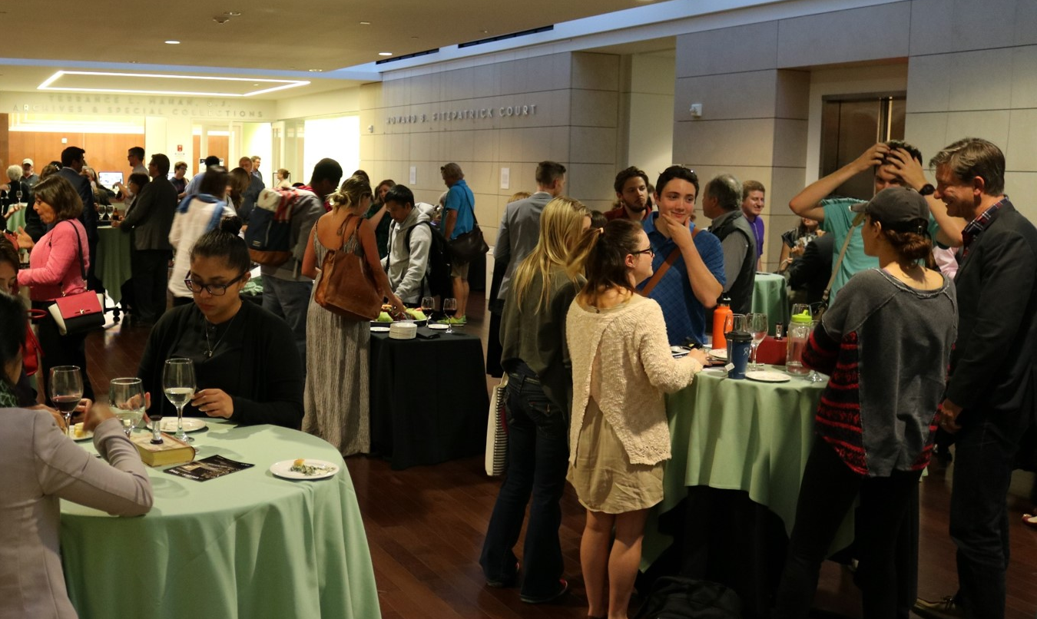
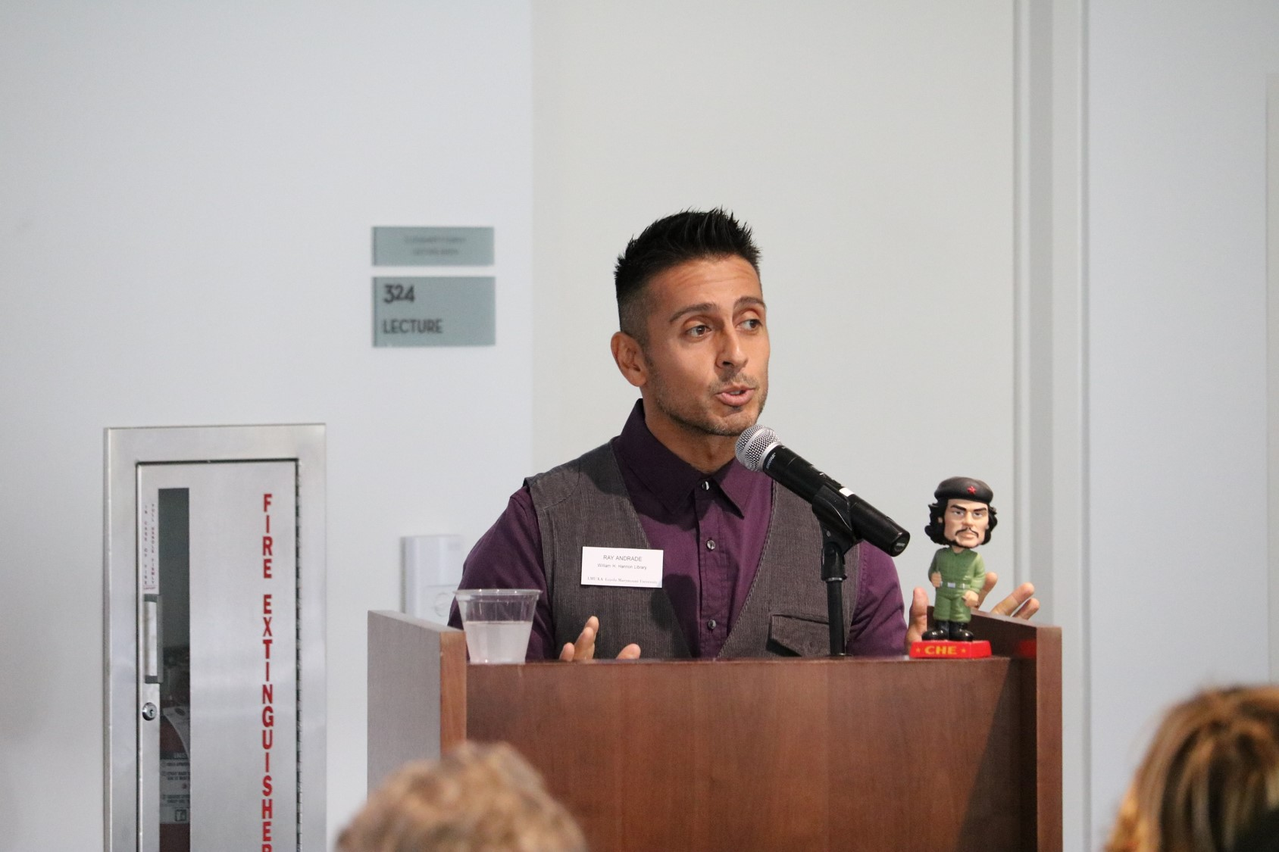
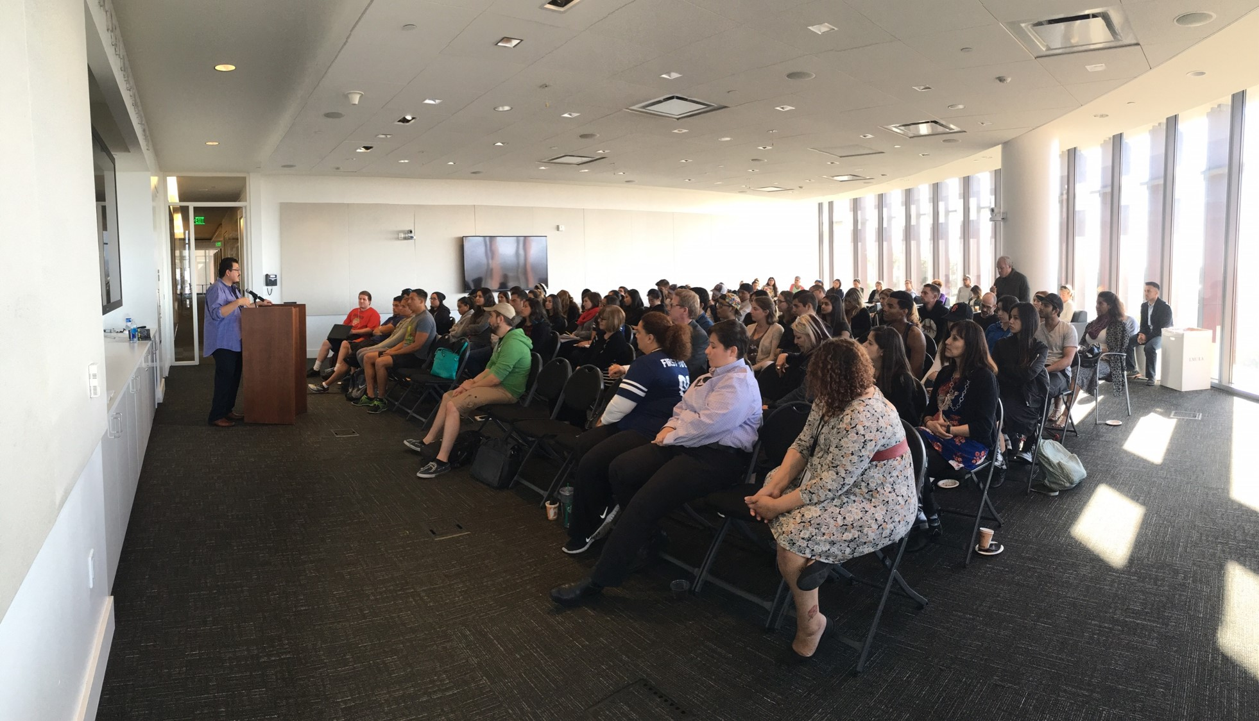
Type of Programming We Do
Notes:
We host between 45-50 public programs a year, bringing in approximately 4,000 students, staff, faculty, and community members into library spaces. These programs are wide-ranging in their format and appeal: Haunting of Hannon, storytime for the local on-campus pre-school, therapy dogs during finals, in-house art workshops, author talks, exhibition receptions, our faculty pub night series, and so on. Our level of leadership in these programs often varies depending on who are partners may be, how many partners we are working with, etc. but for each we provide at least some strategic, operational, or financial support to make these programs happen.
For example, with our Faculty Pub Night series (some more about this), we are the sole coordinators, handling all aspects of the program: the call for speakers, selection process, promotion, catering, design of promotional material, etc. For other programs, like our conversation with Los Angeles poet laureate Luis Rodriguez during Banned Books week, we collaborated with the College of Fine Arts and split the workload down the middle. Last year alone, we collaborated with 43 unique partners to provide LMU students with rich and robust library programming. That’s almost one new partner for every event!
Many of our programs are planned 6-8 months out. A few of our annual programs are planned up to a year in advance. And so, we have the opportunity in many cases to really think about assessment. However, like many librarians, I also wear other hats, including collection development and subject liaison duties, reference desk hours, and (when called upon) instruction. The outreach and programming team at LMU is made up of two full-time librarians, one full-time staff, and a gaggle of on-call student ambassadors.

Slide 4
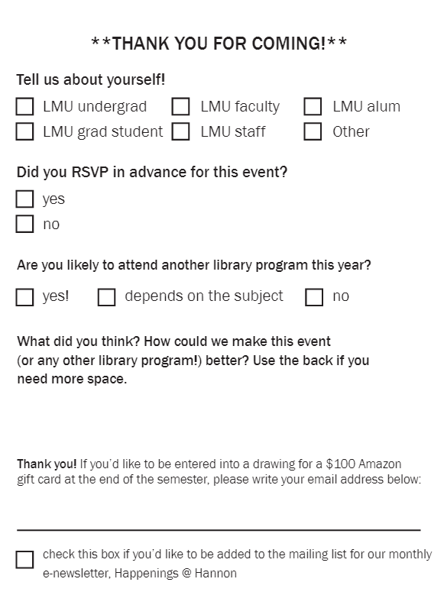
How We Used to Collect Feedback
Notes:
This is how we used to collect feedback. This was our default form for almost every event regardless of whether it was a traditional lecture or if it was a “feel good” event like our Finals Milk & Cookies event. The benefits of using a form like this should be pretty obvious:
Brief: most of the attendees to our events are students and, like many students, tend to bolt once the event is over so they can get to class or practice or their chapter meetings or whatever. Students are extremely busy people!
Easy to duplicate and prepare: this fits onto a quarter of an 8.5x11 sheet. We can easily print and cut a few hundred of these in just a few minutes. And they fit perfectly onto a seat.
Can be applied to any event: for the most part, you could use this form for any type of library programming: lecture, workshop, open house, etc.
So what are the problems with this form and why did we want to change it. Let’s take a look at each of these questions in turn. First of all, the demographic information is useful, but it does technically need to be at the end of the form. That’s standard survey practice 101. But this is information that we wanted to continue to collect so we decided to keep this question when we revised the form this last year.
But let’s look at the second question: did you RSVP for this event?
Not useful other than determining how well people (1) know our protocols or (2) actually read promo material.
Knowing that x% of our attendees RSVP’d in advance doesn’t help you to assess the quality of the event or the experience
Studied last 2 years of RSVP data: found a strong correlation between RSVP numbers and actual attendees (30% below or 20% over), but once that is known, there is no longer a need for this question
And then let’s look at the new question: are you likely to attend another library program? Almost all attendees said “yes” or “depends”. When you already have a robust programming schedule in place, neither response is all that helpful.
Finally, let’s look at the next question: What did you think? This is particularly problematic. It’s not specific. There is no context or framing of the question. And how could we make this better? Well, that’s when responses got interesting...

Slide 5
Results of Old Feedback Forms
Top three categories of responses:
About the event:
Great! Fantastic! Wonderful!
Great, great, great...
About the setup:
More food, too cold
About the communication:
More promotion
Notes:
So what type of feedback did we receive on this last question? The majority of responses fell into three primary categories:
1. About the event: almost always positive and almost always terse…
2. About the setup: you can never make everyone happy. We know to always offer gluten-free, vegetarian, sugar-free, and non-alcoholic options
3. More promotion. This response always struck me as odd. I wanted to ask these people: well, how did you get here? Word of mouth outreach is the most effective type of outreach on a college campus… better than emails, better than e-wom, better than flyers. If you can get faculty to spread the word amongst their colleagues and to their students, you are golden.
So, all that to say, the type of information we were getting from these feedback forms was consistent, but no longer useful to us, especially in determining whether or not an event was transformative…
I keep using this term “transformative.” What does that mean? How do you measure that? When I first started this job and saw that word in our strategic plan (quote!), my immediate thought was how we use strategic learning outcomes in library instruction to measure post-instructional or summative impact.

Slide 6
New Approach to Assessment at LMU Library
Developing Expected Learning Outcomes:
Be Specific (what will they learn, how will they feel, what behavior will change)
Measurable (preferably using no more than 2 questions or indicators)
Focus on what participants will do (rather than what event planners will do)
Notes:
So this past year, we’ve tried to take a more strategic approach to how we assess library programming. Being an instructional librarian by training, I default to developing student learning outcomes. Now, in the context of library instruction, usually the learning outcomes come first: you determine what you want the students to walk away with and then you design instruction around those objectives. But with library programming, that’s putting the cart before the horse. Often, we start with an idea for an event (or someone brings one to us) and so the learning outcomes come later. That said, it can feel a bit like forcing a square peg into a round hole, but here are some suggestions for making it work...

Slide 7
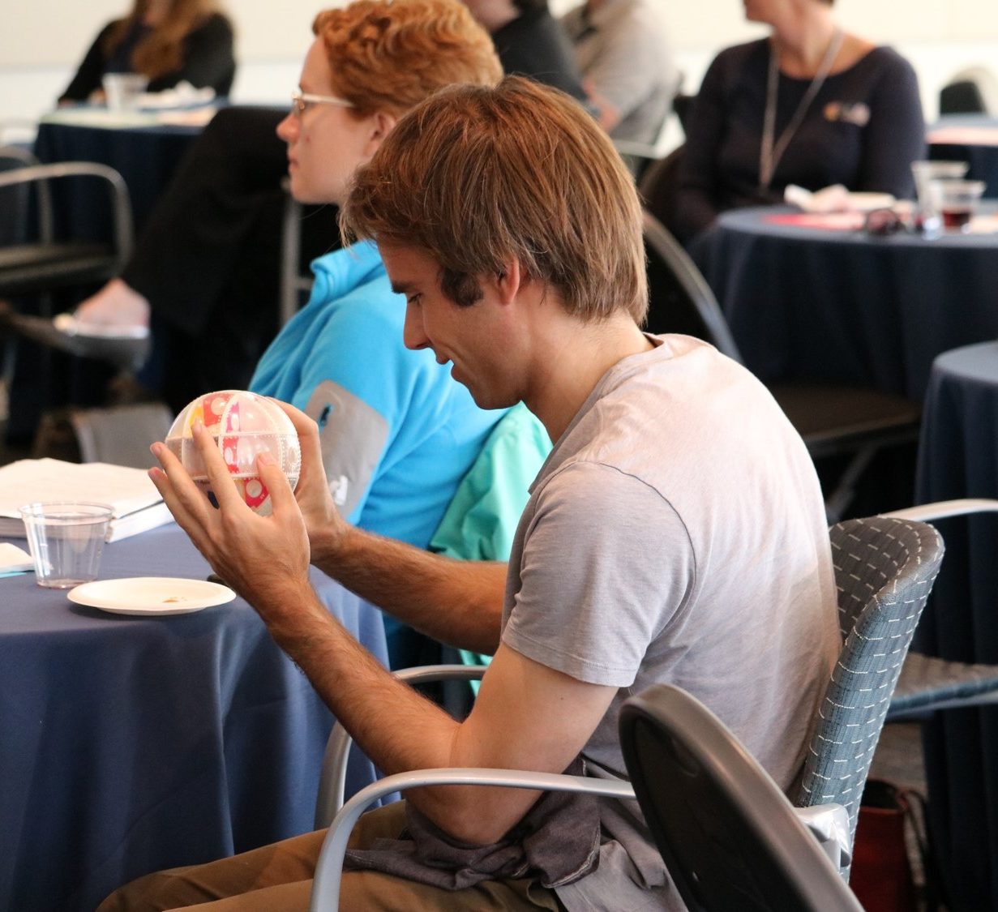
Pre-planning
What does “transformation” look like in a student/staff/faculty?
What conceptual/perceptual threshold(s) do we want attendees to cross?
When in doubt, consult Bloom’s taxonomy (and the verbs!)
Remembering (identify, recognize, select…)
Understanding (explain, discuss, express…)
Applying (use, produce, modify…)
Analyzing (compare, interpret, show…)
Evaluating (reconstruct, prepare, create…)
Creating (justify, defend, interpret…)
How are we going to measure this?
Notes:
What does transformation look like? We like to think not in terms of what information students will walk away with, but what perceptions will be changed, what threshold will be crossed, what biases may be confronted. When I’m not sure where to start, I like to pull out my copy of Blooms taxonomy and ask myself, “Am I addressing one level within the taxonomy (depends on your target audience). Or is my goal to move between categories? (e.g. from understanding to applying?)
Faculty Pub Night with Alissa Crans: understanding -> applying -> analyzing the mathematics of the KO labyrinth and apply that thinking to other objects
How are we going to measure this? As always, it depends (audience, resources, time, learning outcome)… but simply asking the question is half the battle. And so we have integrated this step into the planning process for most of our events at LMU Library.
So let me talk about two specific examples.

Slide 8
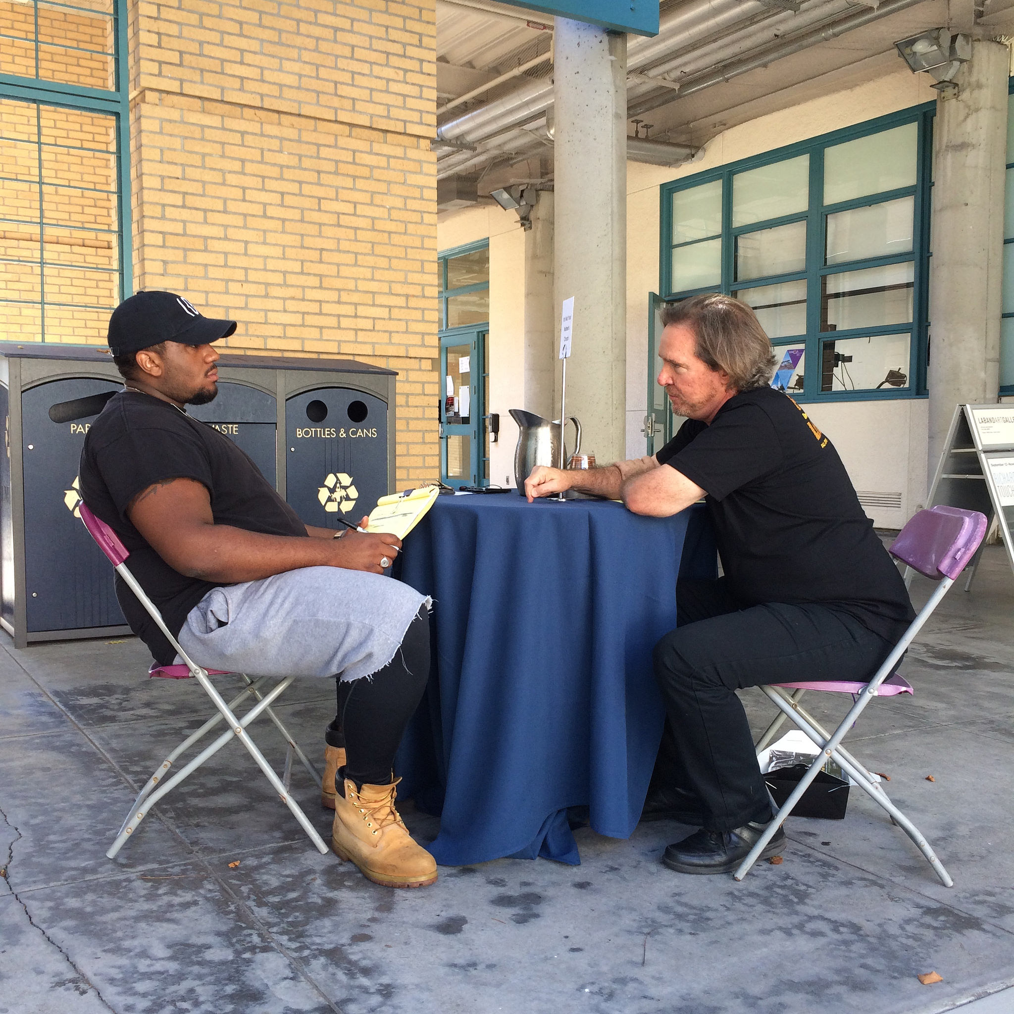
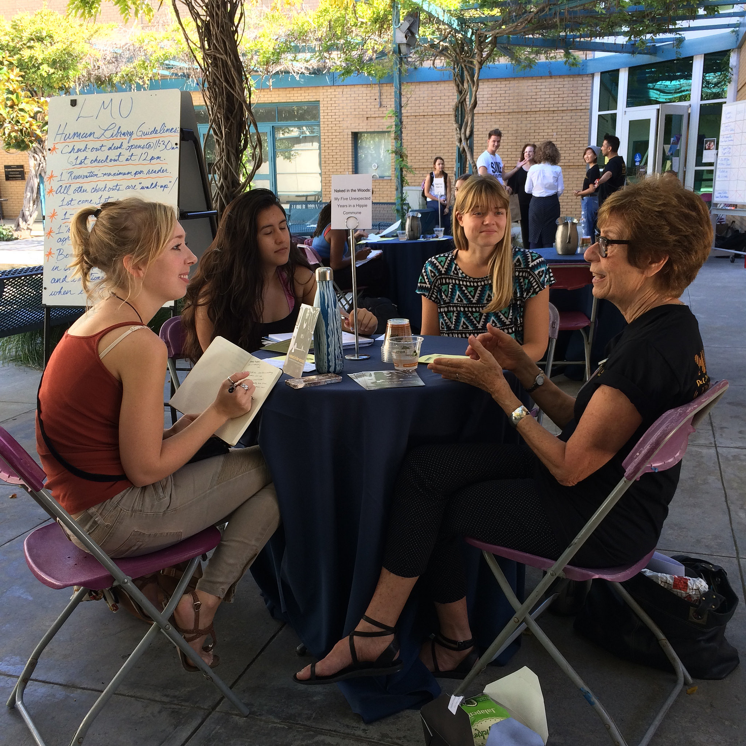
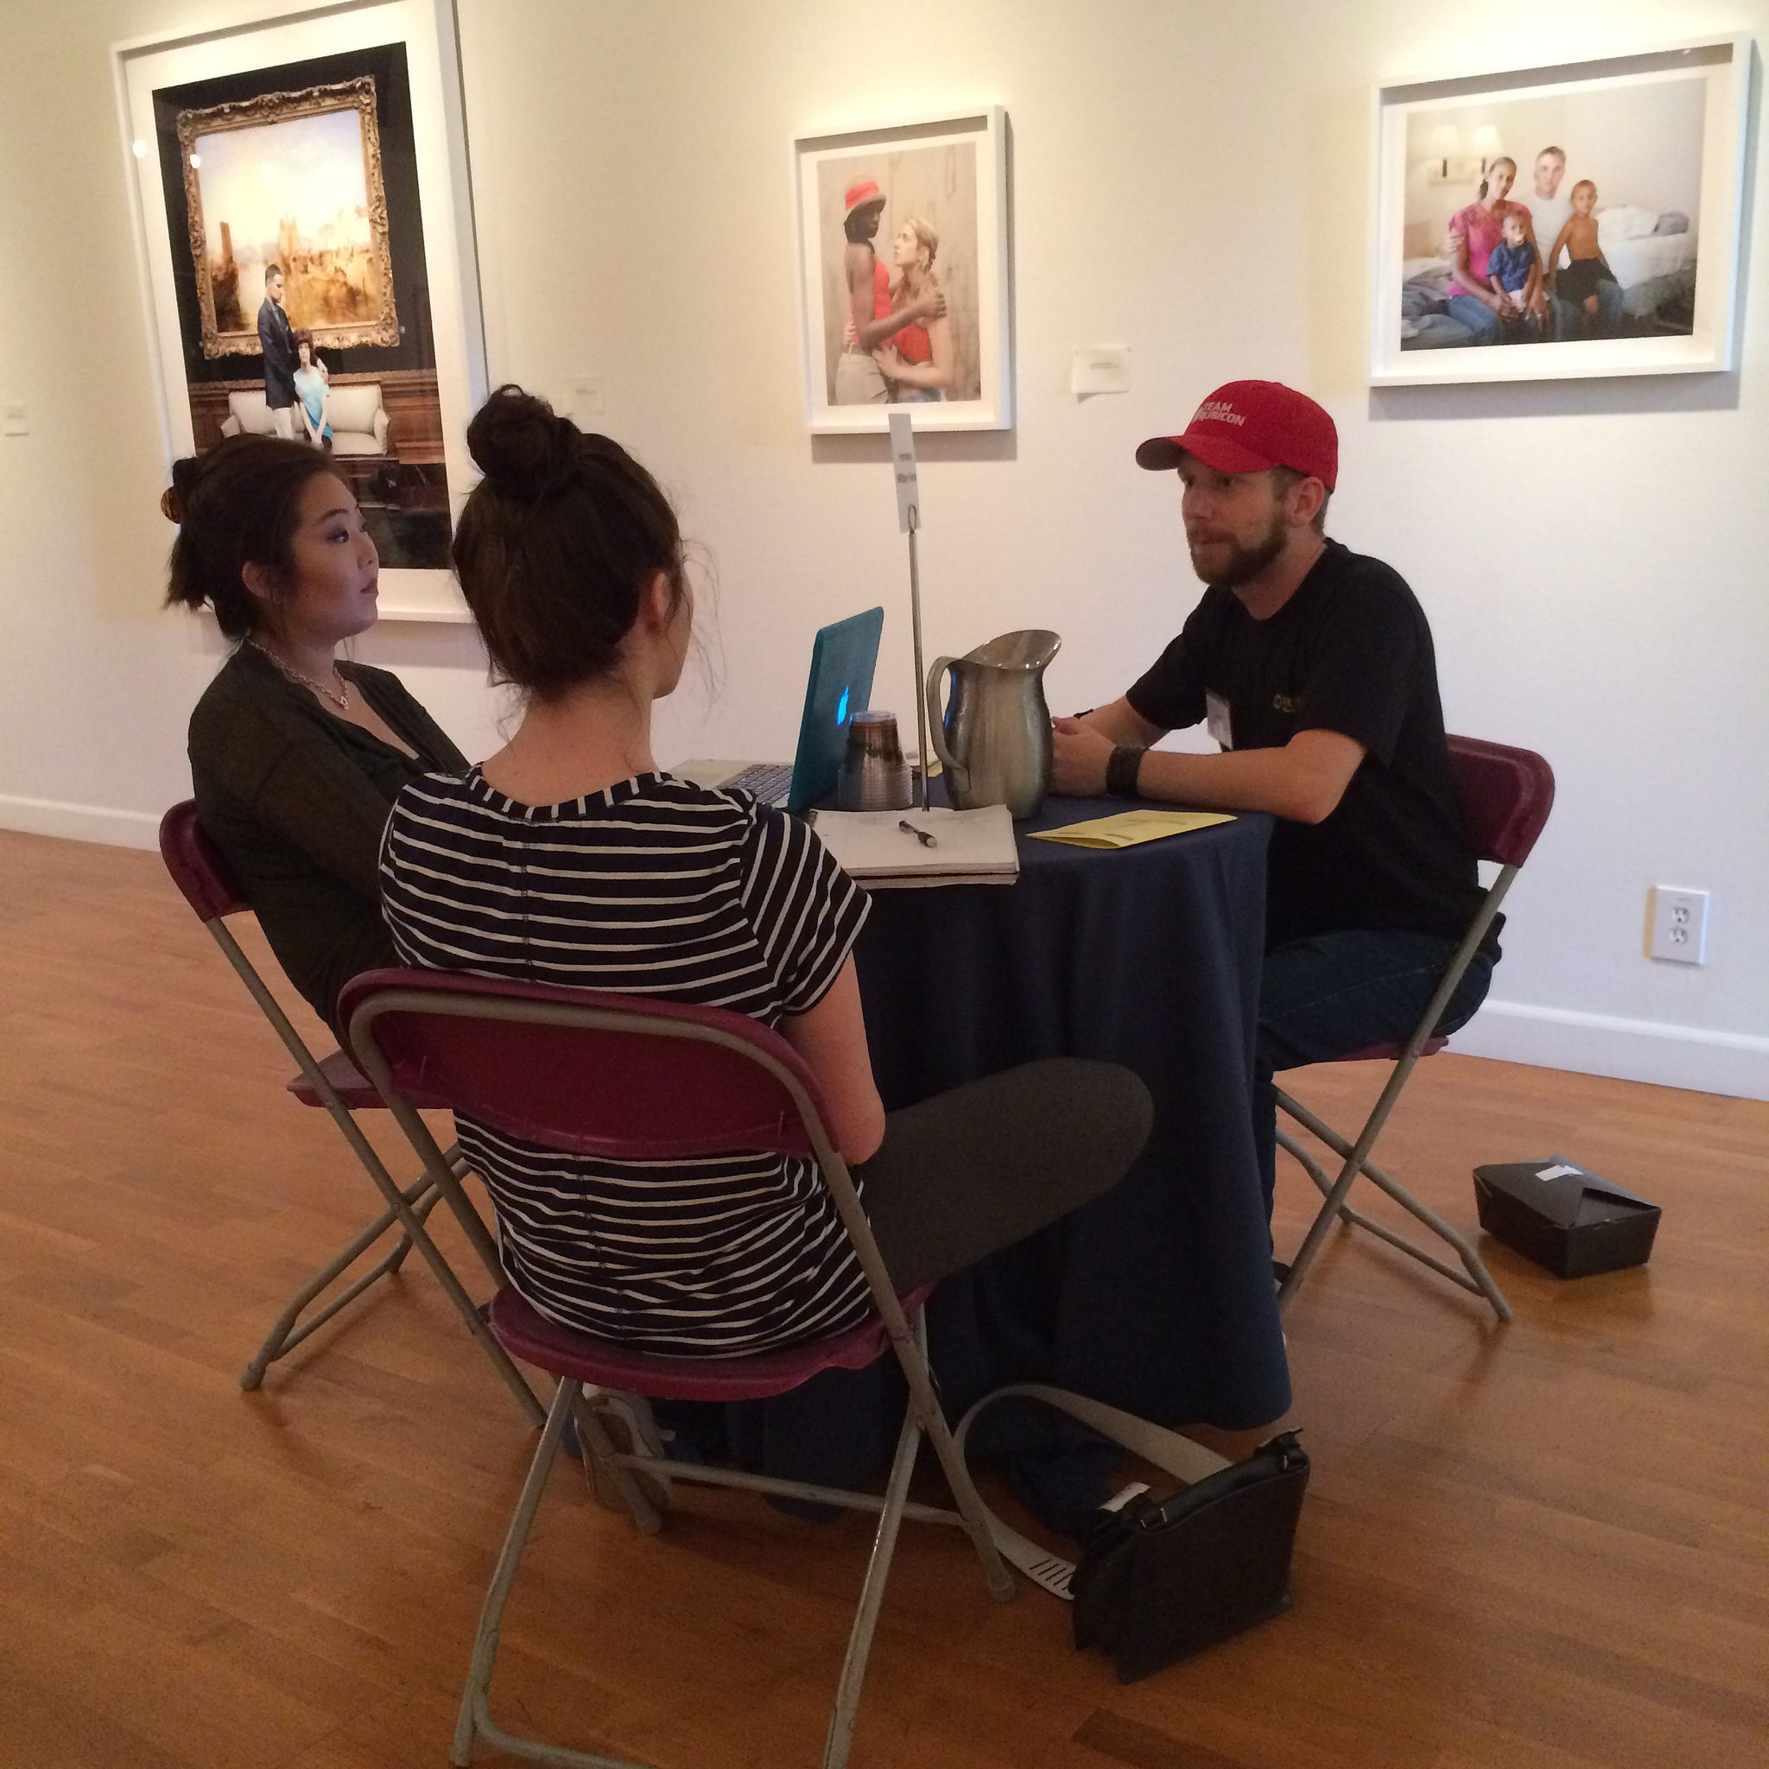
Human Library - About
Learning outcome: Participants will recognize and/or demonstrate the importance of conversation as a means to address issues of discrimination, prejudice, and stigma.
Notes:
Talk about what the Human Library is…
“As a means to” but also “in order to”
So, two possible indicators: (1) that students articulate a positive relationship between conversation and empathetic thinking and (2) that students actually walk away with a demonstrable change in perception

Slide 9
Human Library - Feedback Form
The Human Library is a good way to challenge discrimination, prejudice, or stigma. Do you agree? (Options: strongly agree, agree, undecided, disagree, strongly disagree)
Do you feel that you learned anything about discrimination, prejudice, or stigma today? Is so (or if not!), what did you learn?
Notes:
Recognize
Demonstrate

Slide 10
Human Library - Results
94% “agree” or “strongly agree” that the Human Library is a good way to challenge discrimination, prejudice, or stigma.
Do you feel that you learned anything about discrimination, prejudice, or stigma today? Is so (or if not!), what did you learn?
“In my conversation with the Ishimotos we discussed how strangers have preconceived notions of who or what he ought to be like as a blind man. I think our conversations today helped challenge those stigmas.”
“Definitely, I often think of religion as being slightly constraining. Yet, Peter presented an open and all encompassing idea of what spirituality can be.”
“Yes, I learned that people are so much more than what they seem. It's beautiful to learn more about people.”
“I learned that everybody's story is different. The life-scripts are not the same for all people who might look the same or seem to have similar experiences.”
Notes:
Read slide

Slide 11
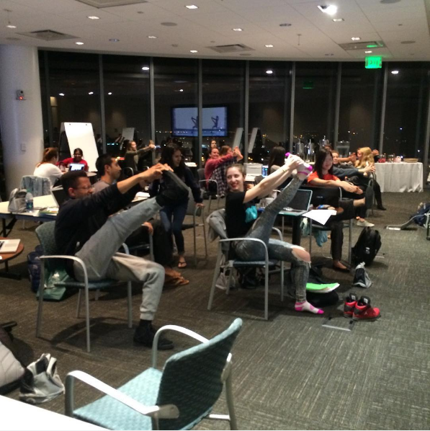
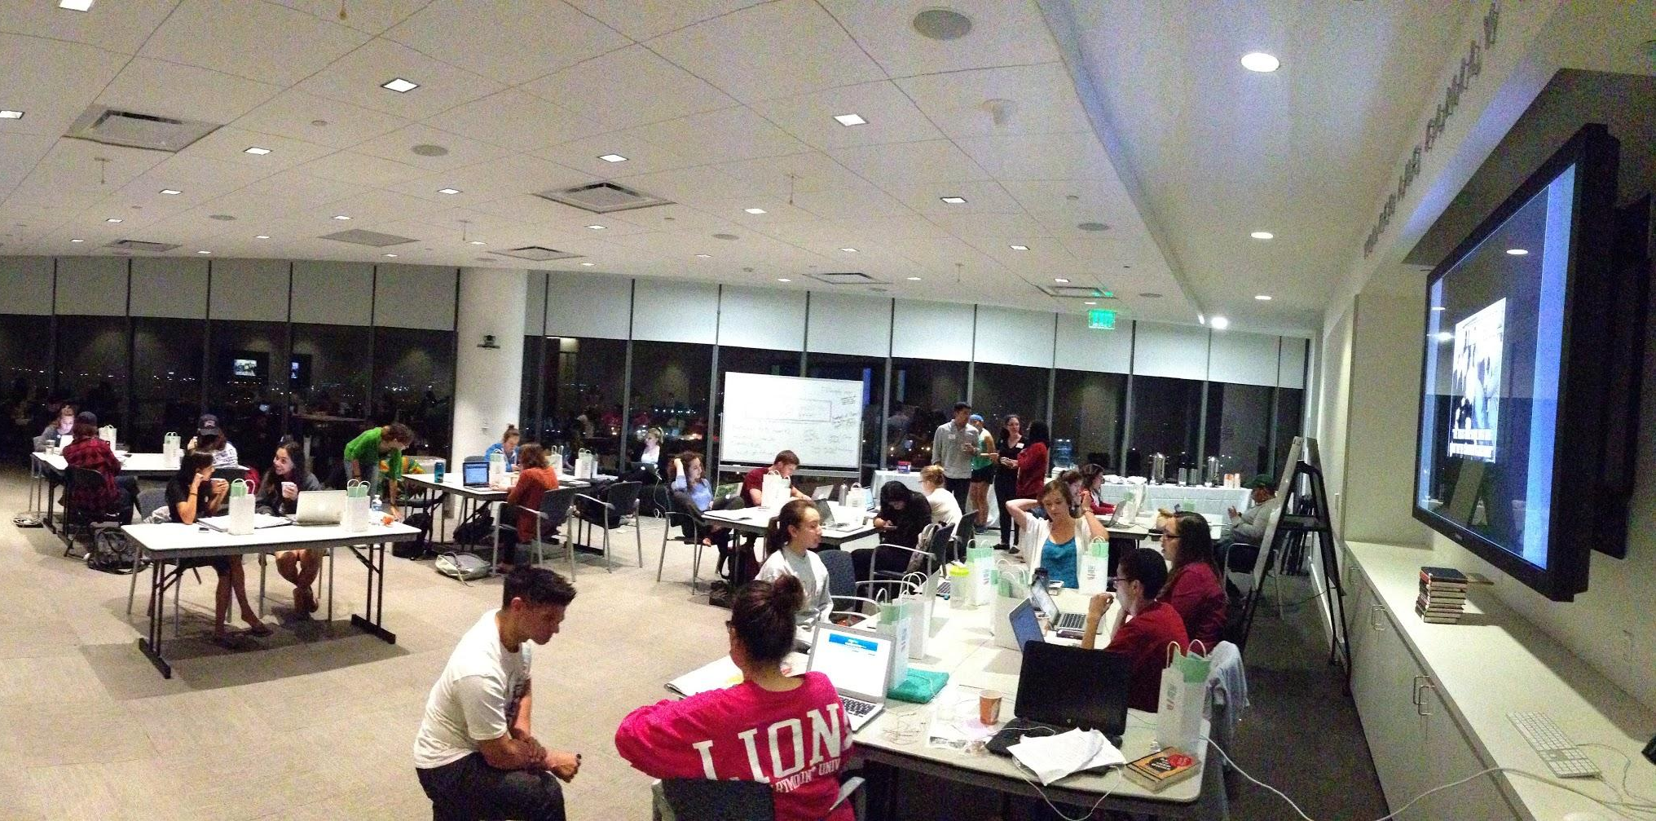
Long Night Against Procrastination - About
Learning outcome: Students will feel that they have made significant progress on their final projects and/or exam prep in a stress-free, fun environment.
Notes:
Talk about what LNAP is...
Measuring two-things…
1. Whether or not students make progress on their projects
2. Whether the atmosphere is anxiety reducing and/or fun

Slide 12
LNAP - Feedback Form
Please rate the following elements of the program: room layout, goody bags, research writing assistance, food, yoga break, cute animals break, bubble wrap, and more. (Options: Awful, Unsatisfactory, Satisfactory, Fantastic, Did Not Use)
What did you accomplish during the Long Night Against Procrastination?
Follow up: What was the best part about LNAP?

Slide 13
LNAP - Results
Of the 10 elements we asked students to rate, all but two were rated above a 3.5 (on scale 0-4). Writing Help and Research Help = 75% Did Not Use
What did you accomplish during the Long Night Against Procrastination?
Follow up: What was the best part about LNAP?
72% reported completing a project
“Sent my grad school documents to UPENN.”
“I finished my paper!”
“I completed the study guide for my Particle Dynamics final.”
“Six reflection papers!”
Top responses:
Study breaks: “Yoga is a fantastic idea, baby animals are great”
Atmosphere: “Being around 49 other productive people!”
Food: “All the food! So appreciated.”
Notes:
Review slide first…
If we had simply asked, “What did you think about the event” we would have probably only received responses like #3. By breaking the questions in two, we captured both types of responses (what they liked vs. what they did)
Going back to Bloom, this was a space for “synthesis” and “application” (we might also say “flow”), not a space necessarily for understanding or analyzing, so the lack of writing/research help is OK and expected.

Slide 14
Developing a Programming Rubric
1 - No evidence Shows no evidence of understanding/ comprehension. Denies any change in perception/ outlook | 2 - Little evidence Acknowledges some aspects of expected learning outcome (e.g. verbatim quotes from speaker, promo material) but without evidence of understanding/ change. | 3 - Some evidence Acknowledges some aspects of expected learning outcome and articulates in part the value/benefit of that knowledge. | 4 - Significant evidence Acknowledges aspects of of expected learning outcome and applies knowledge to other experiences, structures, subjects. Critically analyzes and applies experience. Articulates values of knowledge or change in perceptions. | N/A No response. Illegible response.
Notes:
Here is our current draft of a programming rubric that we use to analyze comments. At this stage, I am mostly using this to identify comments on our feedback forms that I can use in promotional materials and annual reports, but when it comes to a point when I need to consider possibly dropping a program, or increasing the amount of resources I put toward a project, this can be a helpful tool.
Determining the difference between 3 and 4 can be difficult. Full disclosure, I am the sole person responsible for assessing programming so this rubric is just something I use personally to assess our events, but if I would like to take this to the next level and work with another outreach/programming librarian to see if this could be used at another institution. Possibly do a fully-fledged study. So, there’s my pitch!

Slide 15
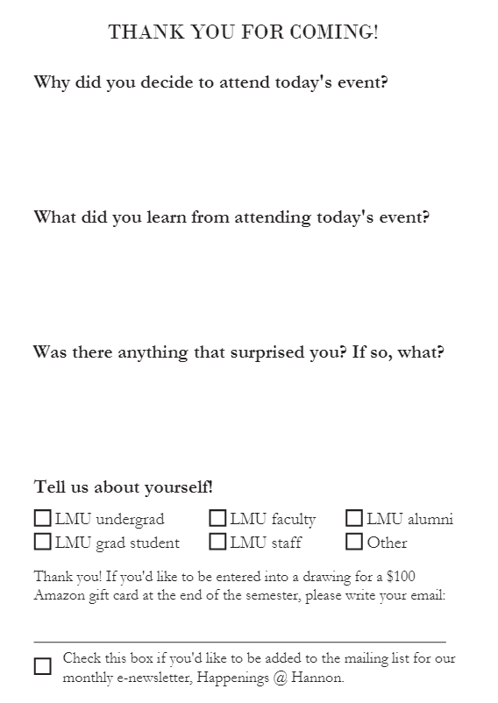
Changes to Our Default Feedback Form
Notes:
So, what else have we done to improve assessment of library programing. Well, we redesigned our default feedback forms. These are handed out at any event for which we do not create customized learning outcomes.

Slide 16
Notes:
Talk about the changes made to the standard form
Wanted to keep demographic question. That is really useful.
Go through each question…
The element of surprise: this is how we are attempting to get at the “transformative” element of programming in a standardized way. When we are not assessing a specific learning outcome, we are hoping to at least capture what elements of our programming catch our students off their guard.
Can easily swap out questions 2-3 with learning outcomes (1-2 indicators is enough!)

Slide 17
What did you think? vs.
What did you learn?
Air conditioning was a bit cold.
Everything is great.
Wonderful event! So important!
Please keep bringing up these vitally important conversations.
Great!
I enjoyed the talk because Professor McDonald is my teacher.
It was great!
Very rewarding, insightful, nothing to comment on making it better.
Dr. Davalos is incredibly eloquent and knowledgeable.
Went all smoothly. Really nothing to improve.
I really enjoyed this event, more Q&A next time.
The room was a little cold. Ask students to not type on computers. It was very distracting.
Outstanding. Excellent viewpoint from scholar.
Fidel Castro wasn't the only leading figure in the revolution.
That I need to return to read Shakespeare criticism again.
We time travel by remembering.
I learned that I ever more desperately want to be part of this conversation of “the value of time.”
I should be proud of my Mexican roots.
I didn't realize the struggle of central Americans with displaying their indigenous culture.
The theme of erasure is a lot more serious than I thought.
That I will die... and the library throws cool events.
The power of theological aesthetics to awaken the heart and mind in balance.
An appreciation of the connection between art and mystery
The unity of creation and the destruction of this unity by faith.

Slide 18
Future Plans
Use other assessment methods (whiteboards, focus groups, object analysis)
Include partners in drafting expected learning outcomes
Use data to assess resource allocation
Longitudinal follow-up on standard feedback questions
Notes:
More whiteboard questions, focus groups with both attendees and participants, object analyses (like in visualizing literature exhibit - explain this)
Build the creation of learning outcomes into each event planning process, including asking our partners what their outcomes would be
Use data to assess resource allocation (using the rubric)
Follow up on the “what surprised you” question in a longitudinal study

Slide 19
Thank You!

