Slide 1
Building a bridge between academic and community information through service learning
Information
in the Real World
Megan Stark
Mansfield Library
University of Montana
Colloquium on Libraries and Service Learning
August 11, 2014

Slide 2
What does research mean in the real world?
We need a balance in the daily and the visionary,
the local and the global,
the practices and the theories,
the ideal and the possible
Heidi Jacobs

Slide 3
Students in Service Learning Courses have Different Information Needs

Slide 4
My experience at UM
Students in service learning courses demonstrated very different information needs than non-service learning courses
Review of the literature of major trends in topic (i.e., “grounding” in the issue)
Understanding of the unique information ecosystem that service organizations value (ie, statistics, reports, government information, local community task forces, etc.) both in terms of access and creation
Ability to translate macro-information to micro-levels

Slide 5
Information in Academia
Centrally held
Classified by controlled vocabularies
Scholarly (i.e. peer-reviewed)
Subscription based
Created by scholars for scholars
Findable via library search tools
Easily cited using approved citation guides

Slide 6
Information in the Real World
Decentralized
Classified chronologically, by administration, etc.
Community based
Created by stakeholders/practitioners for stakeholders/practitioners
Difficult to find using academic search strategies
Difficult to cite using citation guides

Slide 7
Students are responsible for cultivating an understanding of both worlds

Slide 8
What does it look like to build a bridge?
Let’s Try an example

Slide 9
Hunger and Homelessness
Notes:
What would we expect students to know about this topic through scholarly literature? What are the requirements we would place on their citations? Now let’s talk about this in a real world way. Locally, who cares about this topic? What kind of information do they produce and/or value? Where is this information stored? Accessed? How is it properly cited in their research products?

Slide 10
Are we sure this matters?
For students, service learning is a powerful way to connect to community and future careers. Understanding the unique information landscapes affecting particular professions provides the ability to move with increased sophistication around important issues.
For librarians, service learning is a powerful reminder that we need to better connect with community. Understanding that our instruction and collections should reflect the unique information landscapes affecting our society provides the ability to better instruct and prepare our students for life in the real world.

Slide 11
Using The new ACRL Framework to promote new collaboration and new directions
Notes:
Research as Inquiry; Authority is Constructed and Contextual; Information has Value

Slide 12
Thanks for coming today! Questions? megan.stark@umontana.edu

Slide 13
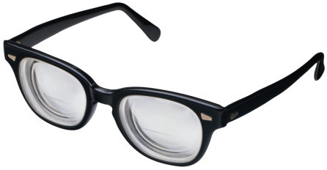
Some good reading
Service Learning Librarian
http://www.libraries.wright.edu/servicelearning/
Barry, M. (2011). Research for the greater good: Incorporating Service-Learning in an Information Literacy course at Wright State University. College & Research Libraries News, 72(6), 345-348.
Hernandez, M. & Knight, L.A. (2010). Reinventing the box: Faculty-Librarian collaborative efforts to foster service learning for political engagement. Journal for Civic Commitment, 14(1).
Herther, N. K. (2008). Service learning and engagement in the academic library. College & Research Libraries News, 69(7), 386-389.
Nutefall, J. E. (2009). The relationship between service learning and research. Public Services Quarterly, 5(4), 250-261.
Riddle, J. S. (2003). Where’s the library in service learning?: Models for engaged library instruction. Journal of Academic Librarianship, 29(2), 71.

