Slide 1
Emptying the Silo, Entering the 21st Century: Librarians Engaged in Service Learning Elizabeth Heffington, MLIS Christin Shatzer MPA

Slide 2
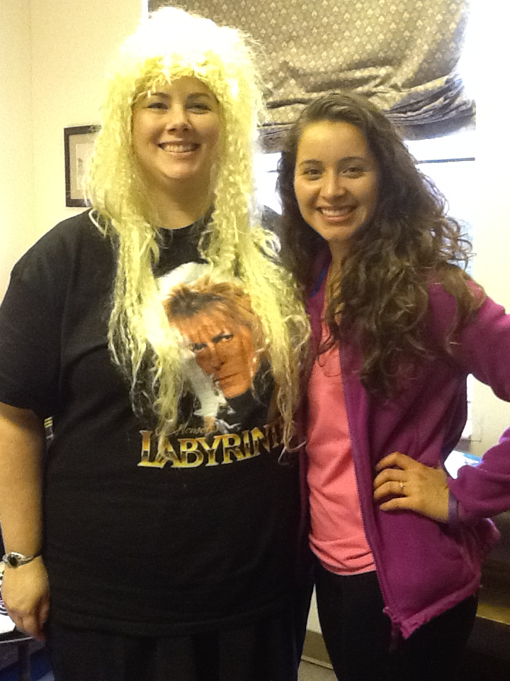
Librarianship is a Service Profession
Michael Stephens –
Office Hours: Reflective Practice
Library Journal, January 13, 2014
Be visible
Put a face on the library
Service learning: linking library education and practice
Loriene Roy, Kelly Jensen, Alex Hershey Meyers, ALA, 2009
Creating communities of service
Service-based education part of LIS since Dewey in 1896

Slide 3
Characteristics and Culture
Academic librarianship shares the core values of service-learning
Service-learning provides a means of breaking out of the library silo
Collaboration with unlikely partners increases library stakeholders

Slide 4
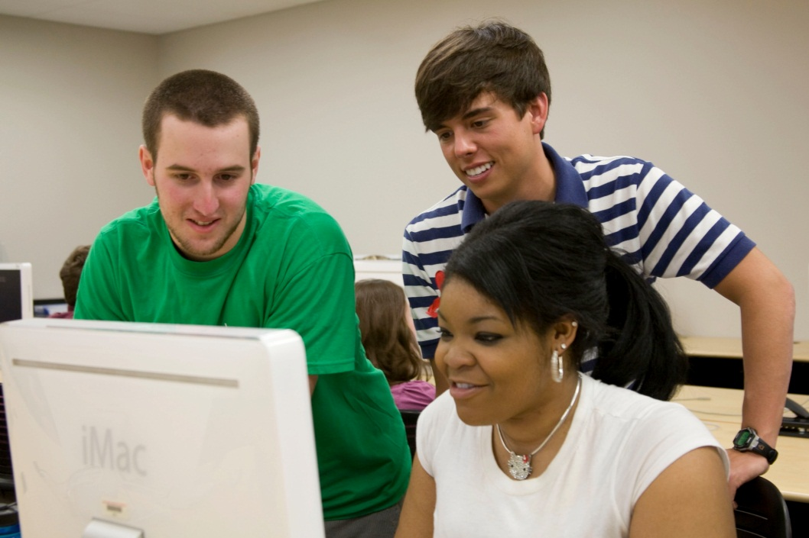
Service-Learning at Lipscomb
Notes:
RCG

Slide 5
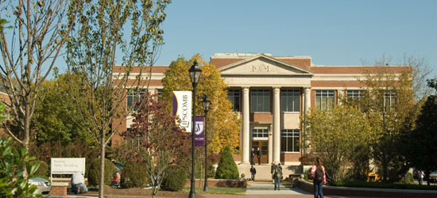
Service-learning at Lipscomb University is a teaching and learning methodology that
(1) allows students to apply their knowledge and skills to specific service projects associated with a non-profit or for profit organization and
(2) provides for growth and development in understanding better the academic, spiritual, and civic elements associated with service to others.
Notes:
CS

Slide 6
Graduation Requirement
Before graduating, traditional undergraduate students must complete two SALT experiences.
At most one can be from Tier I, and at least one must be from Tier II or III.
Developmental level | SALT experience | Length of service engagement
Tier I | SALT enhanced service days | 3-5 hours
Tier II | SALT enhanced university courses | 10-20 hours
Tier III | SALT enhanced mission trips, internships, SALT cooperatives, SALT/FWS | 40+ hours
Tier IV | SALT capstone project (for SALT Scholars only) | 30+ hours

Slide 7
Tensions and Potential
Librarian as instructor
Service-learning buy-in
Extending OUR reach
Notes:
RCG

Slide 8
Generating New Ways of Thinking
Describe an inanimate object or an animal
Include the who, what, when, where, why of the item in your description

Slide 9
Creating New Perspectives
Switch papers with a partner and create an analogy between service-learning & libraries and their object or thing
“Service-learning & libraries is like ______________ because: ____________________________”
Notes:
RCG

Slide 10
Q & A

Slide 11
Elizabeth Heffington, MLIS
Catalog and Acquisitions Librarian
elizabeth.heffington@lipscomb.edu
Christin Shatzer, MPA Director of Service-Learning christin.shatzer@lipscomb.edu
Enhancing academic understanding * Increasing civic responsibility * Fostering
Christ-like attitudes and a worldview of lifelong Christian service

