Slide 1
Community Engagement & Information Literacy
A Case Study
Gretchen Keer, Online Learning & Outreach Librarian, CSU East Bay
Jeffra Bussmann, STEM/Web Librarian, CSU East Bay
CLSL, August 11, 2014
Notes:
G
on-going, early stage case study - did pilot, running study in the fall

Slide 2
Introductions & Context
CSU East Bay
  Public university in Hayward, CA
  ~14,000 FTE
  Center for Community Engagement
Introduction to Information Literacy
  2-unit required course for incoming freshmen
  graduation requirement
  taught by 12 library faculty + part time faculty
Faculty Learning Community
Notes:
G
⅓ of new students are freshmen, ⅔ are transfers
we have access to a course, acknowledge that’s rare - approach is scalable to one-shots
FLC - how to apply community engagement & social justice concepts to information literacy?

Slide 3
Definitions
To view the definitions of the vocabulary used in the chart, please view our Google doc.
http://goo.gl/OgFx7O
Notes:
J
foundation - difference between service learning & community engagement, etc.

Slide 4
Our Class Module
Completed in one 110-minute class session
  Read articles before class
  Discuss “What is research?”
  Watch Polling for Justice video
  Complete Activity Worksheet comparing research methodologies
  End with Reflection writing
Ongoing modification to improve session
Notes:
J

Slide 5
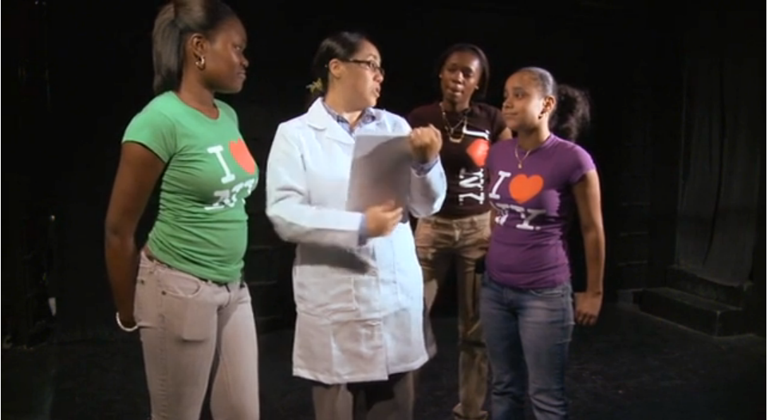
Polling for Justice
Notes:
G
Just 2:00 - 6:00.

Slide 6
Article Activity
Two Articles:
Ethnographic Method of Researchhttp://goo.gl/CzpkRM
Community-Based Participatory Research http://goo.gl/lBY4PT
Complete the Worksheet. Answer questions to compare the research methodologies.
Notes:
J

Slide 7
Data Analysis Frame
Do students make community engagement connections when comparing these approaches to research?
Do students make social justice connections?
How does this module expand our approach to teaching IL Standard 5?
Notes:
G

Slide 8
Pilot Data
Q5 What does the researcher expect the research to accomplish?
Notes:
G
Pilot data: Responses from two sections (Winter & Spring 14) - 34 responses total
Future data: Four sections using revised worksheets from Fall 14 - ~120 responses total

Slide 9
Pilot Data - Main Themes
Ethnographic Article:
advance the field
share information
find answers
positive action
CBPR Article:
share information
positive action
  community engagement
  community change
  individual empowerment
Notes:
J

Slide 10
Pilot Data - Minor Themes
Ethnographic Article:
investigate topic
further study
new information
prove point
confusion
CBPR Article:
find answers
further study
demonstrate value
confusion
Notes:
J

Slide 11
Pilot Data - Reflections
Participation in Research on:
  Rich/Powerful people, ‘oppressing me’
  Teens/Young adults, ‘my age’
  An area ‘where I can respect the research’
  My community
  Heard with decision makers & people who share the same views as me
  Teens, their education, if their homelife has an effect on that
  Criminal justice study
  People’s sleep patterns
  Shoe research, comfiest shoe
Notes:
J

Slide 12
Brainstorm
Discuss how you might take what you have learned today and apply it in the context of community engagement and information literacy instruction at your institution.
Notes:
G
Brainstorm ideas!

Slide 13
Q&A
Thank you!
References: http://goo.gl/bBhJKl
Slides: http://www.slideshare.net/grkeer/clsl-14-gk-jb
gretchen.keer@csueastbay.edu
jeffra.bussmann@csueastbay.edu

