Slide 1
(How) Are Academic libraries partnering with service learning initiatives on their campuses?

Slide 2
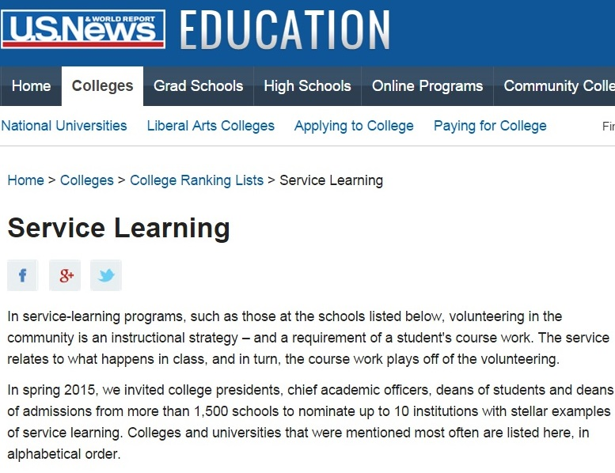
Methodology
Exemplary Service Learning Programs*
*as identified in the U.S. News and World Report annual Education Rankings & Advice
Years 2010-2015
40 Institutions
Qualtrics survey via emails
Dean or Library Leadership
Service Learning Leadership

Slide 3
Which Schools?
Augsburg College
Bates College
Berea College
Brown U
Butler U
Calvin College
Canisius College
Carson-Newman U
College of the Ozarks
Creighton U
DePaul U
Duke U
Elon U
Georgetown U
Gettysburg College
IU-PUI
James Madison U
John Carroll U
Loyola U – Chicago
Loyola U - Maryland
Loyola U - New Orleans
Michigan State U
Niagara U
Northeastern U
Ohio State U
Portland State U
Rollins College
Seattle U
Stanford U
Tufts U
Tulane U
U Michigan
U Notre Dame
U Pennsylvania
U Scranton
UMD- College Park
UNC – Chapel Hill
Valparaiso U
Wagner College
Warren Wilson College

Slide 4
Responses by Carnegie Classification
Service learning responses (16)
Library responses (17)

Slide 5
Responses by Size of Institution

Slide 6
Do you have active partnerships between Service Learning and the Library on your campus?
Service learning (n=16)
Library (n=17)
Yes | 6
No | 7
Not Sure/ Don’t Know | 1
Yes | 7
No | 6
Not Sure/ Don’t Know | 1

Slide 7
Describe active partnerships
Service learning (SL)
Research/resource guide on library web
Collections/resources to support SL work
Instruction/research training for SL courses
Research assistance for projects, presentations and student papers
Archive SL materials
Librarian serves on the faculty learning committee for SL
Personal connections (between individual staff members in both areas, or between individual library staff member and SL projects)
Library is a site for independent SL hours
Librarian office hours in SL space

Slide 8
Describe current partnerships
Library
Research/resource guide on library web
Library instruction in academic SL courses
Personal connections (individual library staff participate in SL activities)
Partnerships with major campus SL initiatives (campus day of service)
SL capstone projects are in institutional repository
Library staff lead SL trips and teach SL courses
Library hosted an event for faculty re: information literacy and academic SL
Archives of SL materials
Host SL displays & events
GIS training for community partners
Research support for student SL team leaders
Librarians attend & present at state campus compact conference
Library participates in SL course design workshop

Slide 9
Do we have Common Ground?
Resource/Research Guide
Library Instruction for SL courses
Personal Connections
Active Partnerships

Slide 10
Are there potential partnerships you’d be interested in pursuing?
Service learning
Library
Yes | 8
No | 0
Not Sure/ Don’t Know | 5
Yes | 8
No | 1
Not Sure/ Don’t Know | 4

Slide 11
Are there potential partnerships you’d be interested in pursuing?
Service learning
Community access to library resources
Literacy projects (book drives)
Collaborate around resources for projects
Libraries as space/place for SL students and community partners to come together
Helping SL faculty & students better understand how they (library) can assist with SL projects
Integrate archives in SL and CE
Departmental SL library – raise awareness through main library, coordinate on collection development

Slide 12
Are there potential partnerships you’d be interested in pursuing?
Library
Greater integration of library & information literacy in SL courses
Collect SL capstone projects
Build SL into library paid staff work schedule
Collection development w/ SL partners
SL only as part of “regular” liaison librarian work, not (yet) an area of library focus
Literacy projects
Incorporate SL into library student internships
Partnerships more ad-hoc, want more structure
Embedded librarians in more SL projects, trips & courses
Reaching student leaders (mostly staff now)
SL projects that include access to information
Co-designing research projects for SL courses

Slide 13
Are there potential partnerships you’d be interested in pursuing?
Library
“We have not actively participated in service learning but stand ready to help as needed.”
Service learning
“We have done a little of this, but nothing systematic or ongoing.”

Slide 14
Do we have Common Ground?
Literacy Projects
Collection Development
Potential
Partnerships

Slide 15
What, if any, are possible barriers to expanded partnerships?
Service learning (9)
Time
Funding/budget constraints
Little to no history of partnership
No clear understanding of mission – from both directions
Lack of imagination
Capacity / bandwidth (both staff and students)

Slide 16
What, if any, are possible barriers to expanded partnerships?
Service learning
“SL courses are packed, some instructors feel it is difficult to ‘fit in’ time for the library to be involved.”
“There is just so much demand for partnerships with off-campus entities – like our local public library, where we have a very robust partnership, it’s hard to find the bandwidth to partner with on-campus entities.”

Slide 17
What, if any, are possible barriers to expanded partnerships?
Library (10)
Time
To coordinate projects, work on learning outcomes, and find partners for projects
Lack of imagination
Individual faculty members (or departments) who do not have relationships with librarians
Capacity / bench strength
Just knowing what each other does (and would be interested in doing)
Librarians don’t teach credit-bearing courses (and SL courses are credit-bearing)
Commuter campus challenges – difficult to make or maintain community connections outside of work hours

Slide 18
What, if any, are possible barriers to expanded partnerships?
Library
“Explaining how information literacy instruction enriches & supports many of the existing goals of SL courses takes time and often personal selling. The individual faculty members involved do not have existing relationships with librarians.”
“I believe (SL) is independent of most of the current programs, services, and collections our library offers and that the library need not feel a special imperative to find a way to support the various methods by which service learning might be implemented.”

Slide 19
Do we have Common Ground?
Time
Capacity
Imagination
Perceived Barriers
No mutual understanding

Slide 20
Are there any other observations about these partnerships you’d like to share?
Service learning
Library
“This is a largely untapped and unconsidered area of partnership on our campus.”
“The librarians are reaching out, making themselves available across campus, offering to make presentations and attending campus meetings. They are very involved in the life of the University.”
“I think this is a great idea and motivates me to seek out partnerships on campus.”
“Is this a solution in search of a problem?”
“I feel like…the service aspect is interwoven throughout the school without the library having to purposefully seek out service learning.”

Slide 21
(Joan’s) Takeaways and Observations
Not everyone in libraryland is as excited about service learning/library partnerships as are the people in this room.
Some of our service learning partners may see literacy programs as a natural fit for the academic library.
Community partner access to library resources (collections, space, and expertise) is of interest to some SL partners.
Your observations?

Slide 22
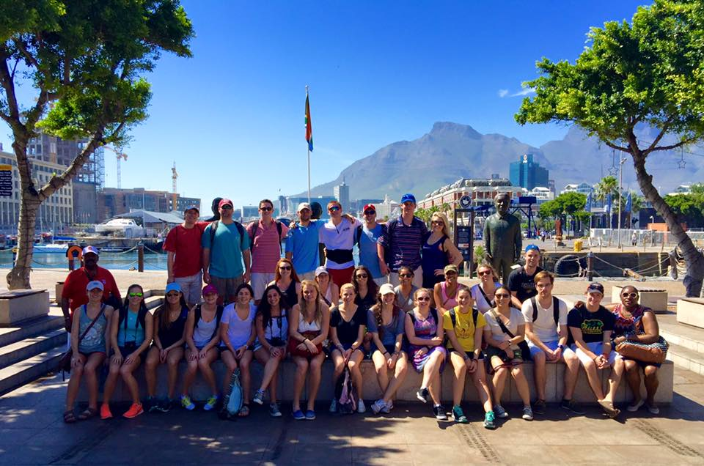
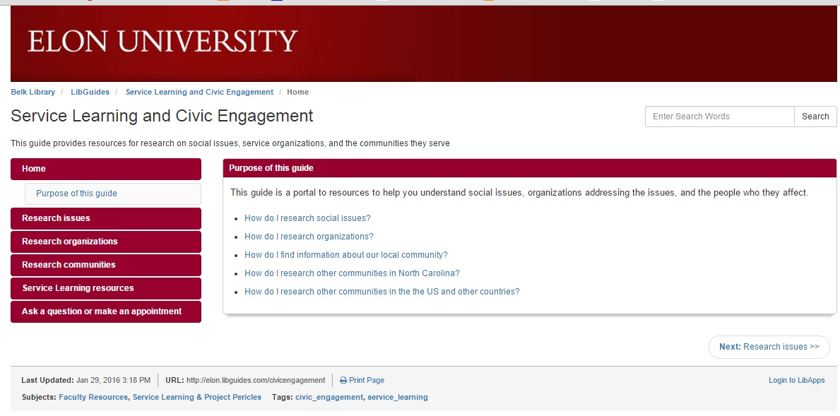
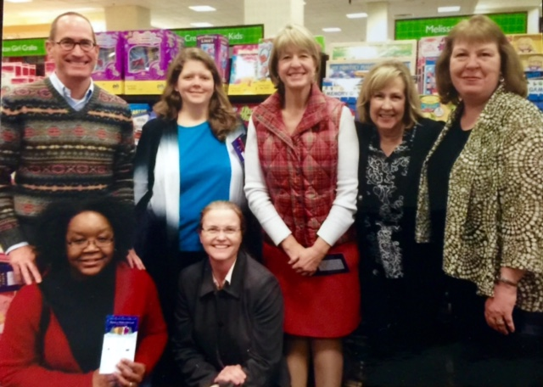
Questions? Comments?
Joan Ruelle
jruelle@elon.edu

