Slide 1
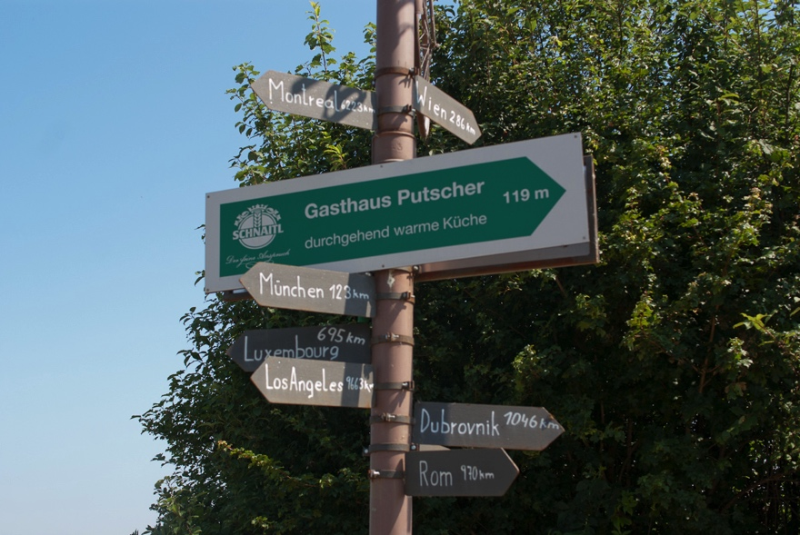
On the Road to Information Literacy: Using Curriculum Maps to Build Connections Between Service and Learning Outcomes

Slide 2
Agenda
Intersecting pieces: Service Learning, Information Literacy, Curriculum Mapping
Take apart the pieces and put them back together
Emphasis on Curriculum Mapping
American University as Case Study
Your mileage may vary
Service Learning
Curriculum Mapping
Information Literacy
Notes:
To explore curriculum mapping’s role in highlighting information literacy outcomes in service learning, we’ll take look at each piece and how it functions. I hope to spend the most time on curriculum mapping

Slide 3
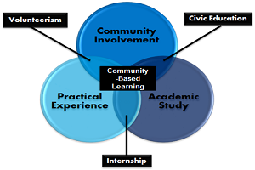
Necessary Vocabulary
Service Learning Definition:
“A teaching and learning strategy that integrates meaningful community service with instruction and reflection to enrich the learning experience, teach civic responsibility, and strengthen communities”
National Service Learning Clearinghouse

Slide 4
Questions for the Audience
Q: Is SL formalized at your institution? If a course meets the definition, but isn’t institutionally recognized, what does that mean for library integration?
Notes:
I’m going to ask questions periodically and I want you to make note of the answers in writing as we go. I expect answers will vary, but how you respond will shape how you move forward with a curriculum mapping project at your institution, should this presentation inspire you to do so. I hope we have time to dig into some examples from the audience and work together to build a plan for some of you.

Slide 5
Service Learning: Morton’s Typologies
Direct Service
Service to individuals to meet immediate needs
Project
Implementing or participating in service programs through community service organizations
Social Change
Addressing problems through systemic change
Student
Service
Notes:
If we want to know what relationship information literacy has to service learning and where libraries and librarians can make those connections stronger, it helps to know what students are doing when they do service learning. Morton’s typologies were established in his 1995 article in the Michigan Journal of Community Service Learning. He actually used the word Charity to describe direct service, but I’ve changed it here to reflect 2016 rhetoric, as charity tends to strike the modern ear negatively. The research and follow up studies I’ve looked at delve into student preferences, finding that students prefer direct service and have the least interest in engaging on social change. Others look at the relationship between these types of service and the goal of improving civic engagement learning outcomes. This is good information, but what’s missing and what librarians can bring to the table is the potential to teach students skills for seeking out and engaging with information. When planning course integrated information literacy instruction or designing course specific LibGuides, librarians often look to the specifics of the assignment in order to improve outcomes for the course. Viewed in the opposite direction, emphasizing research and information literacy can elevate direct service or project work toward social change. In fact, an IFLA presentation in 2014 entitled “Information Literacy + Service Learning = Social Change” noted in a case study that “incorporating a research component to service learning does more than expose students to social action.” Add the research component pushes students to look at the larger environment. Gradis, Jennifer, and Tiffini Travis. “Information Literacy + Service Learning= Social Change.” Lyon, France, 2014. http://library.ifla.org/1058/.
We’re making progress in establishing a symbiotic relationship between information literacy and service learning → service can be a valuable vehicle for developing information literacy skills and putting information literacy skills into practice and enhance a service learning experience.
Similarly, understanding how students are engaging in service learning may influence our approach to information literacy instruction. Curriculum mapping is one way to tease out this kind of information. So hold that thought…

Slide 6
Question for the Audience
If you have worked with service learning courses, what kind of service did the students perform?
Do all students in a given course do the same kind of service?
Who decides the nature of the service activities? (student, professor, community partner?)

Slide 7
Service Learning at AU
Center for Community Service and Engagement
Resource Hub for Faculty, Students, and Community Partners
CB Designation in Course Catalog
CSLP Add-on Credits
Community Based Research Scholars: Living-learning community
Independent Service Learning
Hard to identify
Notes:
A quick look at how service learning is structured at AU… and where it isn’t. The center for community service and engagement provides valuable resources to professors looking to build service learning into their courses. Workshops and sample syllabus language helps courses get off the ground. Faculty can apply to have their course receive an office designation as “community based” in the course catalog. Faculty can also support students wishing to add a service component to their courses. CCSE sets the criteria for the credit. They also maintain a database of community partners so that faculty and students can find organizations with a history of working with AU service-learning programs.
For curriculum mapping purposes, they offer a master list of CB courses for each semester, providing a shortcut for librarians looking to build relationship with service learning classes. If you’re looking to pull together the resources necessary for curriculum mapping, this is a great place to start.
Things get trickier when community based work isn’t necessarily formalized. Librarians often have connections across departments, which allows us to hear what our fellow educators are doing, but a comprehensive picture remains elusive

Slide 8
Student Perspective On Information Literacy
Service site: DC Doors
Student Project: Teach a session on paths to permanent housing
Notes:
I want to segue into the overlap between information literacy and service learning. I think it’s a given at this point that librarians see a connection between service learning and information literacy. As we move into the Information Literacy section of puzzle, I want to emphasize stakeholders, potential advocates, and the importance of learning outcomes, rather than definitions of IL. We know what information literacy is. We also see it’s significance in service learning. Do other educators see this link? This is the question driving my research at this point.
American University hosts an in-house conference on teaching and learning in January each year before the spring term starts. At this year’s conference, the Center for Community Engagement and Service presented on the service learning programs at AU to discuss the value of service learning for today’s students. The students themselves made it clear that the connection between service learning and information literacy is real.
The video of the presentation is available online, but we don’t have time to watch it together, so I’ll set the stage a little by telling you that the students presenting discussed their experience service at DC Doors, a non-profit that focuses of ending homelessness for the latino immigrant population. Service learning opportunities included hosting workshops for the center’s clients. Here’s what one student had to say:

Slide 9
Service Learning and Information Literacy: A Student Perspective
“I’m not in a place to tell you how to find permanent housing (that was my topic) as a 21 year old college student. So the way to get over that was you had to do your homework. Because it wasn’t just for a class. It wasn’t just for an assignment…it was for actual people who need your advice”
-McKinley Doty (Class of 2016)Millennials and Community Based Learning: A Perfect Match
Ann Ferren Conference, January 2016
Notes:
<quote on slide>
So we see a very real attitude shift about engaging with information from what we may see at the reference desk. In a lecture based class, information literacy lessons can feel a little forced. I need peer-reviewed resources because my professor says so. The syllabus says I need 5 peer-reviewed articles and so that’s what the students look for whether they see the link between the type of resource and its suitability to their work or not. They’re checking a box. Students may be motivated by grades or see taking the class a clearing a hurdle to graduation. Service learning makes it clear to the student that engaging with information has consequences.

Slide 10
Information Literacy as a Learning Outcome
ACRL
Information Literacy Standards
Threshold Concepts
Program Goals
Discipline Specific Outcomes for engaging with information
Institutional Goals
Information literacy defined for the institution
AAC&U
Information Literacy as “Essential Learning Outcome”
Information
Literacy
Notes:
Student voices are great in establishing the importance of information literacy as a learning outcome for service learning, but we don’t always have them at the ready.
To establish information literacy as a learning outcome, we can look to existing stakeholders. Expectations of information literacy as a learning outcome abound. Each institution will need to shape its definition, but it’s helpful in getting the conversation going to point out these groups. This allows us to transition to the overlap between info lit and curriculum mapping. Once we identify with some specificity what it is we want students to know, we can map those concepts to the places in the curriculum where they’re being taught (or not, as the case may be). We can pull those learning outcomes from the work of ACRL, and we should. AND we can look to accreditation bodies, internal program goals, shared governance bodies within our own institutions, and others to articulate learning outcomes that resonate with educators beyond the library.

Slide 11
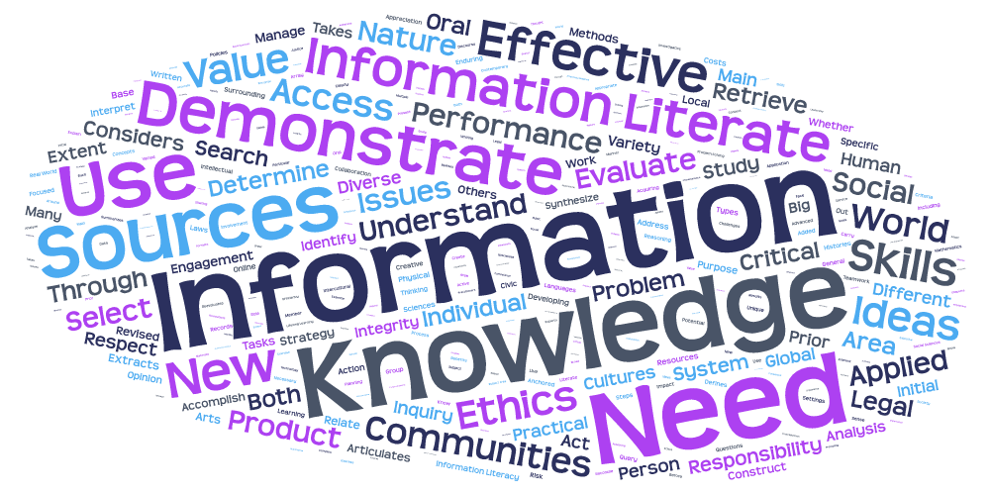
Notes:
I combined the learning outcomes on Information Literacy from ACRL, AAC&U, and AU into a work cloud. Word clouds are not the most sophisticated of information visualization tools, but it is fun to see what jumps out. I particularly like the way “communities” and “ethics” jump out at the bottom – words with strong ties to service learning. And we can keep going: “applied” “world” “performance” – many of these words tie to the idea that all of this information and knowledge can and should live outside the classroom, and information literacy should be a part of that.

Slide 12
Why Learning Outcomes?
LEAP / AAC&U
LOs guide programs to empower and equip students to deal with complexity, diversity, and change.
Essential Learning Outcomes
Notes:
We’re talking about information literacy as a learning outcome, and as we make our way towards curriculum mapping, the phrase “learning outcomes” will play a central role. So why do we care about learning outcomes?
Learning outcomes tell us what knowledge a student will incorporate into their lives based on the experience of taking a class, earning a specific degree, or attending an institution. LEAP or “Liberal Education and America’s Promise” is an AAC&U initiative launched in 2005 to champion the importance of liberal education in the 21st century. They argue, and they’re not alone, that learning outcomes guide programs. Learning Outcomes encourage educators to think beyond just the content of their course in order to secure that content knowledge in a bigger picture. LO’s communicate to stake holders why a class, program, or institution’s degree matters.
Notably for our purposes, AAC&U also marks information literacy as an essential learning outcome, listing it among their “Intellectual and Practical Skills” that should be “practiced extensively, across the curriculum, in the context of progressively more challenging problems, projects, and standards for performance.”
The answer to why learning outcomes is in many ways the answer to why liberal arts education at all. Learning outcomes tell us where we’re going and why. Curriculum mapping show us how we get there.

Slide 13
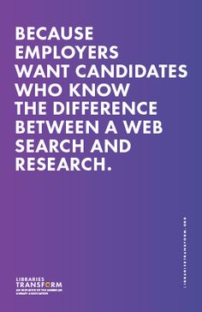
Notes:
Working on the intersection of information literacy and curriculum mapping and thinking about Why Learning Outcomes, ALA’s Library’s transform campaign comes to mind. It’s kind of the PR version of matching steak holders and learning outcomes. Curriculum mapping does this in a more sophisticated and nuanced way.
Imagine “Employers: is replaced with “Service-Learning Community Partners” and “Candidates” with Students.

Slide 14
Why Assess LOs?
Groups with a vested interest in the outcome of student learning:
Government agencies (especially for public institutions)
Accreditation Bodies
Employers
Prospective and Current Students (and their families!)
And…
Notes:
Outside stakeholders can help us advocate for the importance of Information Literacy as Learning Outcome in the first place, but they will also want to see evidence of progress towards those learning outcomes. Curriculum mapping is part of that assessment.

Slide 15
Why Assess LOs… for Service Learning
Service Learning introduces new stakeholders:
Community Partners
Clients of Community Partners
Notes:
We talked briefly about AAC&U’s LEAP program and how it uses learning outcomes to draw a line between what happens on college campuses and the value college graduates bring to society. Establishing learning outcomes helps answer “why higher education.” Service learning introduces a new a specific set of stakeholders. Do service learning courses teach students to be information literate? Who cares? We saw a quote from a student showing that she finds the needs of the community partner and its clients a driver for doing research well. Presumably, these stakeholders also find value in information literacy as a learning outcome for students who engage with their populations. As librarians move forward in this arena, I think there’s a great opportunity here to do additional research with community partners to find out their expectations of student’s information literacy when engaging in service learning.

Slide 16
Question for the Audience
Does your institution list Information Literacy as a learning outcome for its students?
At the institution level?
At the program (degree/major) level?
Course level?
Who provides the definition?
Librarians?
Individual instructors?
Accreditation bodies?
Collaborative process?

Slide 17
Information Literacy at AU
INFORMATION LITERACY: Graduates will identify their information needs, and search, select, retrieve, and evaluate relevant information from an array of sources. They will recognize reputable and accurate information and synthesze materials from varied sources.
COLA’s assessment plan for institution wide learning outcomes is very much a work in progress, but curriculum mapping is a planned piece.
Notes:
Let’s thread back in AU as a case study. I also want to clarify that by “what’s happening at AU” what I really mean is “what I’ve been able to learn so far about what’s happening at AU” Universities are complex places and no orientation could ever hope to bring a library or instructor up to speed on all the nuance of how these pieces come together overnight. In addition to telling you what I’ve learned about AU as a case study, I hope I’m giving you tools for sorting out how these pieces come together at your institution.
Information Literacy is one of 9 Institutional Learning outcomes
http://www.american.edu/provost/assessment/News.cfm
“On March 6, 2014, the American University Faculty Senate passed a resolution approving updated institution learning outcomes. The idea of providing new institution learning outcomes was presented by Provost Bass in his April 2013 address to faculty. The Middle States Self-Study includes a recommendation to update AU’s institution learning outcomes. In January, the Ann Ferren Conference Plenary Session devoted time to reviewing the draft learning outcomes and the Senate Committee on Learning Assessment (COLA) offered a public comment period on the outcomes using a blog to gather feedback. The new outcomes provide the university with a way to better articulate what AU undergraduates take away as a result of graduating from the university.”
The faculty senate has a designated seat for a library representative as does the learning assessment committee, so librarians has a voice in including information literacy and in crafting the definition
Keeping them present in our collective consciousness is another matter
The outcomes will be posted more widely soon. What’s next? COLA will propose a schedule for assessing the new outcomes and the Faculty Senate will review the outcomes again next year.

Slide 18
Why curriculum mapping
Identifies strengths and weaknesses in the curriculum.
Where are we teaching the skills we say we want students to have? Where aren’t we?
Increase collaboration and collegiality
Notes:
Bullet point about increasing collaboration and collegiality: Uchiyama & Rodin 2009. “An increase in collaboration and collegiality among faculty emerged as an unintended outcome as a result of participation in the [mapping] project.” We have the advantage of knowing about this unintended outcome, so we can have it as a goal instead of a pleasant surprise
Uchiyama, Kay Pippin, and Jean L. Radin. “Curriculum Mapping in Higher Education: A Vehicle for Collaboration.” Innovative Higher Education 33, no. 4 (January 2009): 271–80. doi:http://dx.doi.org/10.1007/s10755-008-9078-8.

Slide 19
Curriculum Maps – Many shapes and sizes
Course Maps
Diary Maps
Projection Maps
Program Maps
Connect Course Los to program goals
Institution Maps
Connect Programs Goals to institutional learning outcomes
Connect LOs to course activities
Curriculum Map
Notes:
Curriculum Map is something of an umbrella term, used to describe many ways of connecting planned learning outcomes to the curriculum. Mapping all levels of the curriculum is a multi-person process. This doesn’t mean you can’t use the mapping process on your own, simply that you’ll need to make decisions and judgments on your own, which may minimize buy-in. It may be helpful to partially map areas where you work frequently to make adjustments in your own work and leave large scale mapping for a later date. Once you have small maps for personal use, you may be able to share them with colleagues as a tool for encouraging them to join you in a larger project.
The questions I’ve been asking you throughout are an attempt to set you up for decision making on your own mapping process. Not we’re going to review types of curriculum maps so that you can determine which ones will be valuable for you.
Quick definitions of what we have on the screen here.
Projection maps help us to see what we’ve planned. Do our course activities and readings actually accomplish the things we say we want students to learn?
Diary maps fill in in real time. I don’t want to dive too deep into assignment and course assessment, but these things matter for the curriculum mapping process, so I’ll give them a quick mention. Service learning courses often use the DEAL model for critical reflection (Describe, Examine, and Articulate Learning). These reflections are ideal for filling in a diary map. Instructors can line up student’s self-reported learning with learning outcomes to see if they are actually being achieved.
Program Maps: Programs and majors often articulate what it is they want their students to learn. A program map lines up courses with Learning Outcomes. You can accomplish this by lining up required courses and/or a typical year by year path through the major.
Institution Maps: There are a couple of ways to do this. The design I’ve seen maps the Program Goals to the Institution Goals. AU currently has this infrastructure built into our assessment software, but we haven’t actually begun filling in the program to institution map. I think this “reveals” gaps that don’t really exist. I would advocate mapping from a programs courses to the intuitions’ LOs.

Slide 20
Question for the Audience
Do you track which courses you work with as a librarian?
Do you have learning outcomes for these classes?
Who writes the LOs? (you, the professor for the course, collaboration, standardized LOs written by the library?)
Have you connected the work you do with an individual course with the larger goals of the major? The institution?

Slide 21
Nested Information Literacy LOs
Institutional Learning Outcomes
Program Goals
Course Learning Outcomes
Information Literacy: Graduates will identify their information needs and search, select, retrieve, and evaluate relevant information from an array of sources. They will recognize reputable and accurate information and synthesize materials from varied sources
Demonstrate competence in analyzing, interpreting and evaluating political science research
Define an original research project…
Produce a lit review…
Present research…
Notes:
Pulling apart our course, program, and institutional learning outcomes into mapped concepts helps us see the big picture. For any given student, there we many “course learning outcomes” building up over their time at an institution, eventually building up to program goals. Some will double major or tack on minors or certificate programs, so they may have more than one “program goals bubble” whether its one or more, meeting program goals should also mean that institutional learning outcomes are achieved. Here if we work from the bottom up, I’ve stacked a few specific course learning outcomes as feeding into one of the Political Science program goals, ultimately supporting the Institutional goal of Information Literacy.

Slide 22
Sample Curriculum Map – Course Dissection
Information Literacy Learning Outcome / Performance Indicators (What will the students do) | Assignment (how will the student demonstrate the learning?) | Curriculum (What does the student need to know to do it well?) | How is it Assessed / Graded (How will we know the student has done this well)
Identify a research topic or information need Find and use scholarly and discipline-specific professional information Evaluate a scholarly article and understand research method used Select an appropriate documentation style and use it consistently to cite sources Construct well-supported research-based argument | Bibliography Annotated Bibliography Literature Review | Construct search query Comm Studies Databases to find articles Evaluate a scholarly article including the research method used Identify research question Citation Style | “Research Prospectus” consisting of bibliography / source list Annotated bibliography Lit Review comprises anywhere between 15-49% of grade
Credit: Archambault, Susan Gardner, and Jennifer Masunaga. “Curriculum Mapping as a Strategic Planning Tool.” Journal of Library Administration 55, no. 6 (August 18, 2015): 503–19. doi:10.1080/01930826.2015.1054770.
Notes:
Course maps are great if you’re already involved in the working with a service learning course. Projection maps are set up before the course. Identify the learning outcomes for the course in rows and then arrange the course activities and readings chronologically in the columns. Note which activities will help achieve the learning outcomes. Before you even start, you can see if as designed the course will get you where you want to go.
Archambault, Susan Gardner, and Jennifer Masunaga. “Curriculum Mapping as a Strategic Planning Tool.” Journal of Library Administration 55, no. 6 (August 18, 2015): 503–19. doi:10.1080/01930826.2015.1054770.

Slide 23
Sample Curriculum Map: Library Instruction for Political Science Students
Key: A = Assessed ; I = Introduced ; R = Reinforced ; X = Learning Outcome taught in this course
* Required for all students ±Required for GOVT Majors
 | * WRTG 100: Introduction to College Writing | SPA 220: The American Constitution | ±GOVT 310: Intro to Political Research | JLC 411: Legal History Seminar
Defines and articulates an information need | I, A | R | R, A | R, A
Identifies a variety of types and formats of potential sources for information | I, A | R | R, A | R, A
Considers cost and benefit of acquiring needed information |  | I |  | I, A
Reevaluates the nature and extent of information need | I |  |  | I/R
Notes:
My primary mapping project at the moment is using LibAnalytics data to map the current work I do with SPA students. What you see here is the structure COLA uses for mapping courses to program goal. In reality I would break this out by major, but I wanted an image small enough to project onto a slide. The columns start with 100 level courses and work their way up to courses typically taken by seniors. The rows articulate information literacy learning outcomes. At this point, the language is taken almost directly from the ACRL standards. Long term, I want to refine these standards for majors. Additionally, this will actually be broken out into majors instead of all of SPA in one glance. I can review my lesson plans for each course and determine which los were taught at which point. The final first draft of this document will serve as a launching place for conversations with SPA faculty.
Some versions of this mapping include M for Mastery in addition to the introduce, reinforced, and Assessed,

Slide 24
Sample Map – Program to institution
Political Science Program Goals → Institutional Learning Outcomes | Demonstrate knowledge and understanding of key theories, concepts, and issues surrounding the study of political institutions and processes. | Demonstrate critical thinking, written and oral communication skills. | Demonstrate competence in analyzing, interpreting and evaluating political science research. | Apply the knowledge and skills acquired in the major to the practice of actual politics.
Civic Engagement | X |  |  | X
Collaboration |  |  |  | X
Critical and Creative Thinking |  | X
Cultural Competency
Content Knowledge | X |  | X | X
Effective Communication |  | X
Ethics
Information Literacy |  |  | X
Quantitative Reasoning |  |  | X
Personal Growth
Notes:
What we’ve learned and what we haven’t:
First, mapping should be collaborative. This is MY interpretation of how the program goals for
Based on my interpretation of the program goals, there are gaps in how those goals lead to achievement of institution wide learning outcomes. Strong in content knowledge. Touches on others. Completely absent: Cultural Competency, Ethics, and Personal Growth. Doesn’t necessarily indicate that these learning outcomes are absent, but to the extent that the program goals align with institutional goals, there appears to be some gaps. I believe that we can articulate and demonstrate how service learning builds in some of these missing areas. I also believe that we can articulate the information literacy is one of these areas. This is what I mean my curriculum mapping as tool for advocacy. These aren’t punitive documents. They make clear where our skills can be best put to use in contributing to the overall goals of our institutions.

Slide 25
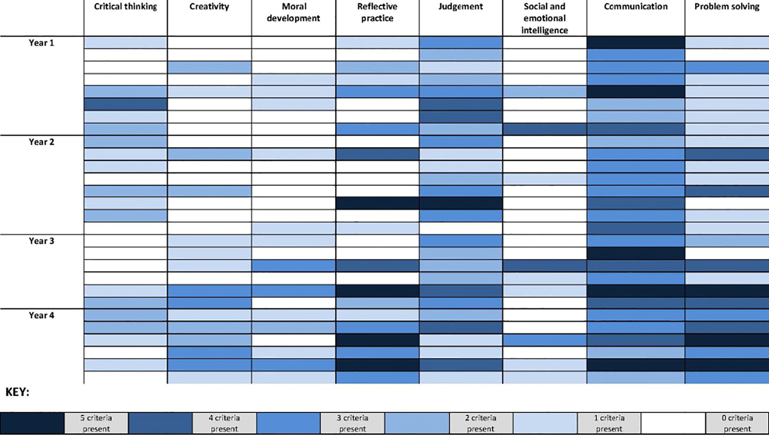
Sample Map: Learning Outcomes For Social Work Education
Published in: Lynelle Watts; David Hodgson; Social Work Education 2015, 34, 682-699.
DOI: 10.1080/02615479.2015.1048217
Copyright © 2015 Taylor & Francis
Notes:
Each learning outcome across the top was broken down into 5 component parts. The curriculum was reviewed by year to determine which components were taught when. The more components present, the darker the shading. Goal: move beyond a simple checklist and instead “produce a whole of the curriculum snapshot…in order to carry out a planned and systematic approach to any future curriculum development and improvements” (Watts, Lynelle, and David Hodgson. “Whole Curriculum Mapping of Assessment: Cartographies of Assessment and Learning.” Social Work Education 34, no. 6 (August 18, 2015): 682–99. doi:10.1080/02615479.2015.1048217.) p. 693.

Slide 26
Closing the loop
Plan
Teach
Asses
Adjust
Notes:
Most of what we’ve looked at so far is pretty linear Talk to anyone who works with assessment and you’ll hear about “closing the loop” Assessment plans are only as valuable as the effect they have on future instruction Curriculum mapping is no different. Done well, a curriculum map will give you the tools to advocate for inclusion on information literacy instruction in service learning, help you rebalance your efforts to that students are gaining the most possible from information literacy instruction, or barring collaboration, your own daily work will be improved.

Slide 27
Who does the Mapping?
Who wants the information? Who is the audience?
Individual Instructors
Teams of Instructors
Individual Librarians
Librarian Teams
Librarian + Instructor Teams
Learning Assessment Committee
Notes:
Collaboration at early stages improves buy-in. Not always possible. Use map as entry point to collaborations. “Hey, Department Head, I’ve worked with several Mandatory Course 101 instructors, and I was hoping to improve the collaboration with the library. I’ve drawn up this map based on syllabuses for past sections of the course. Could we meet to take a look at it?”

Slide 28
Get Started
What are you mapping?
Identify a team
Define your learning outcomes
Determine what information you have
Set goals

Slide 29
Questions for the Audience Revisited

Slide 30
Works Cited
American University. (2015a). Faculty Senate Passes Updated Institution Learning Outcomes. Retrieved March 10, 2016, from http://www.american.edu/provost/assessment/News.cfm
American University, S. of P. A. (2015b). BA in Political Science | American University: Program Goals. Retrieved March 10, 2016, from http://www.american.edu/spa/gov/degrees/BA-POLS.cfm
Archambault, S. G., & Masunaga, J. (2015). Curriculum Mapping as a Strategic Planning Tool. Journal of Library Administration, 55(6), 503–519. http://doi.org/10.1080/01930826.2015.1054770
Ash, S. L., Clayton, P. H., & Moses, M. G. (2009). Learning through critical reflection: a tutorial for service-learning students. Raleigh, NC: [PHC Ventures].

Slide 31
Works Cited Continued
Association of American Colleges & Universities. (2014, April 18). Essential Learning Outcomes [Text]. Retrieved February 11, 2016, from https://www.aacu.org/leap/essential-learning-outcomes
Gardner, J., Campos, M., Doty, M., & Thomas, R. (2016, January). Millenial Students and Community-Based Learning (CBL): A Perfect Match. Presented at the Ann Ferren Conference on Teaching and Learning, American University. Retrieved from https://edspace.american.edu/ctrl/news-events/afc-2016-video/
Gradis, J., & Travis, T. (2014). Information literacy + Service Learning= Social Change. Presented at the IFLA WLIC 2014, Lyon, France. Retrieved from http://library.ifla.org/1058/
Hale, J. A. (2008). A guide to curriculum mapping: planning, implementing, and sustaining the process. Thousand Oaks, CA: Corwin Press.

Slide 32
Works Cited Continued
Morton, K. (1995). The irony of service: charity, project, and social change in service-learning. Michigan Journal of Community Service Learning, 2, 19–32.
Watts, L., & Hodgson, D. (2015). Whole Curriculum Mapping of Assessment: Cartographies of Assessment and Learning. Social Work Education, 34(6), 682–699. http://doi.org/10.1080/02615479.2015.1048217

