Slide 1
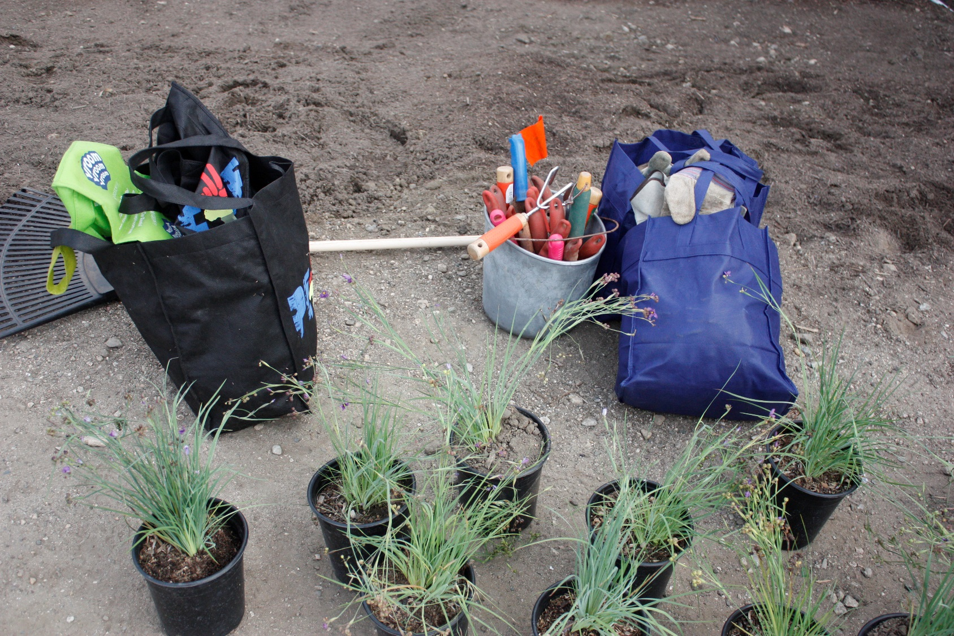
Preparing the Garden Site
Module 10 - Garden Ecology
Lesson 5: Preparing the Garden Site

Slide 2
Why is it important to prepare the site?
More than likely the site you will be transforming will need some attention to get it ready for the makeover you are envisioning.
If you are putting in a path that will have to be mapped out, weeds will need to be removed from a plot of earth, perhaps the soil will need to be amended.
3. As you begin preparing the site you will discover issues you didn’t think of, they have to be addressed before you can continue. For example, there might be a leaky irrigation line, that has to be fixed before you plant.
4. Preparation avoids having to do things over or change things afterwards.

Slide 3
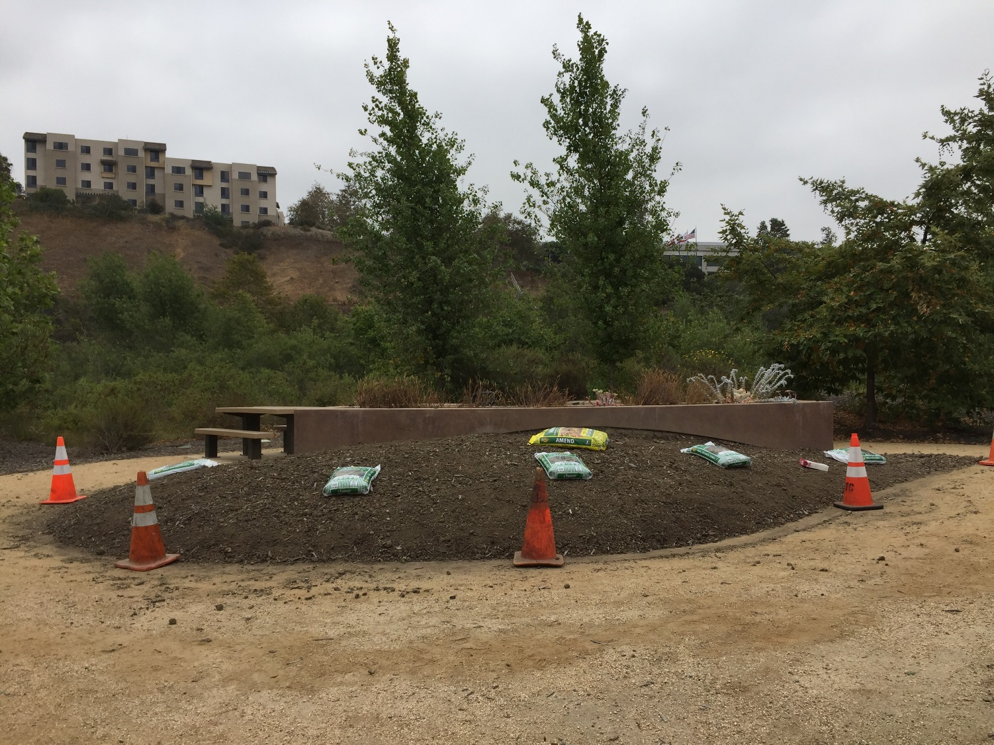
PREPARING THE GARDEN SITE
Example: Summer Camp Garden

Slide 4
PREPARING THE GARDEN SITE
Example: Summer Camp Garden
Plant List
 | COMMON NAME |  |  |  | Sort By:
 | Number | Size | Abbrev. | Botanical Name | Common Name | Planted | Status
1 | 3 | 1 gal | ALKA SEED | Sporobolus airoides | Alkali Sacaton | 2016
2 | 6 | 4" | FESTUCA | Festuca californica | California Fescue | 2016
3 | 3 | 1 gal | GUM | Grindelia stricta | Coastal Gum Plant | 2016
4 | 3 | 4" | YARROW | Achillea millefolium | Common Yarrow | 2016
5 | 3 | 1 gal | HU SA | Salvia spathacea | Hummingbird Sage | 2016
6 | 3 | 1 gal | IN MA | Abutilon palmeri | Indian Mallow | 2016
7 | 7 | 4" | LV | Verbena lilacina "De la Mina' | Lilac Verbena | 2016
8 | 3 | 1 gal | NL MILKWEED | Asclepias fascicularis | Narrow-leaf Milkweed | 2016
9 | 6 | 4" | PU GRASS | Nassella pulchra | Purple Needlegrass | 2016
10 | 3 | 1 gal | PU SA | Salvia leucophylla | Purple Sage | 2016
11 | 3 | 1 gal | RE SA | Salvia greggii | Red Sage | 2016
12 | 3 | 4" | CAREX | Carex pansa | Sand Dune Sedge | 2016
 | 12 | Total |  | Species
 | 46 | Total |  | Plants

Slide 5
PREPARING THE GARDEN SITE
Example: Summer Camp Garden
Challenge: 3 different camps, 3 different plots

Slide 6
PREPARING THE GARDEN SITE
Example: Summer Camp Garden
Example of a Check List of Tools and Tasks
Amendments
  These need to have been applied before planting
Shovels
  Need to be staged near the garden site day of
Gloves
  Need to be ready for planters to use day of
Irrigation
  Needs to be available day of planting
Plants
  Make sure you have them ready the day of
Plant List and Map
  Have ready to reference before placing plants
Plant ID Signs
  Can be done ahead of time or after plants go in

Slide 7
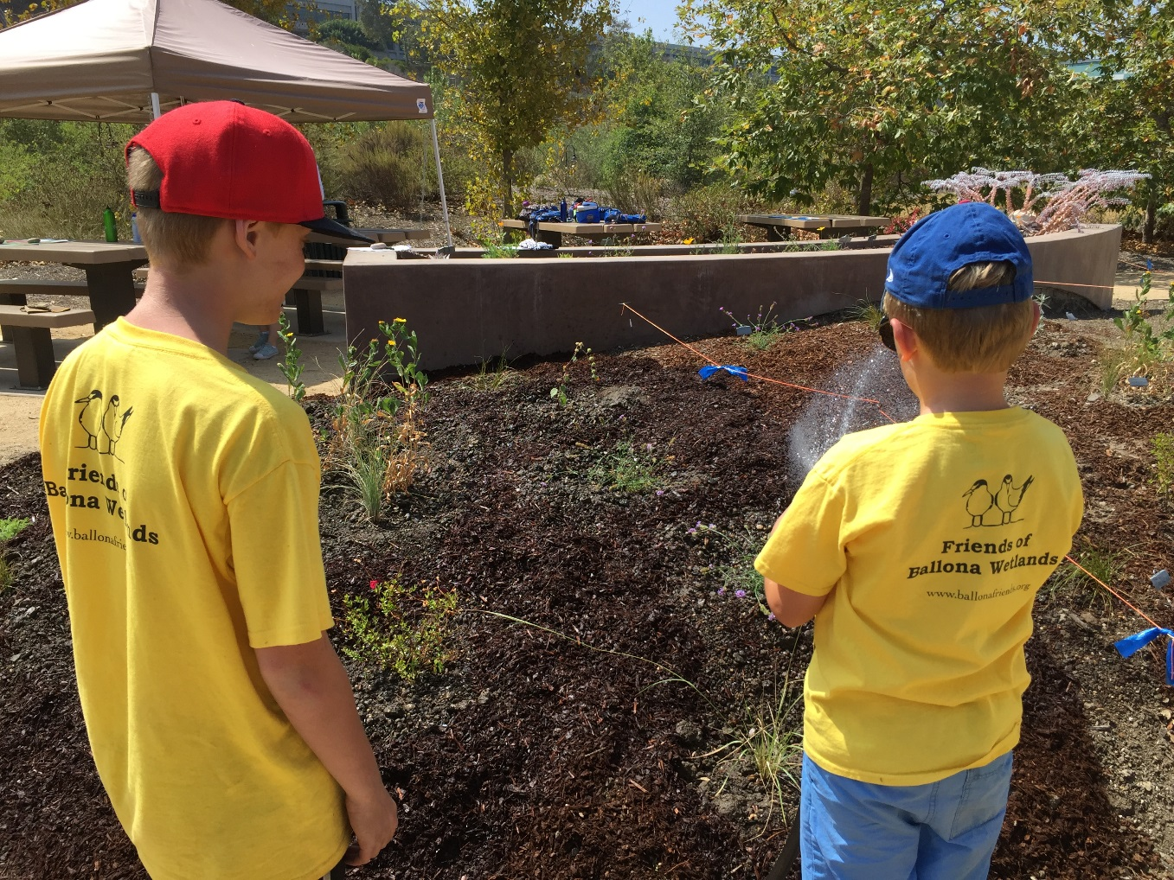
PREPARING THE GARDEN SITE
Example: Summer Camp Garden
Watering after planting

Slide 8
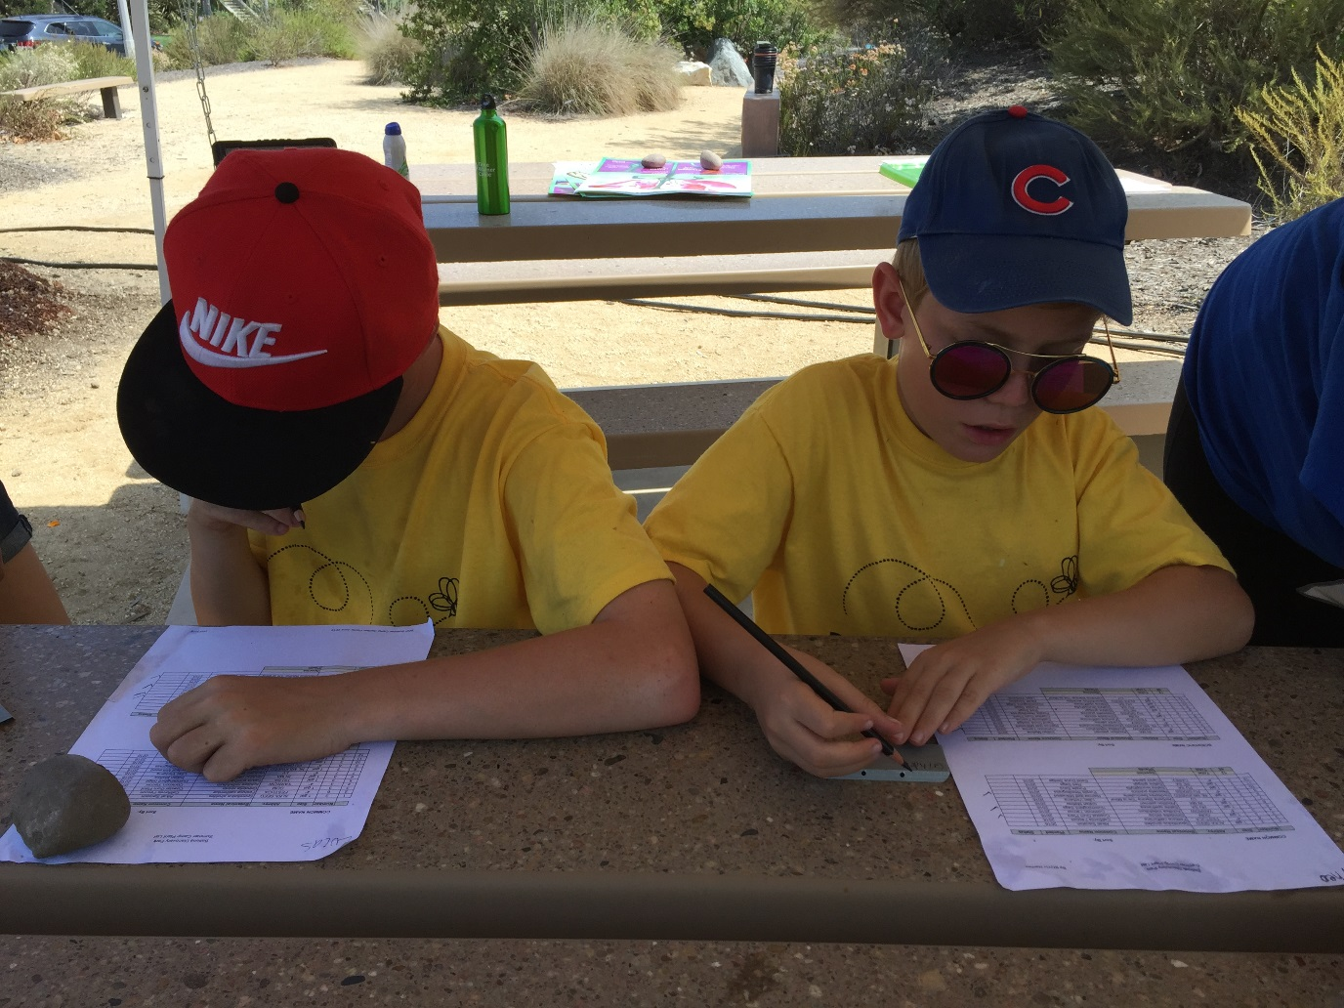
PREPARING THE GARDEN SITE
Example: Summer Camp Garden
Preparing the plant name tags

Slide 9
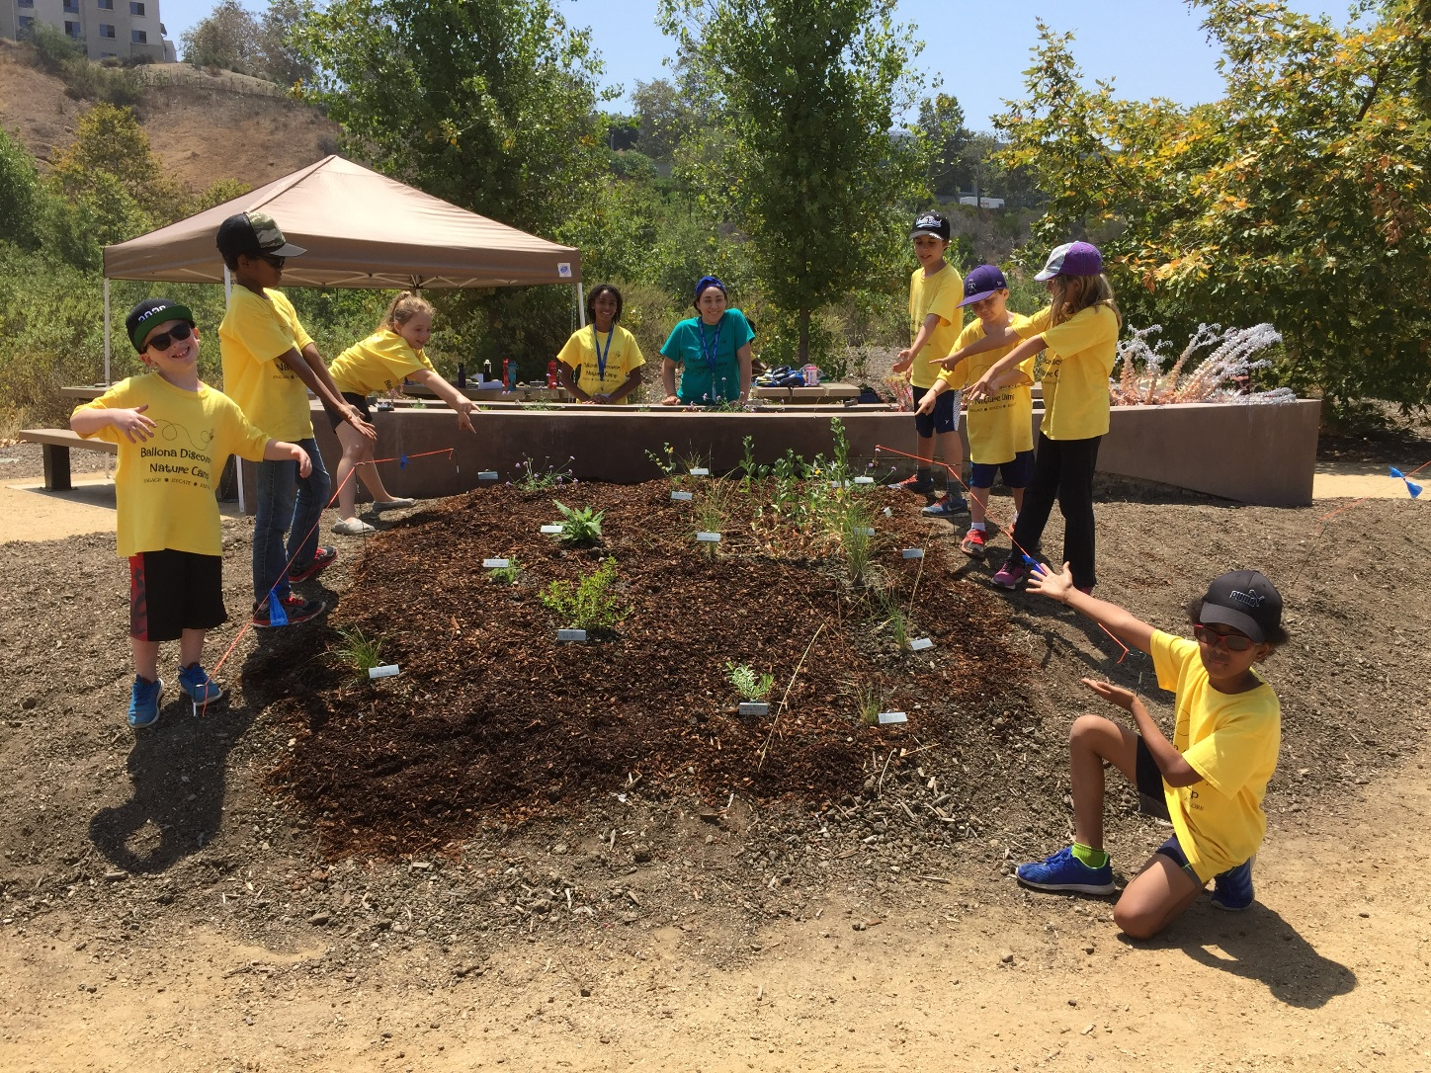
PREPARING THE GARDEN SITE
Example: Summer Camp Garden

Slide 10
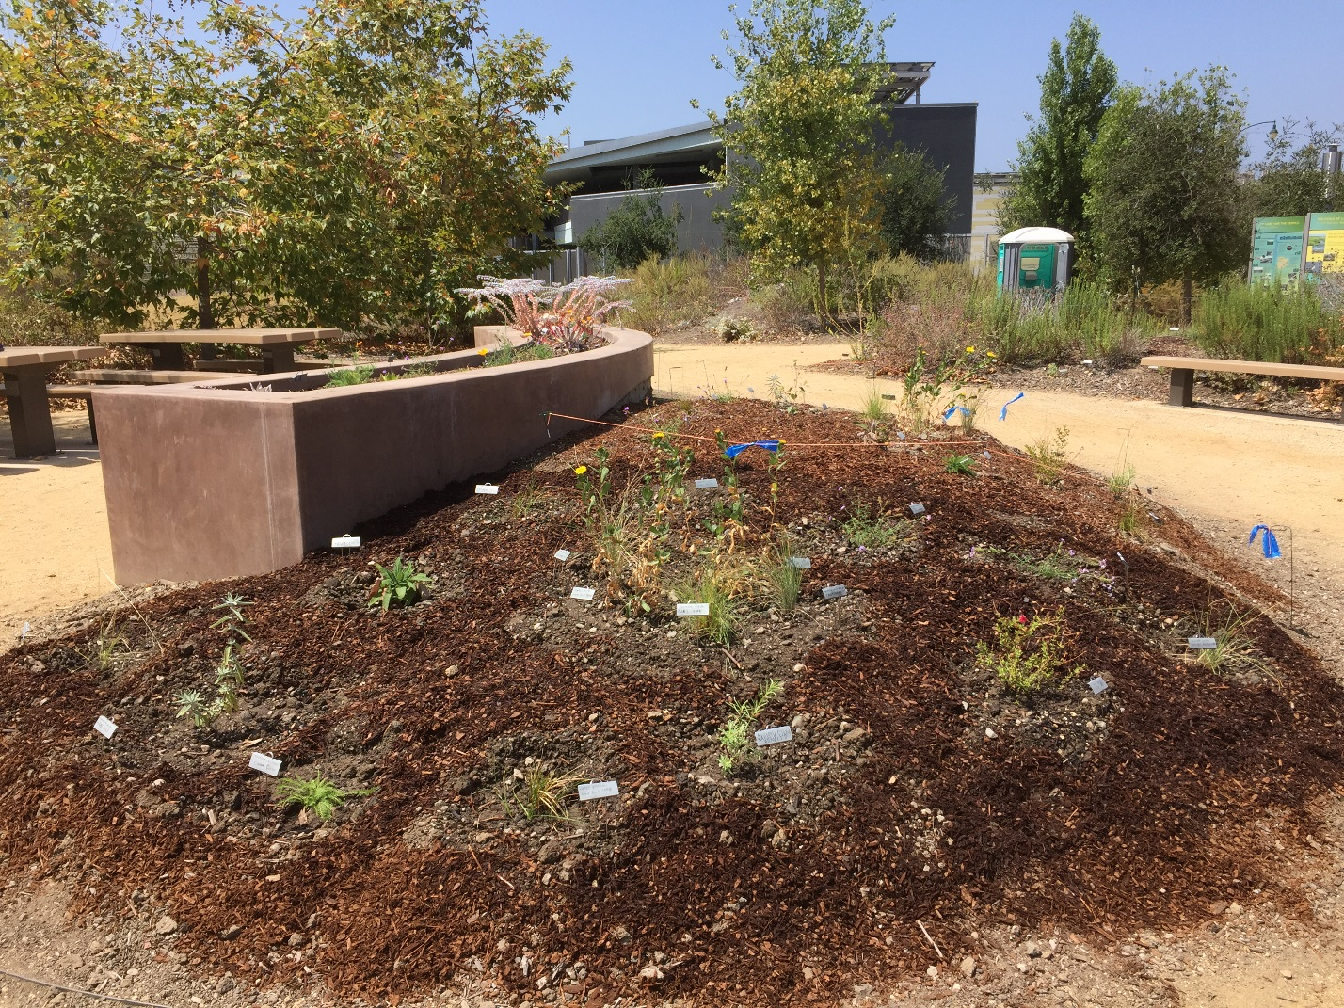
PREPARING THE GARDEN SITE
Example: Summer Camp Garden

