Slide 1
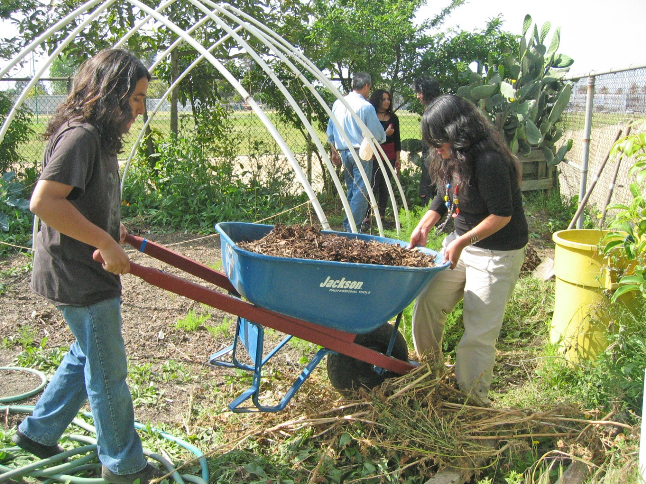
Maintaining the Garden
Module 10 - Garden Ecology Lesson 8: Maintaining the Garden

Slide 2
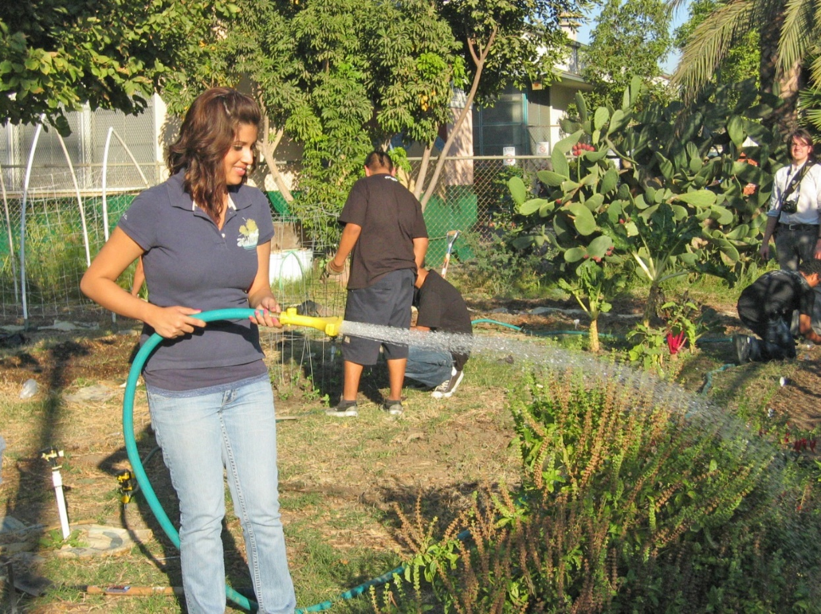
Once established, gardens need to be maintained
regularly, and processes established
to make them successful long-term.
Year-Round Processes to Consider
Composting
Fertilizing
Pest Management
Rotating Crops
Soil Coverage
Walking
Weeding
Watering

Slide 3
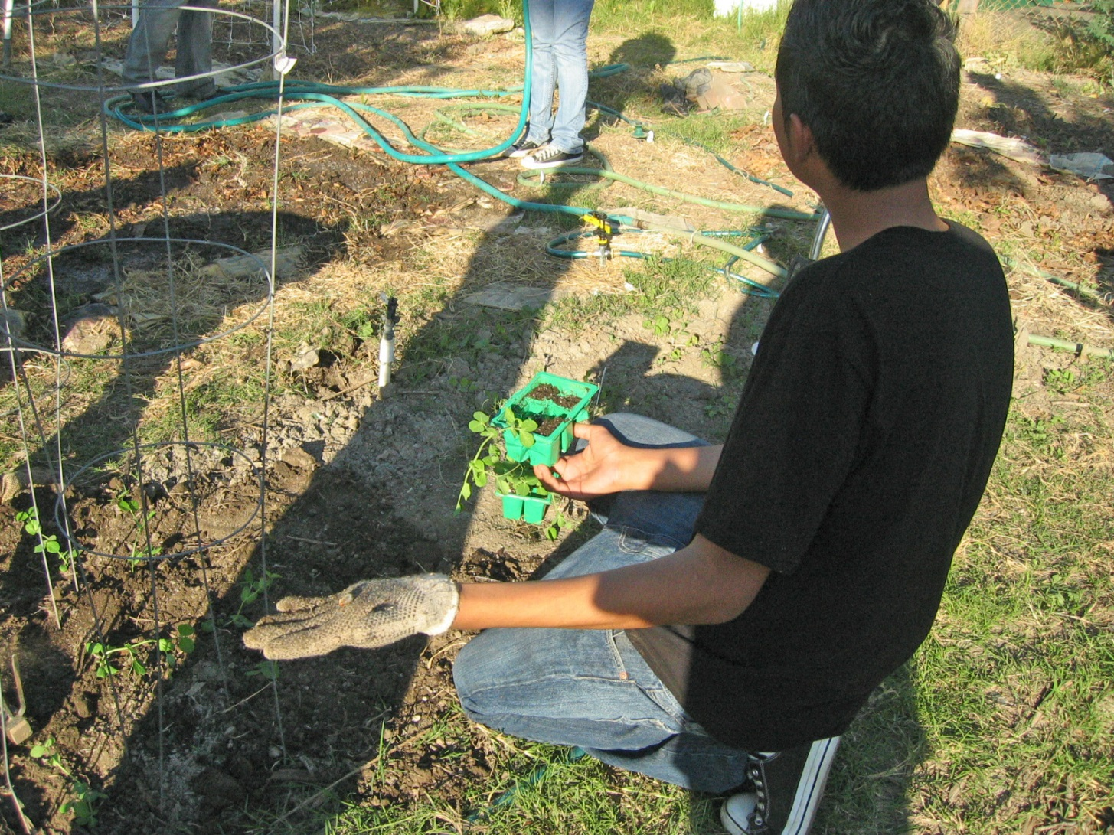
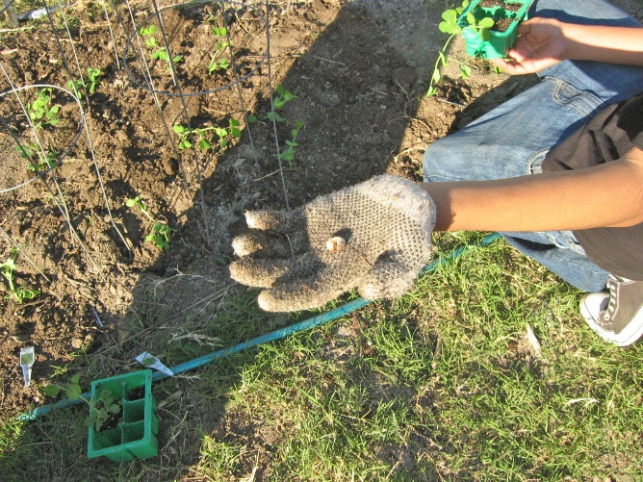
Once established, gardens need to be maintained
Pest Control
Grubs

Slide 4
What is Integrated Pest Management (IPM)?
Integrated pest management, or IPM, is a process you can use to solve pest problems while minimizing risks to people and the environment. IPM can be used to manage all kinds of pests anywhere—in urban, agricultural, and wildland or natural areas.
http://ipm.ucanr.edu/index.html

Slide 5
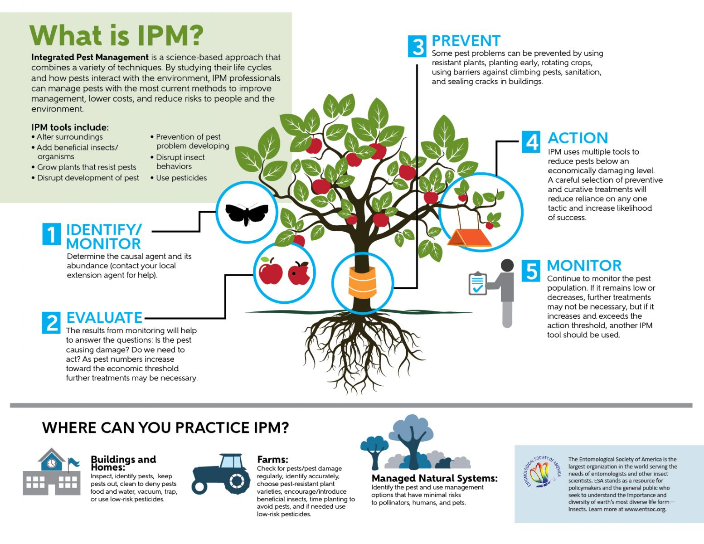
http://ipm.ucanr.edu/FAQ/mgadvanced.html

Slide 6
The California Garden Web
The UC Master Gardener Program designed the California Garden Web to serve as a portal to organize and extend the University of California's vast collection of research-based information about gardening to the public. The California Garden Web focuses on sustainable gardening practices and uses a question and answer format to present solutions.
http://cagardenweb.ucanr.edu/

Slide 7
University of California, Agriculture and Natural Resources
UC Master Gardener Program
Advice to Grow By ... Ask Us!
Los Angeles:
Valerie Borel
Title: Program Coordinator
Phone: (626)586-1986
Email: vtborel@ucanr.edu
http://mg.ucanr.edu/

