Slide 1
Module 12_Lesson 3_Coyote Traits, Adaptations & Behavior

Slide 2
Evolution of Canids
https://www.youtube.com/watch?v=sZhxCUay5ks

Slide 3
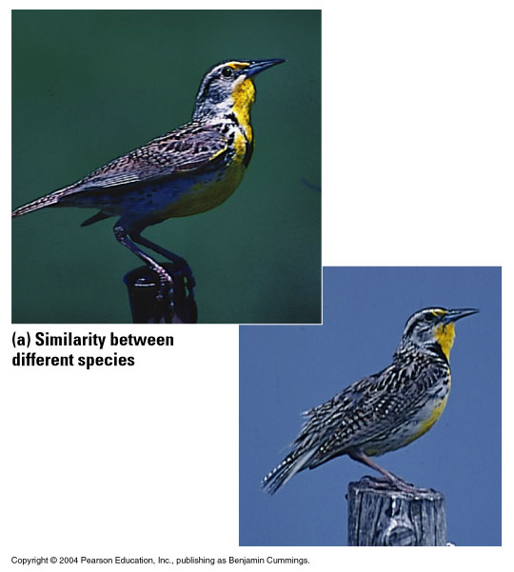
What IS a Species?
The biological species concept (BSC) defines species as “groups of interbreeding natural populations that are reproductively isolated from other such groups”
(a) Similarity between different species
(b) Diversity within one species
Figure 14.4
Notes:
This definition ignores organisms that reproduce asexually. Now we can use molecular data to define species. But the BSC works pretty well, except with Canids, as we’ll see.

Slide 4
Notes:
Gamete isolation = different proteins. Salamanders have offspring that don’t survive long. Mules are sterile. Same with plants. Different number of chromosomes is cause of this.

Slide 5
Notes:
Relationships of common species of current Canids. Ask students if BSC works here You can see gene flow between several of these species. Have they heard of others (many will have heard that dogs and wolves can still breed also)?

Slide 6
Monzon 2020
Notes:
In fact, as we mentioned before, eastern coyotes are a mix of wolf, coyote and dog. Wolves were almost driven to extinction in northern America, particularly in the east, so may have bred with coyotes to pass along their genes.

Slide 7
Nat Geo Kids

Slide 8
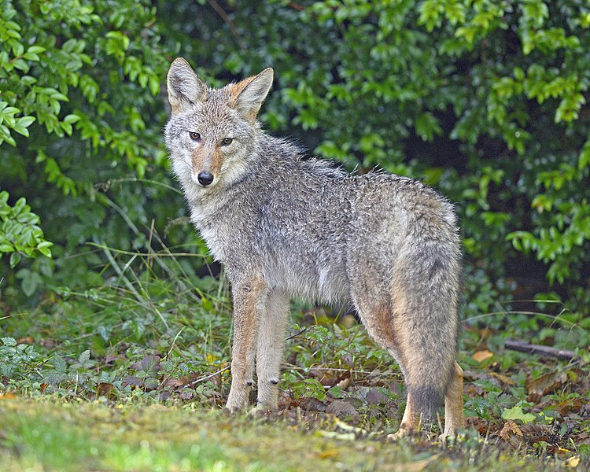
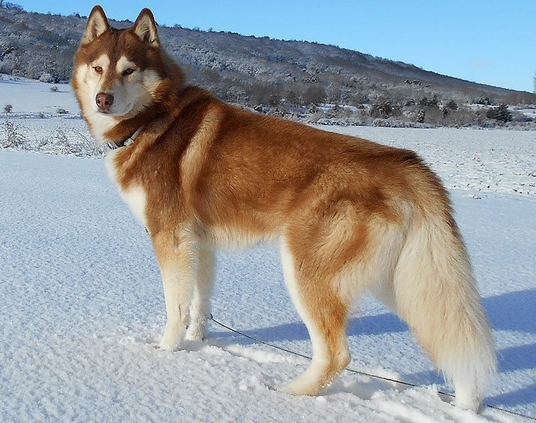
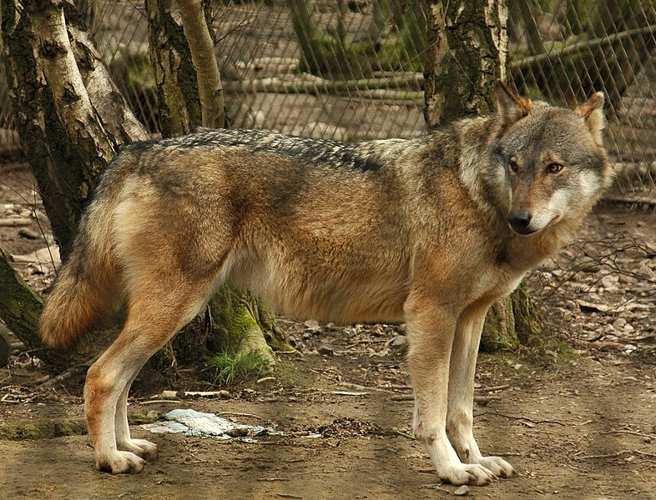

Slide 9
Coyote hunting: https://www.youtube.com/watch?v=AYCSM_Gdu4c
Coyote hunting: https://www.youtube.com/watch?v=1oHZyOutfUE
Wolf hunting: https://www.youtube.com/watch?v=bfGP4Xbme3o
Dog hunting: https://www.youtube.com/watch?v=XrEIj0geRfc
Coyote interactions: https://coyoteyipps.com/category/coyote-behavior/dominant-vs-submissive/
Wolf interactions: https://www.youtube.com/watch?v=RA-aUWoD-sA
Dog interactions: https://www.youtube.com/watch?v=bJCfcAO25tY
Coyote play: https://www.youtube.com/watch?v=a7NPu8vlTuc
Wolf play: https://www.youtube.com/watch?v=EQ-JTduVYb8
Dog play: https://www.patriciamcconnell.com/appropriate-play-between-dogs
Coyote puppies: https://www.youtube.com/watch?v=4csuR0HuwKM
Wolf puppies: https://www.youtube.com/watch?v=_hAv5cd9a28
Puppies: https://www.youtube.com/watch?v=sx3It3Jr5rA

Slide 10
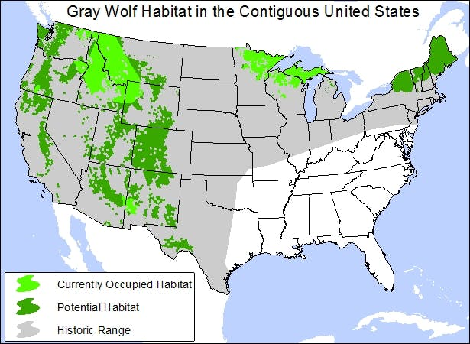
North American Canid Distribution
Notes:
Ask about dog distribution. More homes have one than don’t! ☺ Explain IUCN status. Coyotes and gray wolves both of least concern. Coyotes increasing and gray wolves stable.

Slide 11
Domestication of Animals
https://www.youtube.com/watch?v=4dwjS_eI-lQ

Slide 12
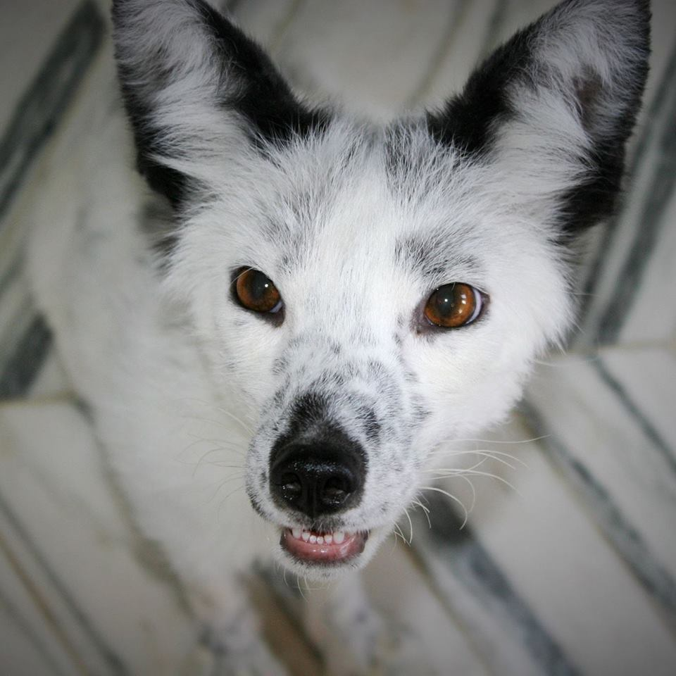
Domestication of Animals
Dogs first (Eurasia at end of Pleistocene?)
Cats likely from being attracted to rodents around human settlements
Results in phenotypic convergence of variations in coat color, docility, shifts in reproduction, alterations in skull shape, size varieties and floppy ears
At first, unintended
Once populations established, relaxed natural selection pressures allowed for appearance of mutations that cause novel traits, making them even more different from their undomesticated ancestors
Notes:
Began roughly 11,500 years and is often referred to as a co-evolution between animals and humans because it changed human behaviors as well. By selecting only for animals that allowed a hand in their cage, Belayev and colleagues found a lot of unintended changes in fox, such as piebald coat, drooping ears, upturned tail, shortened snouts and changes in reproductive timing.

Slide 13
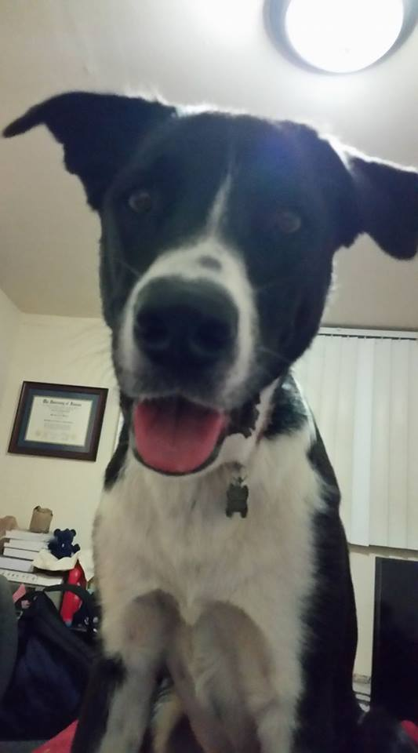
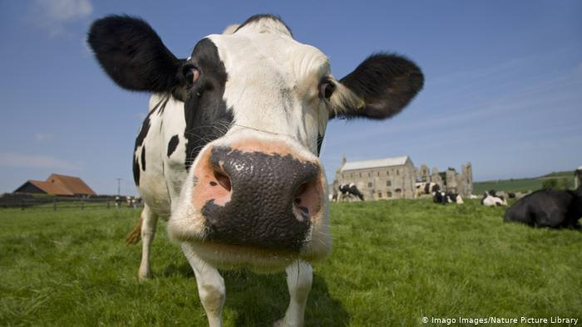
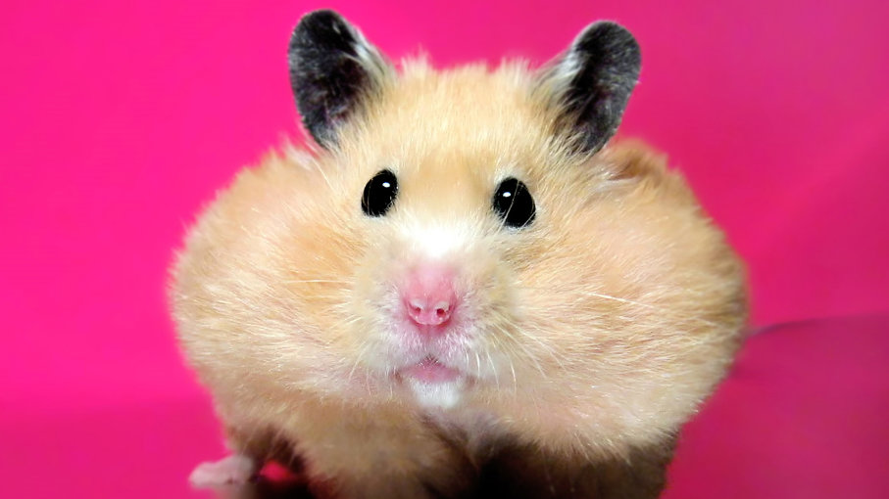
Three Pathways to Domestication
Commensal Pathway: tamer animals who can exploit human resources began living near human civilizations
Prey pathway: targeting hunting strategies for prey
Directed pathway: deliberate objective to domesticate
Notes:
Selection pressures for docility would have been strong as humans moved from hunting to herd management. Evidence that prey populations were very heavily overhunted when this began to occur. Humans would allow breeding females to live. Third involves animals like camels and horses that can be used for transportation and small pets. All of the hamsters that we have today come from one sibling pair brought from the Syrian desert in 1930.

Slide 14
Bright Side of Domestication
Petting an animal reduces blood pressure and heart rate
Reductions in frequency of minor ailments (dogs, not cats)
Lower risk of coronary disease
Reduce effects of stressful events
Reduce levels of anxiety, loneliness and depression
Enhance feelings of self-esteem, autonomy and competence
Can sniff out cancer and hypoglycemia
Can detect seizures up to 45 minutes in advance
Notes:
Familiar animal helps more than non-familiar, and it reduces the dog’s heart rate as well. Presence of an animal also helps. Reduction in heart rate for people watching fish in an aquarium vs an aquarium with no fish. Greater reduction when trying to solve math problems with animal than with friend or family member.

